Slide 1

Towards a Hermeneutic of Uncertainty
Signposts and Soundbites
Damian Feeney 12 June 2020

Slide 2
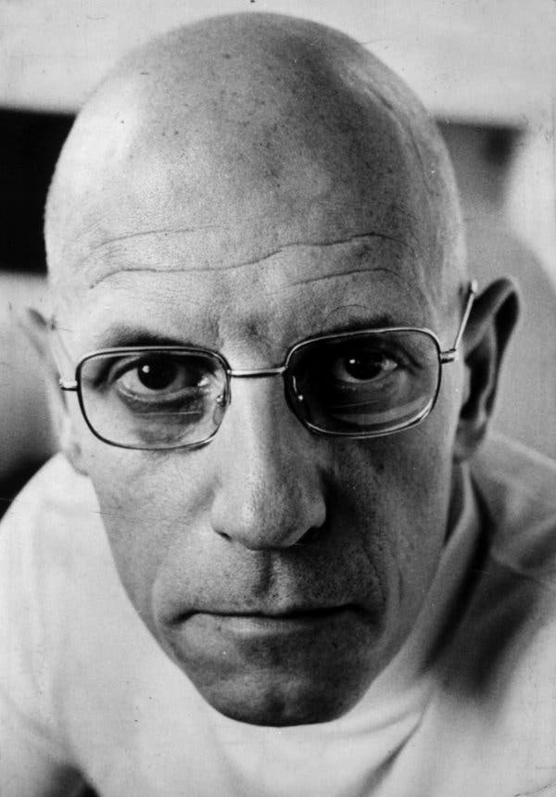
Michel Foucault
‘The game is worthwhile insofar as we don’t know what will be the end’.

Slide 3
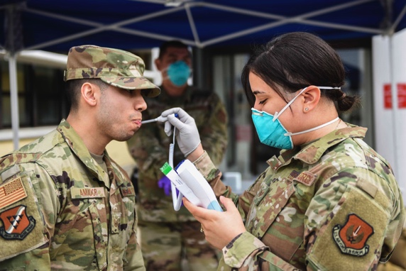
Descriptors of our malaise
The Rhetoric of War (against an invisible enemy)

Slide 4
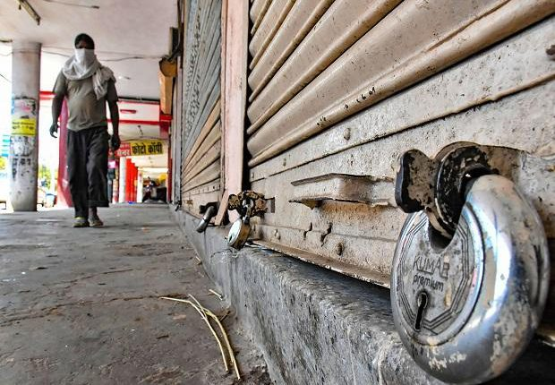
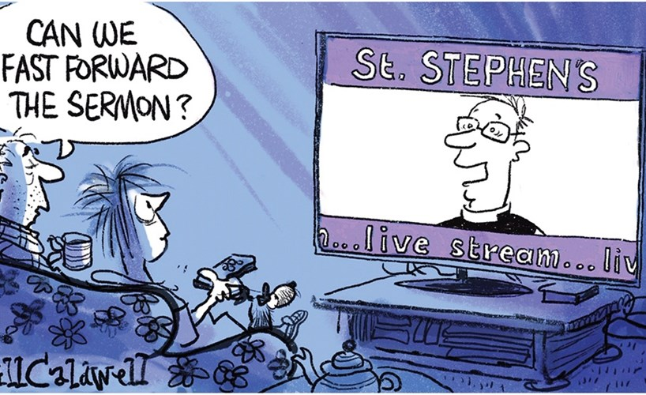
Descriptors of our malaise
Lockdown and Live Stream

Slide 5
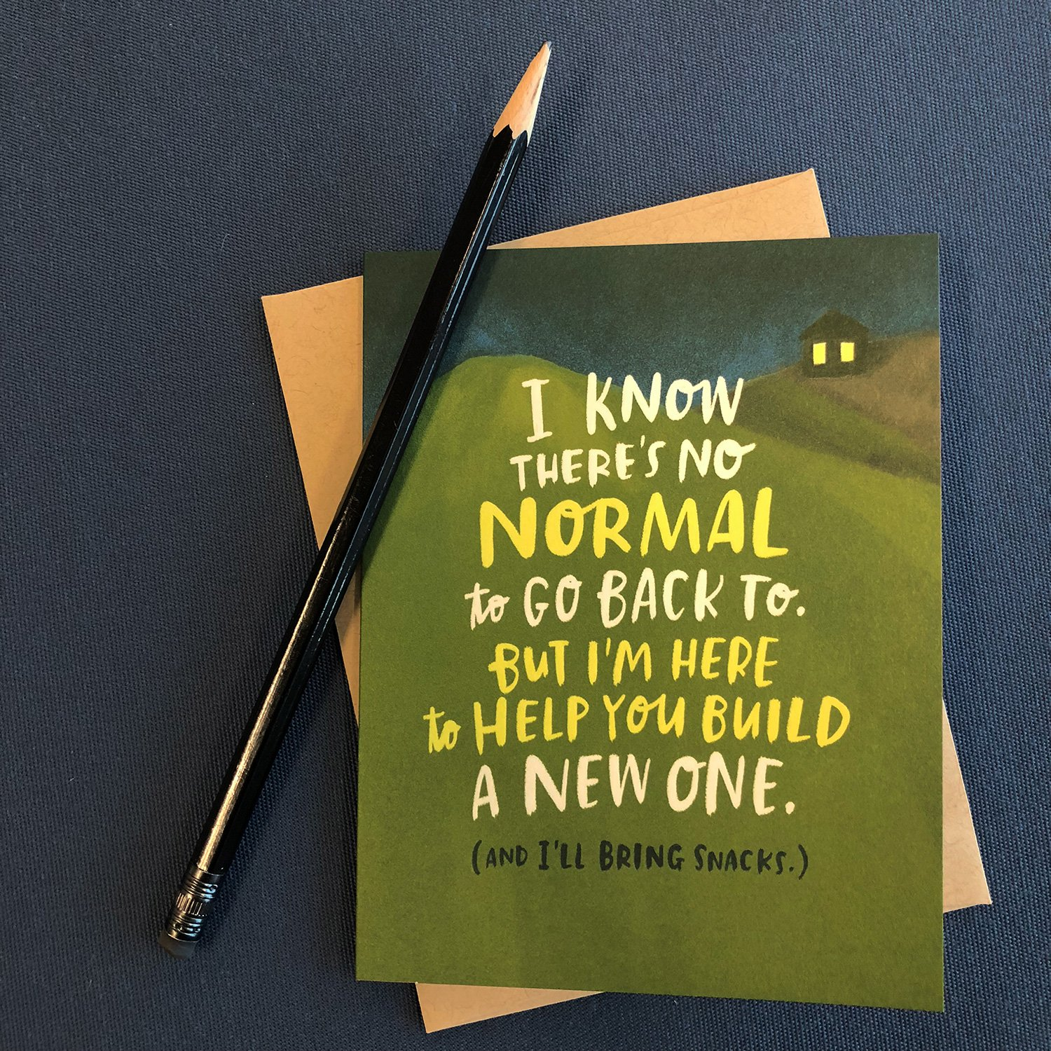

Descriptors of our malaise
The ‘New Normal’
NB: One person’s creative excitement is another person’s stress…

Slide 6
Questions in our malaise
Can we go out? Where to? With whom? Can I go into church? Can I take a funeral? Am I vulnerable? How do I fulfil my role in caring? Will my congregations cease to be? Will my church close? What will the ‘first day back’ be like? Have I been ill? Do I feel guilty for having been ill? Do I feel guilty for not having been ill? How do we assimilate online worship with ‘live’ worship? How do I deal with the frustration and anger in myself and others? Where are the patterns, the routines, which sustain our life together. Have they gone? Are we impoverished, or enriched? What does isolation do to community, to Koinonia? What is the daily life of my folk actually like? Will I have to do the cleaning…Who will…Where is…what will…

Slide 7
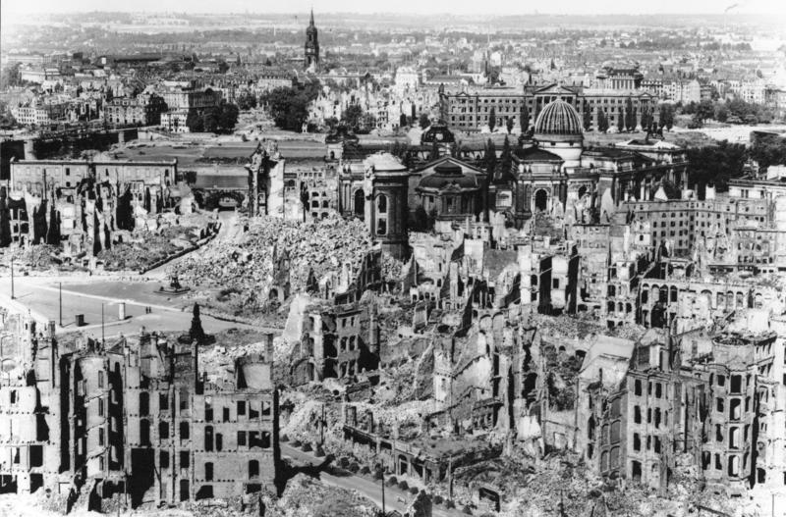
Slaughterhouse-Five
Novel by Kurt Vonnegut (1969)

Slide 8
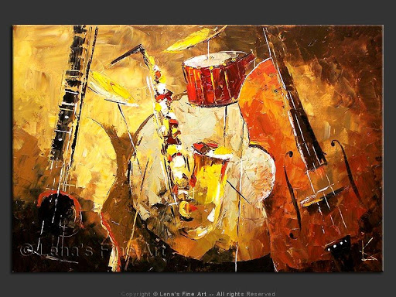
Jazz and Improvisation

Slide 9
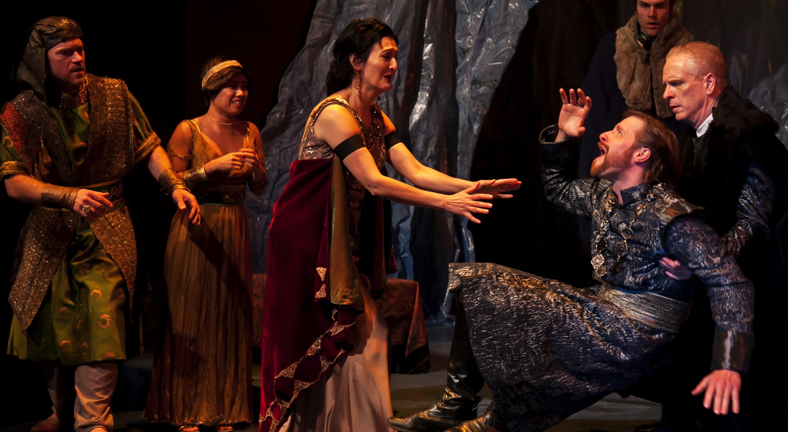
Drama and Improvisation

Slide 10
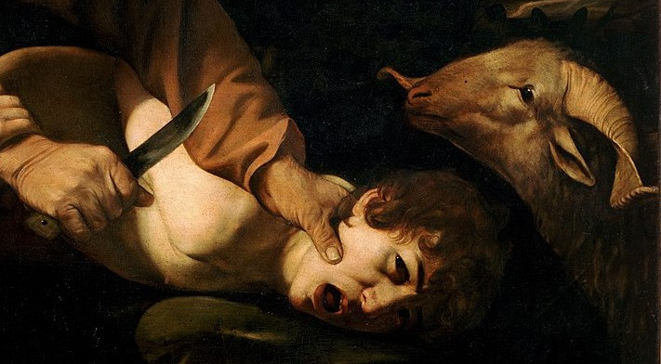
Abraham and Isaac

Slide 11
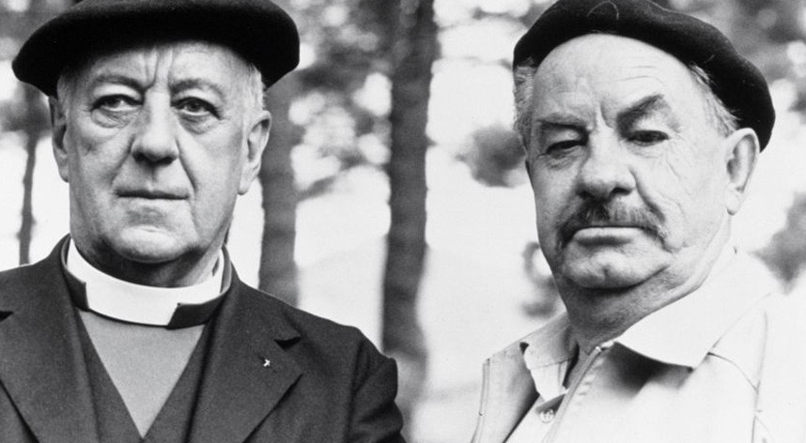
Monsignor Quixote

Slide 12
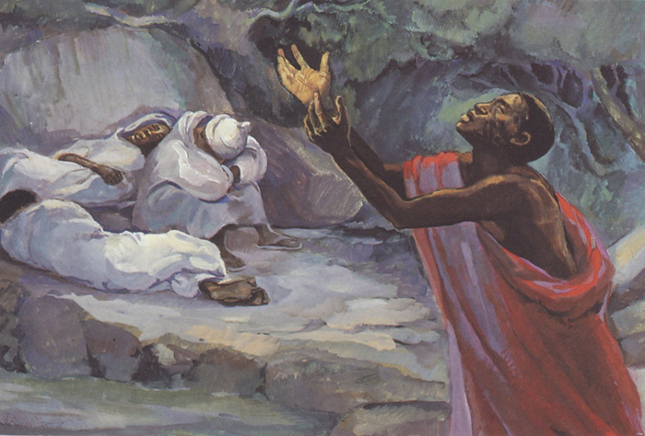
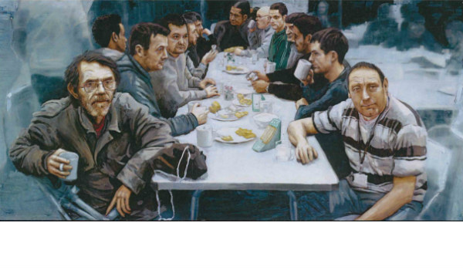
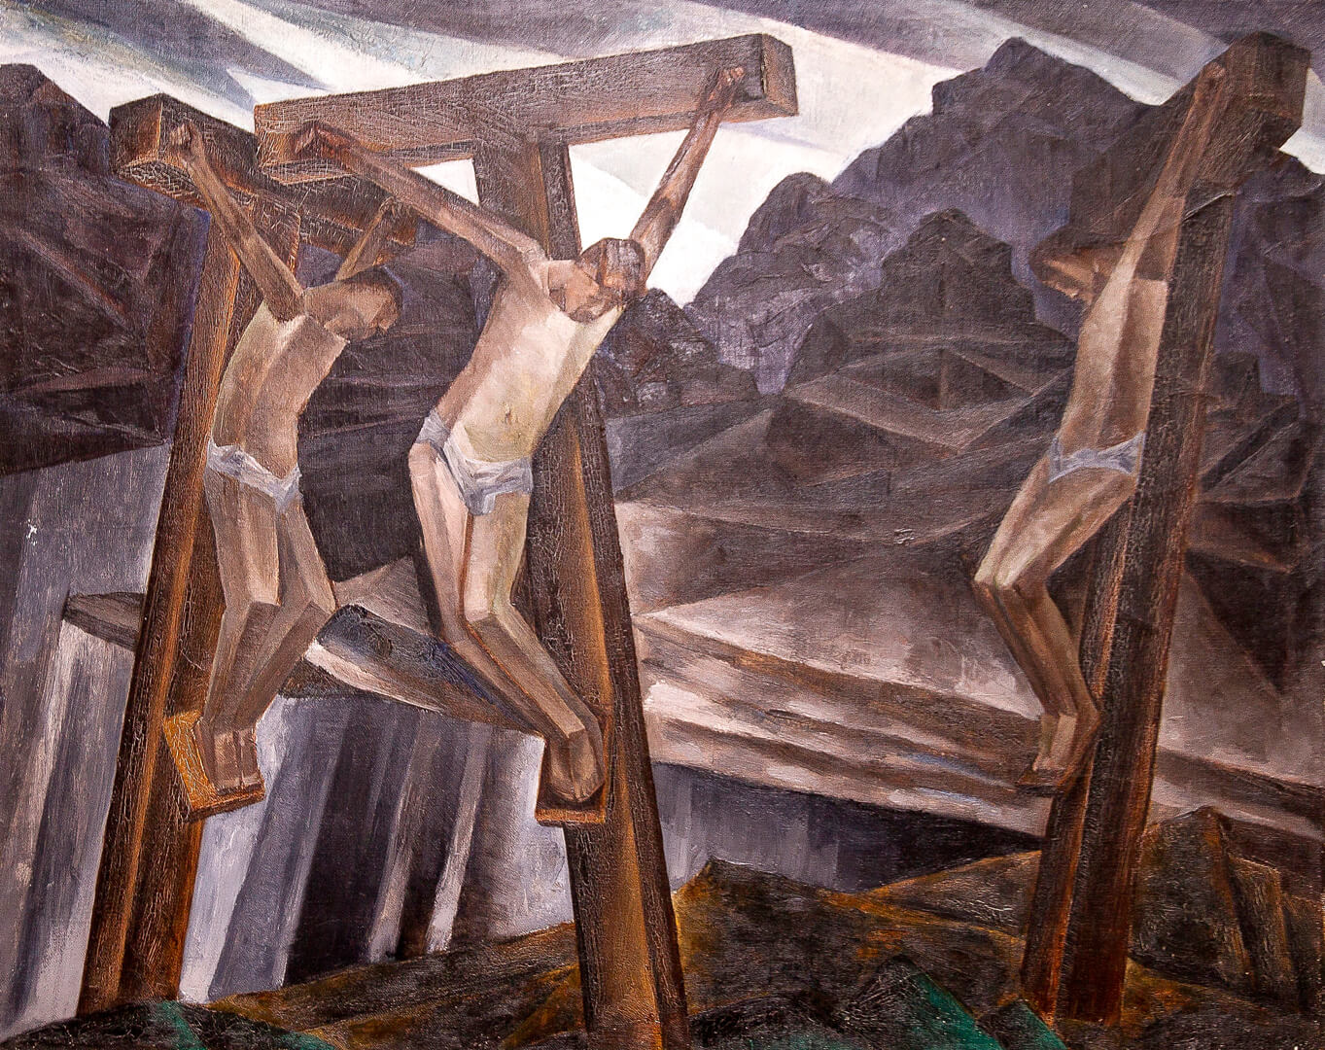
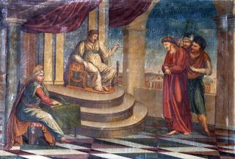
Founding Narratives

Slide 13
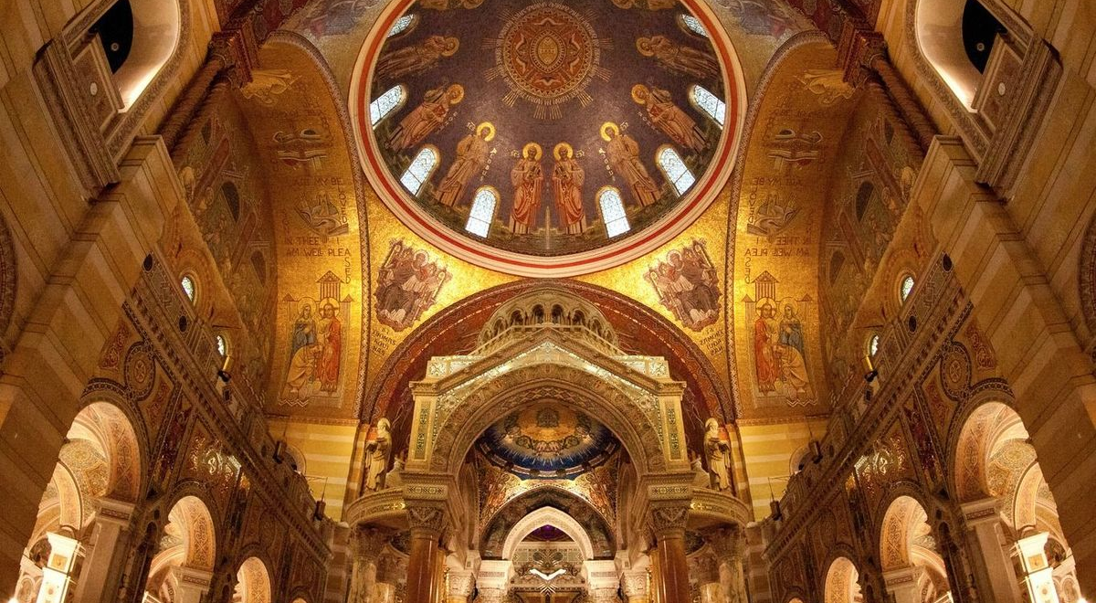
Sacred Space

Slide 14
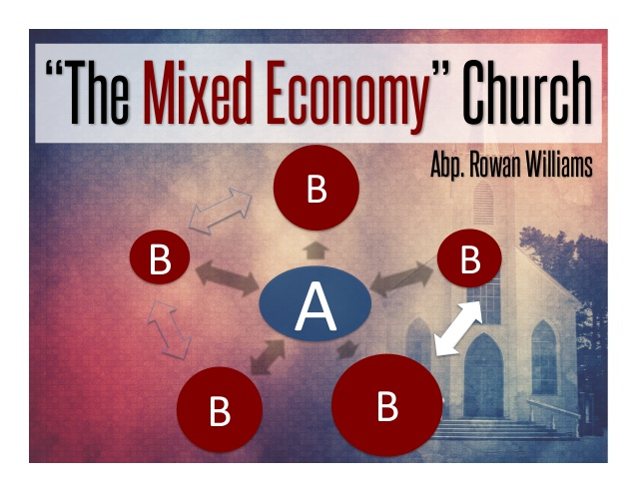
Mixed Economy Church

Slide 15
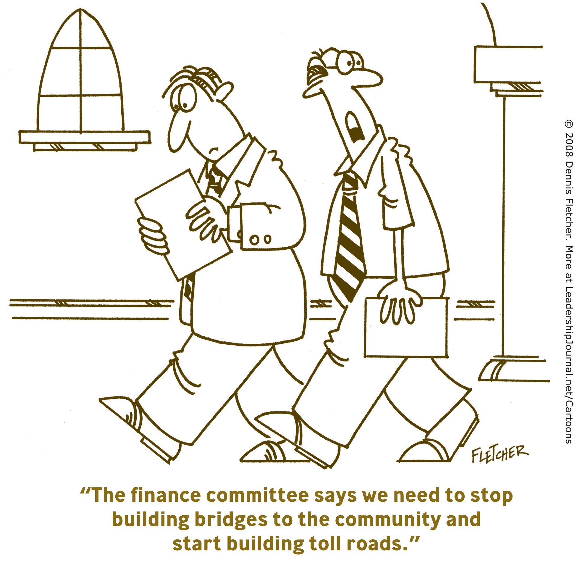
Resource

Slide 16
Our second hour together will be a discussion that may or may not focus on the following areas (but feel free to redirect the conversation!)
From your own perspective, what are the significant shifts in attitude that will affect the church going forward?
What things have you reflected upon as needing to change in your own situation?
How might the church nationally and globally respond more faithfully to the situation in which we find ourselves?

Slide 17


