Slide 1
Strength for the Journey
Dementia Action Week service

Slide 2
Welcome

Slide 3
We come in worship to God
In our need,
and bringing with us
the needs of the world
We come to God, who comes to us in Jesus
And who knows us by name

Slide 4
We come with our faith and doubts
With our hopes and fears
We comes as we are
We come to God in worship

Slide 5
Hymn
Be thou my vision

Slide 6
Be Thou my vision, O Lord of my heart;
Naught be all else to me, save that Thou art;
Thou my best thought, by day or by night;
Waking or sleeping, Thy presence my light.

Slide 7
Be Thou my wisdom, and Thou my true Word;
I ever with Thee and Thou with me, Lord;
Thou my great Father and I, Thy true son;
Thou in me dwelling, and I with Thee one.

Slide 8
Riches I heed not, nor man’s empty praise;
Thou mine inheritance, now and always;
Thou and Thou only, first in my heart;
O King of glory, my treasure Thou art.

Slide 9
O King of glory, my victory won;
Rule and reign in me ’til Thy will be done;
Heart of my own heart, whatever befall;
Still be my vision, O Ruler of all.

Slide 10
Opening prayer

Slide 11
Leader: God who knows us
Response: God who loves us

Slide 12
Interview
Lizzie Evans

Slide 13
Reading
Psalm 23

Slide 14
Hymn
The Lord’s my Shepherd

Slide 15
The Lord’s my Shepherd, I’ll not want;
He makes me down to lie
In pastures green; He leadeth me
The quiet waters by.

Slide 16
My soul He doth restore again,
And me to walk doth make
Within the paths of righteousness,
E’en for His own name’s sake

Slide 17
Yea, though I walk in death’s dark vale,
Yet will I fear no ill;
For Thou art with me, and Thy rod
And staff me comfort still.

Slide 18
My table Thou hast furnished
In presence of my foes;
My head Thou dost with oil anoint,
And my cup overflows.

Slide 19
Goodness and mercy all my life
Shall surely follow me,
And in God’s house forevermore
My dwelling-place shall be

Slide 20
Prayers
Writing prayers on the flowers

Slide 21
Hymn
Be still for the presence of the Lord

Slide 22
Be still for the presence of the Lord
The Holy One is here
Come bow before Him now
With reverence and fear

Slide 23
In Him no sin is found
We stand on holy ground
Be still for the presence of the Lord
The Holy One is here

Slide 24
Be still for the glory of the Lord
Is shining all around
He burns with holy fire
With splendour He is crowned

Slide 25
How awesome is the sight
Our radiant King of light
Be still for the glory of the Lord
Is shining all around

Slide 26
Be still for the power of the Lord
Is moving in this place
He comes to cleanse and heal
To minister His grace

Slide 27
No work too hard for Him
In faith receive from Him
Be still for the power of the Lord
Is moving in this place

Slide 28
Prayers
Gathering the flowers

Slide 29
Reading
John 10:1-5, 14-15

Slide 30
Short Address

Slide 31
Act of Faith
Anointing with oil

Slide 32
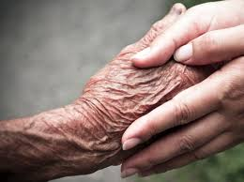

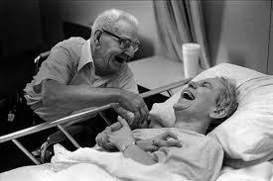
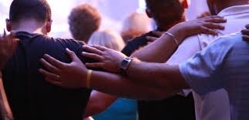
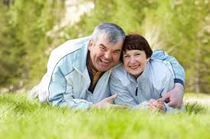

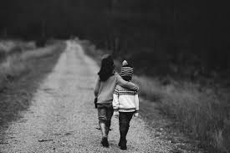


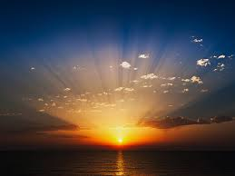
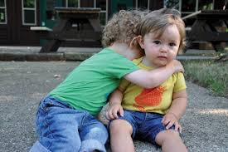
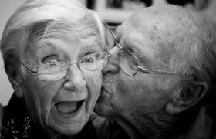
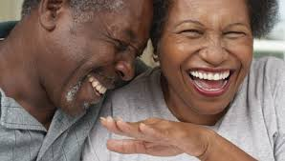
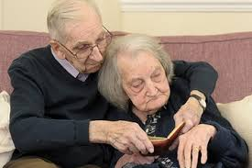

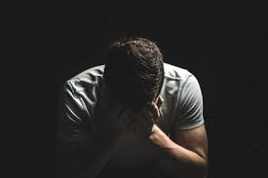
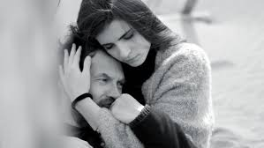
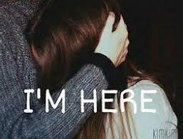
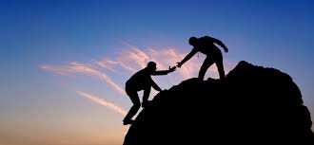
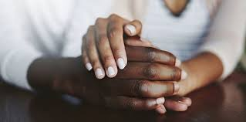

Slide 35
Act of Faith
Anointing with oil

Slide 36
Hymn
Shine Jesus Shine

Slide 37
Lord, the light of your love is shining
In the midst of the darkness, shining
Jesus, Light of the world, shine upon us
Set us free by the truth you now bring us
Shine on me, shine on me

Slide 38
Shine, Jesus, shine
Fill this land with the Father's glory
Blaze, Spirit, blaze
Set our hearts on fire
Flow, river, flow
Flood the nations with grace and mercy
Send forth your word
Lord, and let there be light

Slide 39
Lord, I come to your awesome presence
From the shadows into your radiance
By the blood I may enter your brightness
Search me, try me, consume all my darkness
Shine on me, shine on me

Slide 40
Shine, Jesus, shine
Fill this land with the Father's glory
Blaze, Spirit, blaze
Set our hearts on fire
Flow, river, flow
Flood the nations with grace and mercy
Send forth your word
Lord, and let there be light

Slide 41
As we gaze on your kingly brightness
So our faces display your likeness
Ever changing from glory to glory
Mirrored here may our lives tell your story
Shine on me, shine on me

Slide 42
Shine, Jesus, shine
Fill this land with the Father's glory
Blaze, Spirit, blaze
Set our hearts on fire
Flow, river, flow
Flood the nations with grace and mercy
Send forth your word
Lord, and let there be light

Slide 43
Blessing

Slide 44
Please join us for tea and cake
There will also be opportunities
for prayer and information

