Slide 1



Slide 2

Welcome + introductions

Slide 3
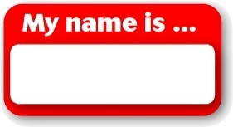

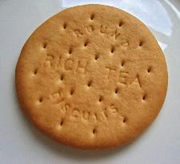


Helping you this morning:
Our Welcomers who are wearing badges
At the back of church there are glasses of water and biscuits if you are thirsty or hungry
Feel free to walk about the church
The TOILET is in our Church Hall next door – one of the Welcomers will show you the way.

Slide 4
Opening Sentence:
The Lord is my strength and my shield;
My heart trusts in him, and He helps me.
My heart leaps for joy,
And with my song I praise Him!
Psalm 28:7

Slide 5
Hymn 413 – Lord of all hopefulness ♫♫
Lord of all hopefulness, Lord of all joy,
Whose trust, ever childlike, no cares could destroy,
Be there at our waking, and give us, we pray,
Your bliss in our hearts, Lord, at the break of the day.

Slide 6
♫♫
Lord of all eagerness, Lord of all faith,
Whose strong hands were skilled at the plane and the lathe,
Be there at our labours, and give us, we pray,
Your strength in our hearts, Lord, at the noon of the day.

Slide 7
♫♫
Lord of all kindliness, Lord of all grace,
Your hands swift to welcome, your arms to embrace,
Be there at our homing, and give us, we pray,
Your love in our hearts, Lord, at the eve of the day.

Slide 8
♫♫
Lord of all gentleness, Lord of all calm,
whose voice is contentment, whose presence is balm;
Be there at our sleeping, and give us, we pray,
Your peace in our hearts, Lord, at the end of the day.

Slide 9
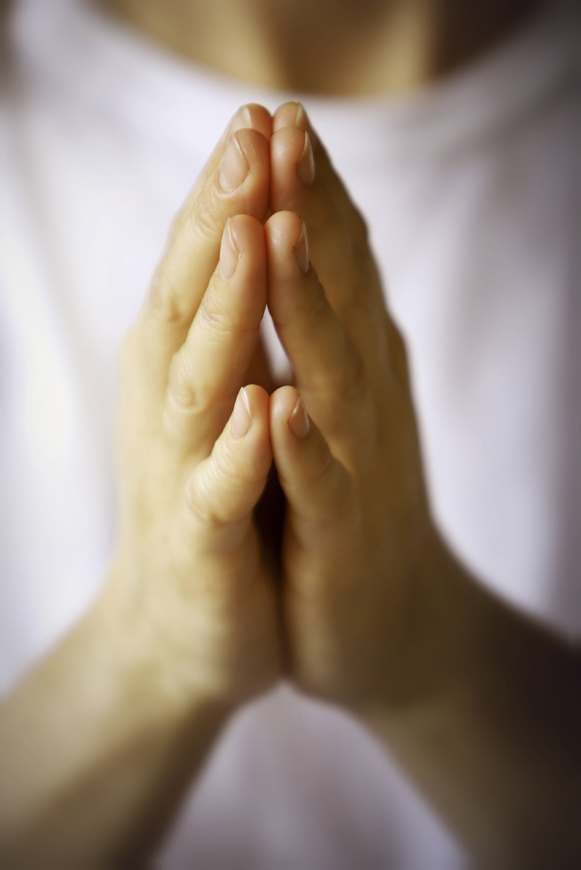
Prayers for today

Slide 10
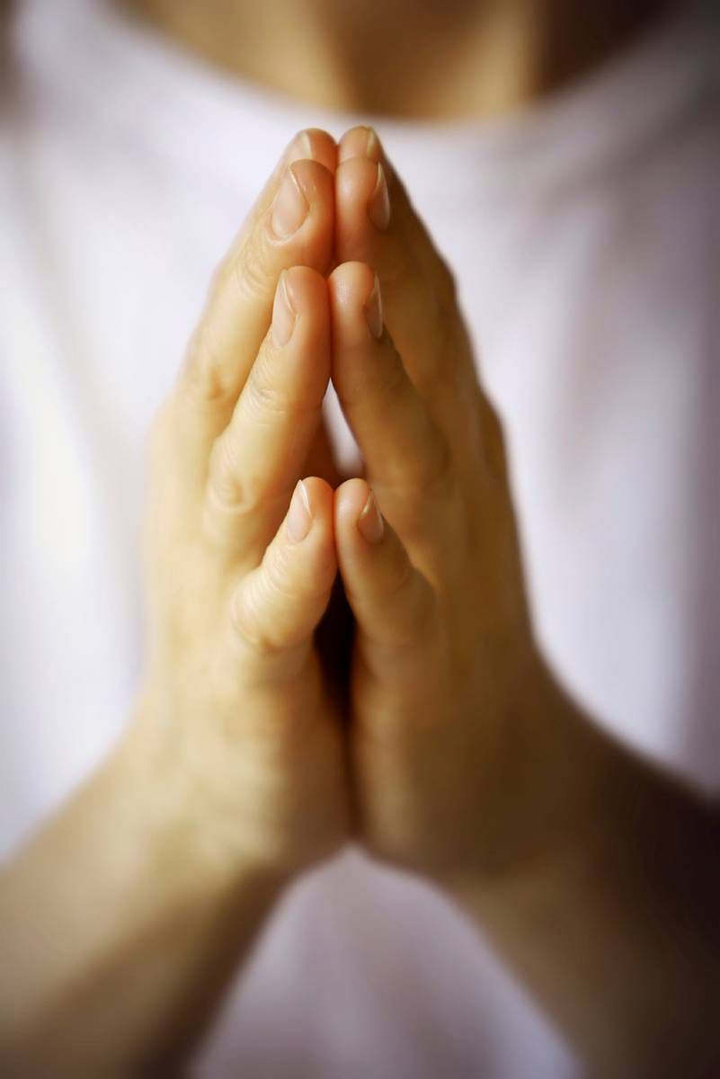
We say together:
We pray, Lord God, for people whose day begins with confusion and fear and who struggle to understand the world around them.

Slide 11
Grant us comfort and peace, loving Lord, and especially to those who struggle to see and understand things as clearly as they once did.

Slide 12
May your calming Spirit and the love of friends and family bring light into all our lives. We ask this in Jesus’ name
Amen

Slide 13
We say the words in bold type together -
Gracious and loving God,
we give thanks for those who love and care for someone who is living with dementia,
or who is losing memory, judgment and the ability to manage their lives without support.
You are the God who promises to remember us even if those we love forget us.
This we believe

Slide 14

We say together
Psalm 23
This Photo by Unknown Author is licensed under CC BY-SA

Slide 15
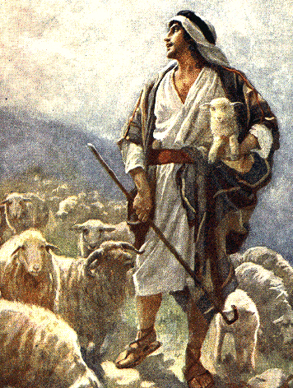
The Lord is my shepherd;
I shall not want.
He maketh me to lie down in green pastures:
He leadeth me beside the still waters.
He restoreth my soul:
He leadeth me in the paths of righteousness for his name's sake.
This Photo by Unknown Author is licensed under CC BY-NC-ND

Slide 16
Yea, though I walk
through the valley
of the shadow of death,
I will fear no evil:
for thou art with me;
thy rod and thy staff
they comfort me.

Slide 17
Thou preparest
a table before me
in the presence
of mine enemies:
thou anointest
my head with oil;
my cup runneth over.
This Photo by Unknown Author is licensed under CC BY-NC-ND

Slide 18
Surely goodness and mercy
shall follow me
all the days of my life:
and I will dwell
in the house of the Lord
for ever.

Slide 19
Hymn 428- Love divine all loves excelling ♫♫
Love divine, all loves excelling,
Joy of heaven, to earth come down,
Fix in us thy humble dwelling,
All thy faithful mercies crown.
Jesu, thou art all compassion,
Pure unbounded love thou art;
Visit us with thy salvation,
Enter ev’ry trembling heart.

Slide 20
♫♫
Breathe, O breathe thy loving spirit into ev’ry troubled breast;
Let us all in thee inherit, let us find thy promised rest.
Take away the love of sinning, Alpha and Omega be;
End of faith, as its beginning, set our hearts at liberty.

Slide 21
♫♫
Come , almighty to deliver,
let us all thy grace receive;
Suddenly return and never,
never more thy temples leave.
Thee we would be always blessing,
serve thee as thy hosts above;
Pray and praise thee without ceasing,
glory in thy perfect love.

Slide 22
♫♫
Finish then thy new creation,
pure and spotless let us be;
Let us see thy great salvation,
perfectly restored in thee.
Changed from glory into glory,
till in heaven we take our place,
Till we cast our crowns before thee,
lost in wonder, love and praise.

Slide 23

We say together -
As we move through the duties and difficulties of this day, enlighten our minds, and lighten our hearts by your grace.

Slide 24
Awaken within us your wisdom, your courage, your strength, your patience and forgiveness.
Make us worthy of the task to which you have called us.
Amen

Slide 25

Sharing the peace
Jesus said – “Peace I leave with you, my peace I give unto you, not as the world giveth, give I unto you. Let not your heart be troubled, neither let it be afraid.”

Slide 26

Feel free to share a peace greeting with others around you.

Slide 27
Hymn 450 Morning has Broken ♫♫
Morning has broken, like the first morning
Blackbird has spoken, like the first bird
Praise for the singing, praise for the morning
Praise for them springing fresh from the Word.
♫♫

Slide 28
♫♫
Sweet the rain's new fall, sunlit from heaven
Like the first dewfall, on the first grass
Praise for the sweetness of the wet garden
Sprung in completeness where His feet pass.

Slide 29
♫♫
Mine is the sunlight! Mine is the morning
Born of the one light Eden saw play!
Praise with elation, praise ev’ry morning,
God’s re-creation of the new day!

Slide 30
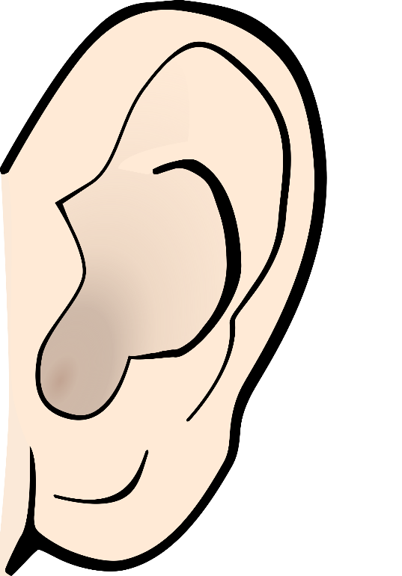

We sit to listen to Psalm 71
Read by Eileen and Lesley
This Photo by Unknown Author is licensed under CC BY-NC-ND

Slide 31

Psalm 71 v 12 – 21
^{O God, do not be far from me,}
O my God, make haste to help me!
Let my accusers be put to shame and ^{consumed;}
^{let those who seek to hurt me}
be covered with scorn and disgrace.

Slide 32
^{But I will hope continually,}
and will praise you yet more and more.
My mouth will tell of your righteous acts,
of your deeds of salvation all day long, though their number is past my knowledge

Slide 33
I will come praising the mighty deeds of the Lord God,
I will praise your righteousness, yours alone.
O God, from my youth you have taught me,and I still proclaim your wondrous deeds.
So even to old age and grey hairs,

Slide 34
^{O God, do not forsake me,}
^{until I proclaim your might}
to all the generations to come.
Your power and your righteousness, O God,
^{reach the high heavens.}
You who have done great things,
^{O God, who is like you?}

Slide 35
You ,who have made me see many troubles and calamities, will revive me again;
^{from the depths of the earth}
^{you will bring me up again.}
You will increase my honour, and comfort me once again.

Slide 36
Hymn 201 – Give me joy in my heart ♫♫
Give me joy in my heart, keep me praising,
Give me joy in my heart, I pray.
Give me joy in my heart, keep me praising,
Keep me praising til the end of day!

Slide 37
♫♫
Sing hosanna! Sing hosanna!
Sing hosanna to the King of Kings!
Sing hosanna! Sing hosanna!
Sing hosanna to the King!

Slide 38
♫♫
Give me peace in my heart, keep me resting,
Give me peace in my heart, I pray.
Give me peace in my heart, keep me resting,
Keep me resting til the end of day!

Slide 39
♫♫
Sing hosanna! Sing hosanna!
Sing hosanna to the King of Kings!
Sing hosanna! Sing hosanna!
Sing hosanna to the King!

Slide 40
♫♫
Give me love in my heart, keep me serving,
Give me love in my heart, I pray.
Give me love in my heart, keep me serving,
Keep me serving til the end of day!

Slide 41
♫♫
Sing hosanna! Sing hosanna!
Sing hosanna to the King of Kings!
Sing hosanna! Sing hosanna!
Sing hosanna to the King!

Slide 42
♫♫
Give me oil in my lamp, keep me burning,
Give me oil in my lamp, I pray.
Give me oil in my lamp, keep me burning,
Keep me burning til the end of day!

Slide 43
♫♫
Sing hosanna! Sing hosanna!
Sing hosanna to the King of Kings!
Sing hosanna! Sing hosanna!
Sing hosanna to the King!

Slide 44

Prayer of Blessing
In moments of confusion,
God keep us safe.
In moments of clarity,
God grant us joy.
In moments of frustration,
God give us peace.
In moments of sorrow,
God bring us comfort.

Slide 45
May he who sees into the secret places of our mind,
beyond anything which limits us,
to the person that is us,
has always been and will always be,
encircle us in his arms,
until that day when all is made new
in his eternal home.
AMEN

Slide 46

We say together the Lord’s Prayer
Our Father, who art in heaven
Hallowed be thy name.
Thy Kingdom come,
thy will be done
on earth as it is in heaven.

Slide 47
Give us this day
Our daily bread,
And forgive us our trespasses,
As we forgive those
who trespass against us.

Slide 48
Lead us not into temptation;
But deliver us from evil.
For thine is the Kingdom,
the power and the glory,
for ever and ever,
AMEN

Slide 49
Hymn 252 – Guide me O thou great Redeemer ♫♫
Guide me O thou great Redeemer,
pilgrim through this barren land;
I am weak, but thou art mighty,
hold me in thy pow’rful hand:
Bread of Heaven, Bread of Heaven,
feed me till I want no more,
feed me till I want no more.

Slide 50
♫♫
Open now the crystal fountain,
whence the healing stream doth flow;
Let the fire and cloudy pillar
lead me all my journey through.
Strong deliv’rer, strong deliv’rer
Be though still my strength and shield,
Be though still my strength and shield.

Slide 51
♫♫
When I tread the verge of Jordan,
bid my anxious fears subside;
Death of death and hell’s destruction,
land me safe on Canaan’s side.
Songs of praises, songs of praises,
I will ever give to thee,
I will ever give to thee.

Slide 52
♫♫We sing a blessing together (with actions too!) ♫
May the road rise to meet you.
May the wind be always at your back.
May the sun shine warm upon your face
And the rains fall soft upon your fields.

Slide 53
♫ ♫ And until we meet again, until we meet again,
may God hold you in the palm of his hand,
and until we meet again, until we meet again,
may God hold you in the palm of his hand.

Slide 54

Please stay for a chat over a cuppa!
Have a look at our Faith Memory Box and information folder

Slide 55


