Slide 1
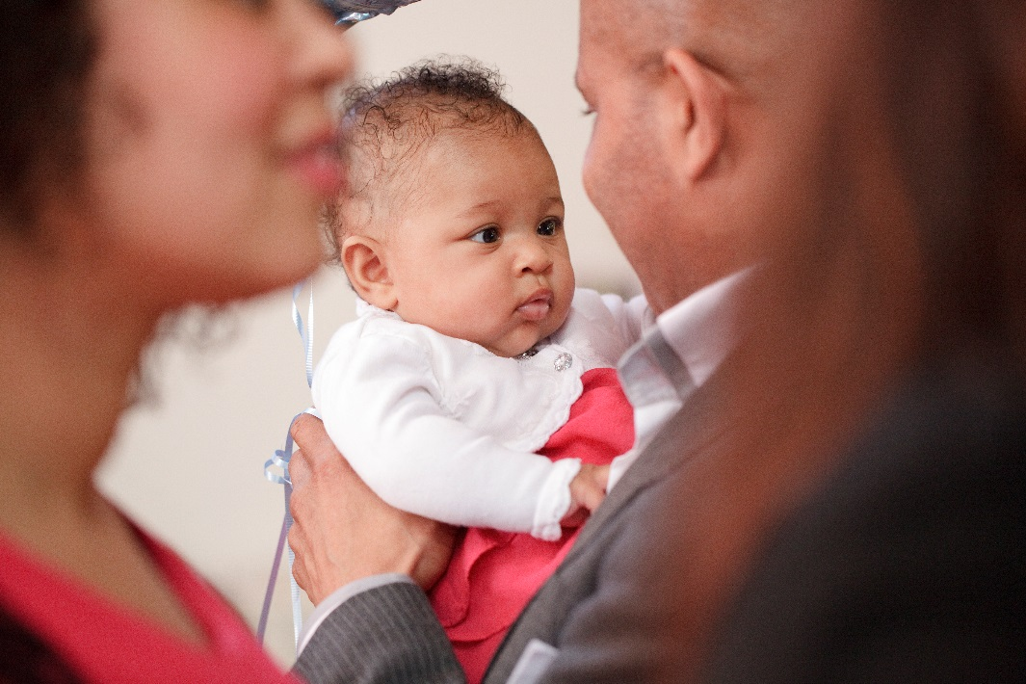
Welcoming families
through the gateway of baptism

Slide 2
Part 1: Context and background
Background to the work
Biblical reflection
The statistics and the story
The research and core messages
Notes:
This section could be used alone for a general discussion or to introduce any of the other sections, or as the start of the whole presentation. It is the most visionary.

Slide 3
The Archbishops’ Council Project
Ministry at the time of
birth and death…
aka funerals and baptism
(not forgetting weddings)
Notes:
Introduce this work – it is directed and significantly resourced by the Archbishops’ Council.
Between 2008 – 2012 ABC developed the work around weddings, and then moved to thinking about birth and death.
We don’t actually do ministry at the time of birth – so what we are talking about is baptism of children.
Try not to use the word project, except for internal reporting, because baptisms etc. are not projects in the life of the church; they are the bedrock of what we do. Sandra Millar leads this work with a team of 8 people

Slide 4
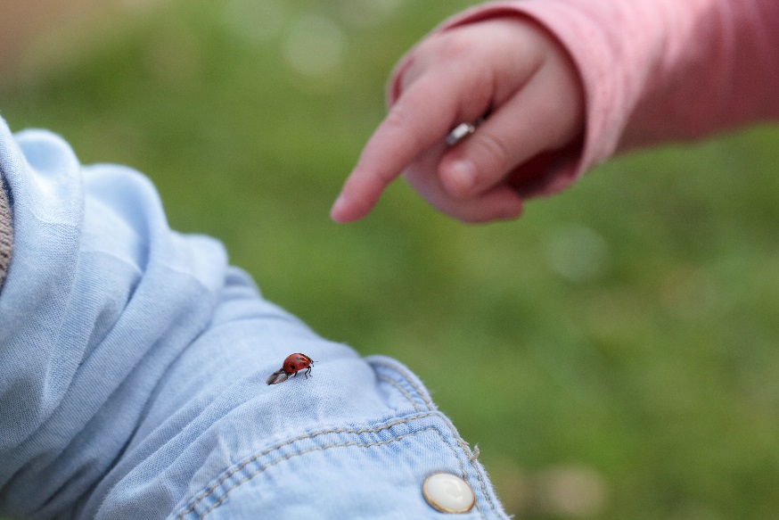
The Archbishops’ Council Project
Three purposes:
Attract
Build
Care
Notes:
Talk about general aims that underpin all the work:
Attract is about helping people to know that the CofE is there for them a life’s transitional moments – a wedding, a new baby, the loss of a loved one. These times bring big thoughts, big feelings, big questions and the church has been alongside people for years to help. Recent research showed that life events are often a trigger to drawing people to explore faith.
Build is about building understanding in two ways. Building understanding with the public about what the COfE offers: increasingly important in a post Christian world where we can no longer assume people know who we are and what we do. Secondly, and importantly, this work is about building understanding within the church about people’s experiences and expectations when they encounter the CofE. We are often good at knowing what people want without asking them!
Finally, we need to care about what we do to such an extend that people have a really positive experience of the hospitality of God and of God’s people.
There are specific aims about numeric growth, and seeing families become involved in church– more later.

Slide 5
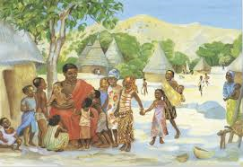

Ministry
Mission
Notes:
Alongside these general aims, the team have spent some time thinking about what scripture might say about this work. The first story to reflect on is the parable of the sower, and thinking about this parable has informed all our thinking about occasional offices. Three things: the idea that seed can simply be scattered in a casual way would have seemed ridiculous. It is a finite resource and costs money, but the sower in the parable simply sows the seed in an extravagant, even wasteful way, reminding us of the generous, prodigal God.
Secondly: in 1st century Jewish culture some seed was always sown on the margins for the poorest and most vulnerable: funerals bring us into contact with those who are right on the edge of church, and sometimes of society too.
Three: As citizens of the Kingdom of Heaven we do not live out of an economy of scarcity, but are working from an economy of abundance – the Good News doesn’t run out, we can’t waste it! However, we ourselves are finite, so have to remember to share the task. Summarize all this as mission
Then went to look at the Gospels to see how Jesus was involved in baptism. The difficulty is Jesus didn’t actually baptise anyone, unlike a wedding which he attended, and funerals, which we know he disrupted. So instead turned to a passage that is in three of the gospels, when Jesus welcomed children and blessed them.
Retell the story, the scene with women and children wanting to come close to the rabbi. The disciples trying to control the situation and keeping them away. Jesus inviting them close and then saying ‘the kingdom of God belongs to such as these.’
Jesus welcomes families and welcomes children. Heart of our ministry. Invite people to reflect on these stories.

Slide 6
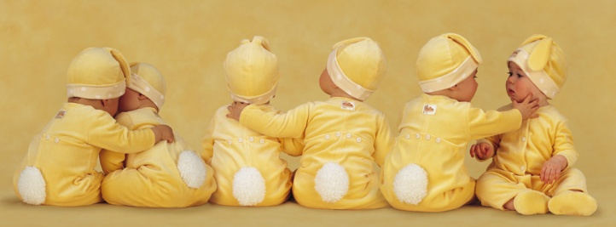
Baby booming?
657,177 live births [2013]
122,000 Baptisms [2013] 65% under 1
114000 baptisms [2014]
5400 thanksgiving services
Birth rate is static
Changing trends around celebrating birth
Notes:
Move from the purpose and reflection to the scope of the work.
These are numbers for England – explain that one of the most significant shifts in the past 20 – 30 years has been the age of baptism. Used to be 90% under 1, but children are now getting older when brought to baptism. In the pilot parishes we found that 75% of those aged 1 – 12 are actually aged 1 – 3 years of age.
In 2014 there was a decline, but the pattern has been stable and 1 in 6 or so births are marked with a baptism, so when someone asks now they are not just doing so because its what is expected.
The birth rate is basically static with some variation, but essentially an ageing population.
Changing trends may impact baptisms: rise of baby showers as people confidently celebrate pregnancy, often with close friends and family. But also although naming ceremonies are very minor at present that could change rapidly as happened with civil funerals.

Slide 7
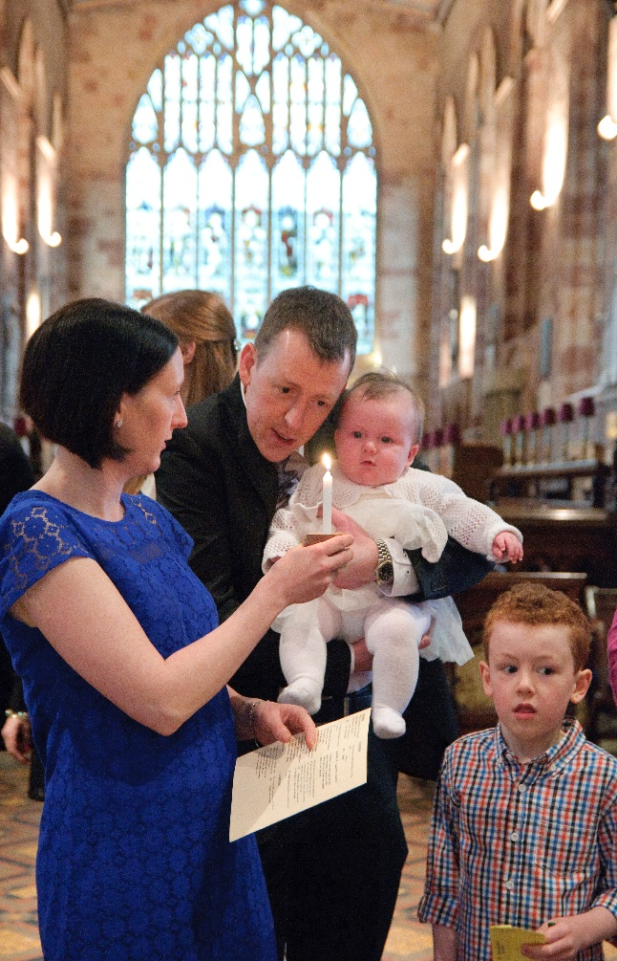
“in baptism the Lord is adding to our number”
2,200 children under 12 per week
200,000 people per week
Notes:
A reminder that in baptism God is adding to our number, even though we may not see the results ourselves. It is about the grace of God at work: Sandra’s own story is of meeting a woman who was baptized as a baby just two months before her at the same church, they lived on the same street, came from non-church families. Now both are ordained priests in CofE.. The timescale was not immediate. So even if sometimes we wonder what is happening, God is at work.
The numbers mean that we are baptizing over 2000 children each week, and comment on how baptism congregations are growing ever larger, so a good guestimate is that we meet 200, 000 people every week just through these services.
And the age group the CofE finds hard to meet is 18 – 40s – which is just the age group coming along as guests to baptisms.

Slide 8
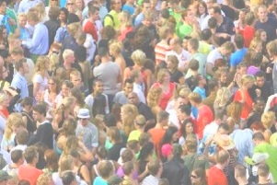
200,000 journeys
200, 000 stories
Notes:
Each of the 200, 000 people is on a journey, each of them has their own personal story. We don’t know how near or far they are from God, nor what their personal thoughts and feelings are on the day of the baptism.
Let’s imagine we are following one of these ‘non churchgoers’
Let’s imagine one of them, we will call her Kate [aged 29] NB This is the same story as I use for baptism presentation.
Kate isn’t a churchgoer. She comes home from work to a real invitation on her door step: its an invitation to a christening from one of her university friends. Now Kate went to University in Warwick, and this friend stayed living near there, so in June Kate finds herself at a gorgeous country church in a Warwickshire village, and she has a great time. In July she finds herself at a wedding for another friend, this time, one who moved to London after uni, so she goes to a suburban church near St. Albans. Then oen of her good friends returns to work after mat leave, they go out for coffee, and her friend asks if she would be a godmother for the baby’s christening in Late October. This time it’s a church across the town where she lives. At Christmas Kate goes home to her family – they live in a small market town in Gloucestershire. Her mum suggests they go to church for a carol service, as they haven’t been for years, so they do. Then just after Christmas another wedding invitation lands on her mat: this time to the wedding of an old school friend, now living in Somerset – great excuse for a weekend away at Easter, and another gorgeous church. Sadly just before that her grandad dies, and in early March Kate finds herself at a funeral service in a church in a Gloucestershire village where her grandad lived all his life. One year, five church visits – and one in the pipeline. But at none of them was she really counted. And here’s the twist. A couple of years later Kate moves away, she meets some new friends and one of them is active in a local church – Kate starts to go along, and now her discipleship springs to life. But who knows what impact all those events had?
Talk about how retail stores need and value passing trade – the growth of Marks and Spencers on motorway service stations, where the same products are to be found. The staff don’t moan about how the customers only come once, or how they are going to spend real money elsewhere. Because they know that they are all part of the same experience. And the Church of England is there for people wherever they are, however they come across us.
NB change locations to suit local knowledge.
If time pause for reflection

Slide 9
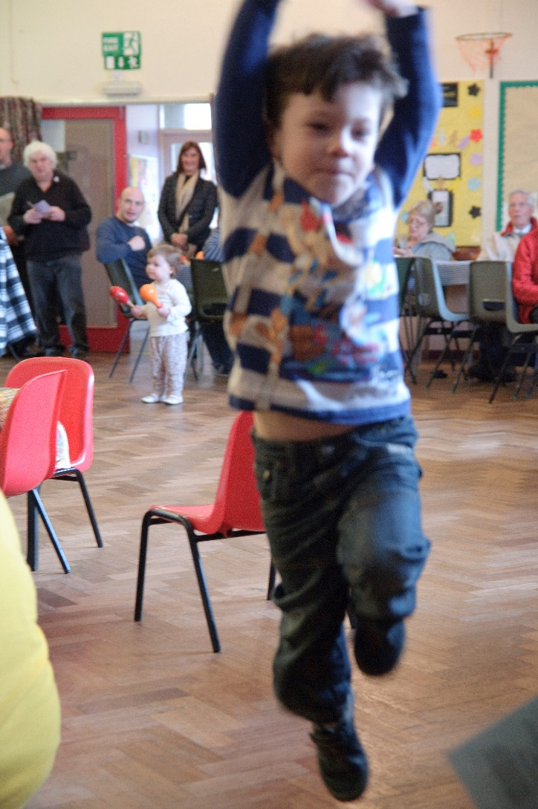
Talk space
Notes:
Slide to show during chat

Slide 10
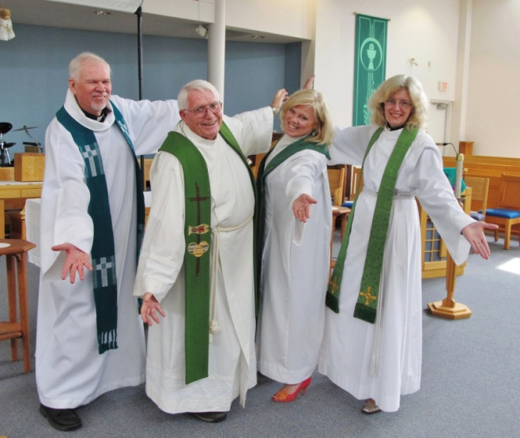
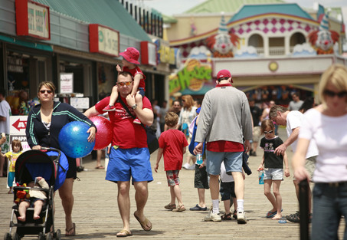
Several conversations:
with the clergy
with the public
Notes:
Given the background and the potential scope, Archbishops’ Council decided to do some research both with clergy and the public.
We interviewed around 300 clergy in the North West and the South East in a series of focus groups, and then did a significant research with families who had had a child under two baptised in the previous four years. All of them were fringe or even non church goers. A thousand families interviewed, and then some interviewed in depth.
It is this that shapes what we are sharing.

Slide 11
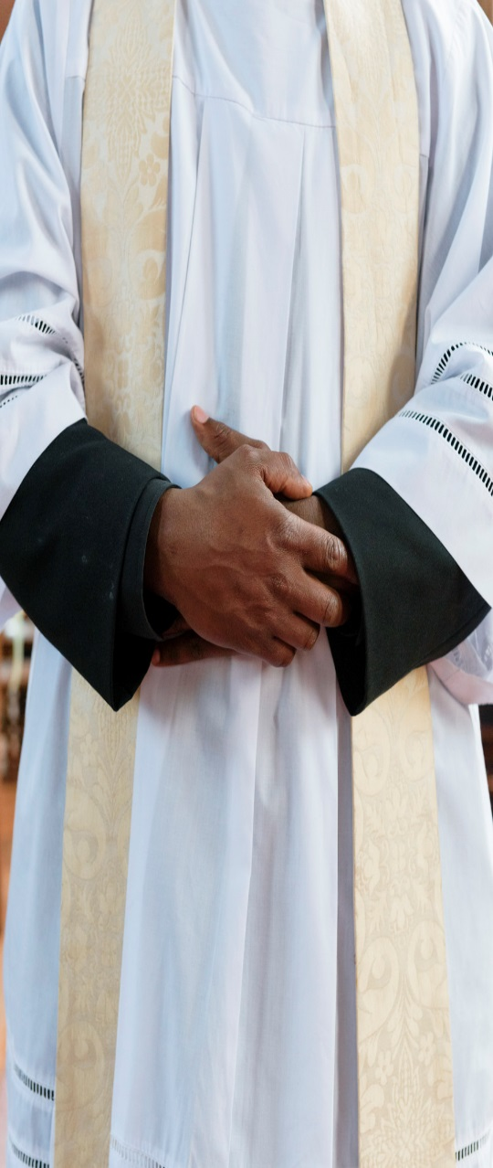
Church worries
When - in the service? Or not?
Being ready – what does that mean?
The words of the service??!!
Do they mean it?
Will they ever come back again?
Is it worth it?
Notes:
These are some of the key worries that emerged from the conversations with clergy. Worries about the service, the words, whether families are taking it seriously and whether they will return. And whilst many clergy love doing baptisms and meeting families, there is sometimes an underlying anxiety about it.

Slide 12
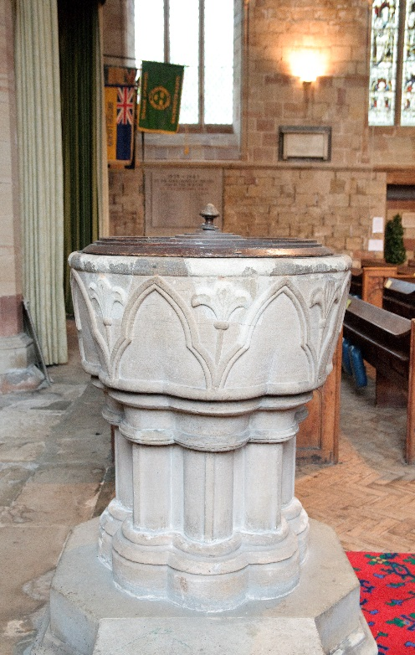
Core messages
Language that connects
Parents are seriously motivated
Godparents really matter
Symbols speak louder than words
It’s about the whole people of God
Follow up, keep contact, make friends
Notes:
From all the research developed these six core messages that we are going to unpack during the presentation

Slide 13
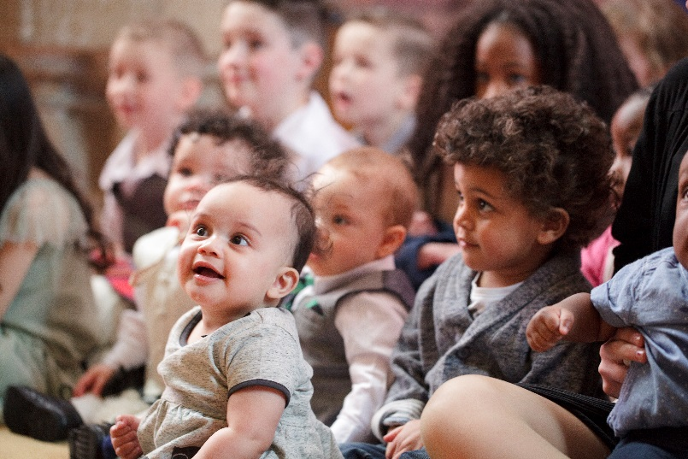
The good news
This research and these resources
can make a real difference:
65% of pilot parishes saw an increase in families engaged with church
93% reported that families had an under-standing that baptism was the start of a journey
Notes:
The good news is that the research showed us that for 1 in 5 families baptism is the start of a new relationship with church – though not necessarily the church where baptism happened. There are many reasons why this happens, but importantly it was about being kept in touch, and invited to come back.
The resources and the key messages were tried out for a year with 150 parishes.
And 2/3rds found that they saw an increase in baptism families engaged with churches. And 93% felt that families were understanding it was the start of a journey rather than an end in itself. This represents a real shift in understanding.

Slide 14
Part 2: Language, motive and people
The language of christening
The amazing journey imagery
Parents motivations – faith journeys and good start
The importance of godparents
Preparing for the day
Communicating
Notes:
This section could be used alone for a general discussion or to introduce any of the other sections, or as the start of the whole presentation. It is the most visionary.

Slide 15
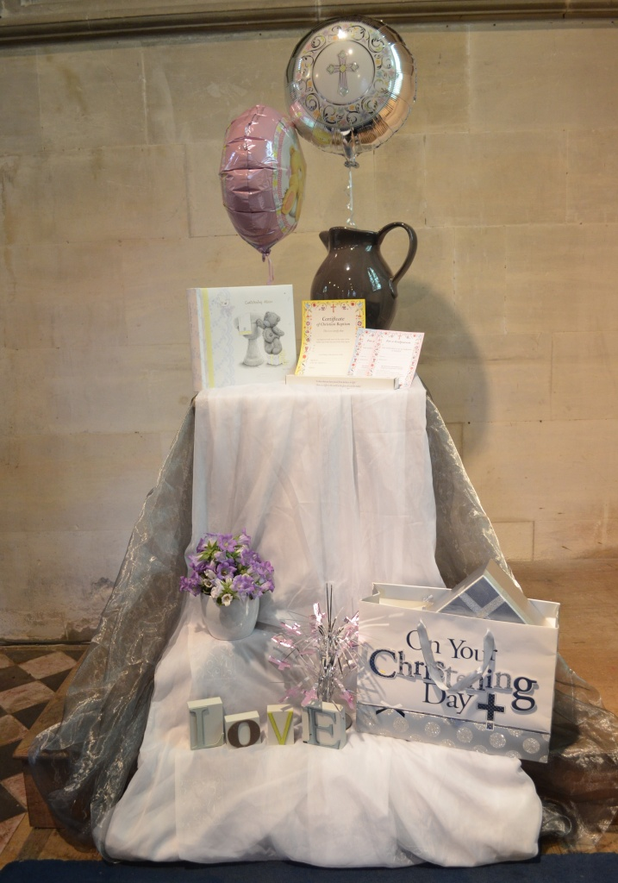
Language that connects
It’s a christening…
...and a baptism
Notes:
The first thing we discovered is that to the public this service is a christening. All the research we did, including internet, showed that this word is widely used.
The display is made up of items from the High Street – all with the word christening. The cake, the gown, the party, the gifts, the cards – all say christening. It is not a wrong or bad word, just the word they know.
However it is baptism: baptism is what happens in the service and it is the word that we will use on the day. So the first step on the journey people make is to say something like during the christening your baby will be baptised. It is helping bridge from the language people speak to the language of the church, in the same way as when St. Paul spoke to the Athenians about the unknown God.
All the public facing resources we have produced use the word ‘christening’

Slide 16
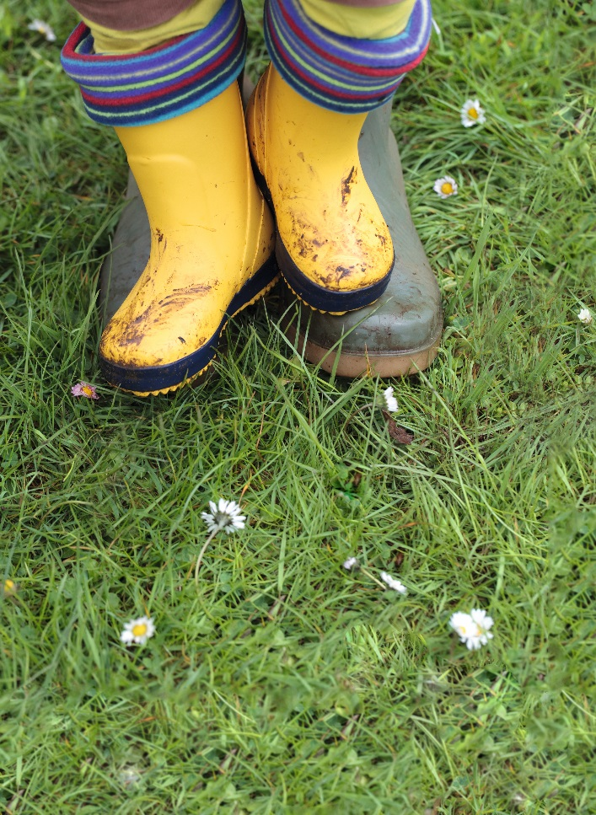

The amazing journey
Notes:
The images, language and identity that we have developed was informed by the research and also by the metaphor for the Christian life as a journey. This identity has been really well-appreciated by clergy and by families, and has provided a real key to explaining and exploring the fuller meaning of what happens at a christening.

Slide 17


“Just ask…”
For toddler groups, nurseries and libraries
Light touch
Encourage contact with the church
Important thing is to respond positively to enquiries
Two versions available
Notes:
Increasingly, parents don’t know what to expect or where to go for information. So this simple leaflet is designed to leave at places where expectant mums, and those with young families pick up information. It simply points to the vicar and suggests finding out if a christening could be for them. It is available to buy on the Church Print Hub.

Slide 18
Parents are seriously motivated:
Understanding why
Notes:
There are many reasons why parents bring a child for baptism, and the research discovered that most of them are serious in intent and give us a good basis for exploring further.

Slide 19
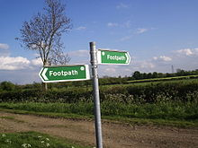
1. Part of a journey
Families are already on a faith journey
Christening is an essential
foundation for their child’s
faith journey
Christening will ‘open doors’
to later choices
“God knows you are out there”
But faith journeys may not be church journeys
Notes:
Faith journeys can be long, and many parents have already had positive experiences of faith in their own lives. It may be the memory of a church school, a Sunday school, choir, youth group or even uniformed organisations. Something in their past touched them and they want to reconnect. For example, one man talked about the impact going to the cathedral service as a scout, and how he wanted his child to have the same experiences.
Many parents see baptism as the foundation for a faith journey, and without making some kind of start, spiritual life may never begin or come to life.
And the christening will open doors later – parents know that a child may not choose to have an active faith but they feel they have opened the possibility.
For some there was also a sense of bringing the child into God’s presence, almost echoing the Christ Child in the temple. However, faith journeys may not be church journeys.. Especially when children are young. But just because we don’t see them in church doesn’t mean that spiritual life is not happening.

Slide 20

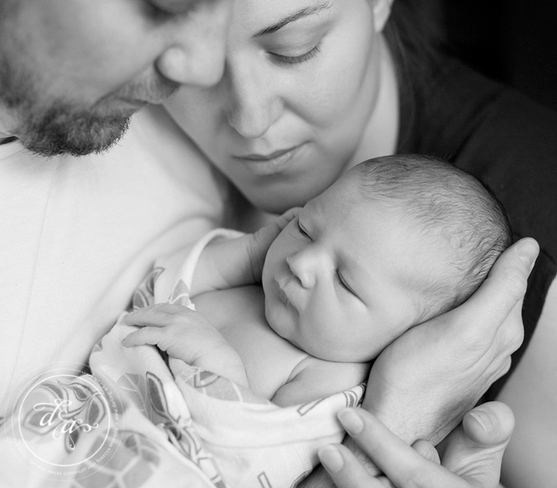
2. To make a good start
“It’s overwhelming”
“Absolutely incredible, weird feeling you won’t feel about anything else”
“You hope that the world isn’t really changing for the worse, but I fear that it is, so you worry about the world you’re bringing the child into…the wider issues, which you have no control over”
Protection, blessing, right path, good start
Notes:
All the quotes on this page are, coincidentally, from dads talking. Having a baby, becoming responsible for a child is a life-changing moment, and it heightens awareness of both the vulnerability of the child and the task of ensuring they grow up well. As part of a TV programme about the Prince’s Trust [ITV 5/1/16 When Ant and Dec met the Prince], Prince William talked about how he felt when he became a father, and he echoed these thoughts, talking of anxiety about the world and the future.
During research for this work, the team visited the National Baby Show at the NEC to see if the CofE might exhibit [we did in October 2015]. Amidst all the baby paraphanalia one stand stood out:RSPB. A conversation with the stall staff revealed that they too know that when a child arrives families worry whether the world will still be there for their child in the future. The second thing is that parents want to give their child the best childhood experience that they can..
This is the same set of motives that underpin the decision to have a child baptised. Its something about setting a child off on the right path, giving them a sense of protection with God’s blessing.
A good start on the right path may mean parents use a lot more language about ethics and values, something that can help bridge to talk about faith and believe.

Slide 21
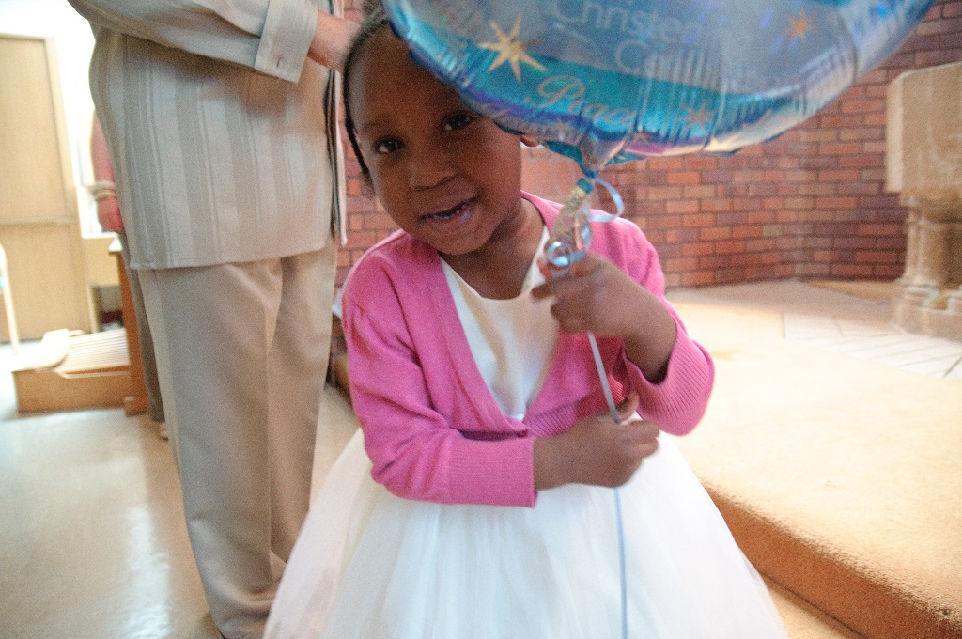
3. People matter
Belonging
Family
Celebration
Party
Community
“When you have little ones you do think more about being part of a community”
Notes:
The third set of reasons for having a baptism might be grouped around people.
A child is part of a network of family and friends and bringing them together to celebrate is important. Although a christening is not seen as a substitute for a wedding, it is very much a celebration of family life, and for some may be the first opportunity to gather people together.
The celebration and party are an integral part of the day, just as a wedding reception is part of a wedding day.
Many young families find affordable housing away from their own roots, and some newer housing estates have few community facilities, so that loneliness and isolation can be a problem for young mothers in particular. Church offers community – a lifelong community and a world-wide community to belong to, so embracing both the wider family and including them within the church community can be helpful.

Slide 22
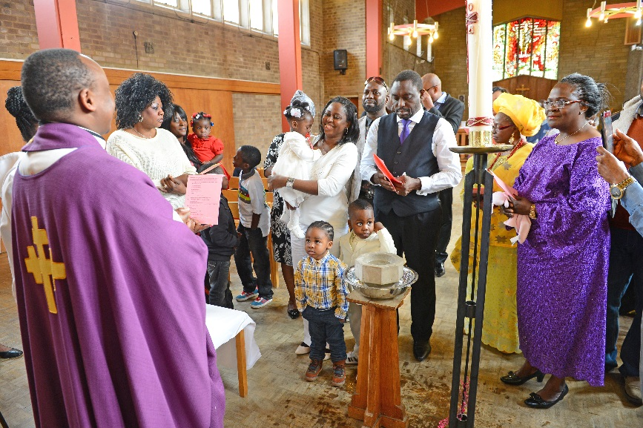
Community counts
Horizontal – family, work, social groups
Vertical – time, history, generations
“having our daughter christened in the church we did has made us feel closer to the church: my husband and his sister and his nephews were christened at the same church and my nephew is head choir boy”
Notes:
It may be that there are two types of community.
Horizontal community is the communities we belong to every day – work colleagues, family, mates down the sports club and so on.
But there is another kind of community that is also important: community that goes back in time, which SM describes as vertical community. It’s about family history and generational stories – think of the growth in websites like Ancestry.com and the interest in genealogy through Who do you think you are?
Parents may ask to have their child baptised in a church away from where they live – perhaps because parents were married there, or grandparents are buried there, and it holds their story. Also note that whilst there is less cultural pressure to have a child baptised in some families it is still very much part of family tradition and experience.
The quote illustrates how important those links are for people and how being able to make links is a positive experience.

Slide 23

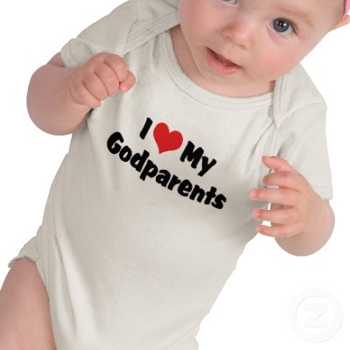
Godparents really count
Guidance – moral, religious, friend
Insurance – if anything happens to me
Constant – alongside parents
But not an easy decision!
“I know they will help, support and
guide my daughter on the right moral path.”
Notes:
There is one group of people who really, really matter: godparents.
91% of research respondents claim choosing godparents influenced their decision, the strongest reason by a small margin [good start and blessing also high in the mid eightys]
The main reason for wanting godparents is so that they will give guidance to the child, often particularly in teenage years. In choosing them parents are often honouring long friendships and looking forward to a relationship that will be part of their lives for the next 25, 30, 40 years.– 61% of respondents were either godparents themselves or close to their own godparent, so its an important role in this age group.
So one of the biggest changes in practice to come out of this research is the way we recognise godparents both beforehand and in the service itself. In the service this can be about mentioning them by name, thanking them, and applauding – all things that show they are significant.

Slide 24
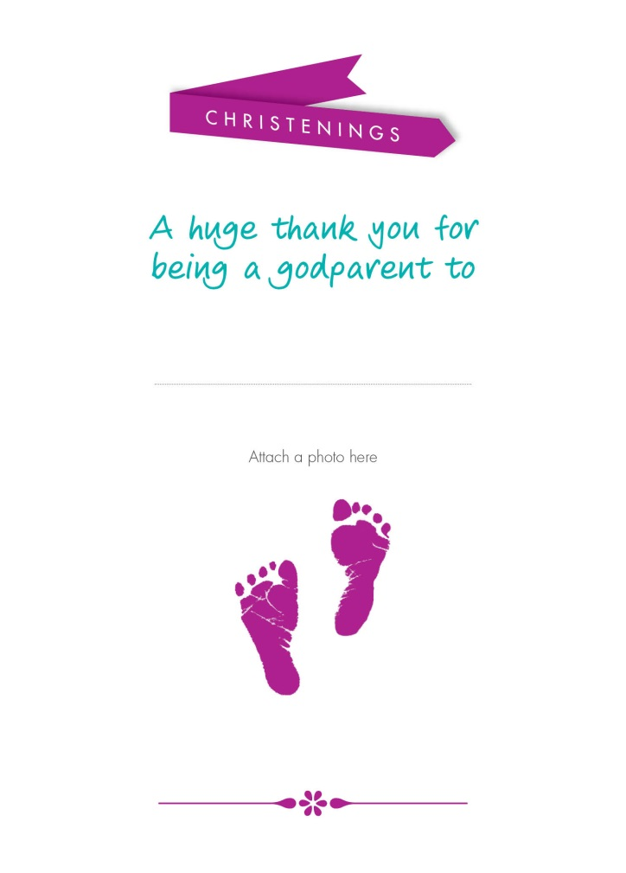

The Godparents card
For parents to give
A reminder of what it means
A gift to encourage prayer
“It was important to us to have other key people in their lives that could guide, support and influence them”
“A godparent should be trustworthy, caring and have a lot of love to give our children”
Notes:
Perhaps the most popular of all the print resources is the godparent card, which was developed to emphasise the importance of the link between parents, godparents and church. It is not a substitute for the certificate.
Stress the mechanics – the church gives it to the parents to give to the godparents, perhaps at the prep or at a meeting.
It includes a fridge magnet, which acts as a prompt to pray in a very simple way, a visual reminder for years of a role that has been undertaken.
There is also a special section for godparents on the website.
Even if godparents live far away, it should be possible to make some kind of contact with them before the service, and give them some information.

Slide 25
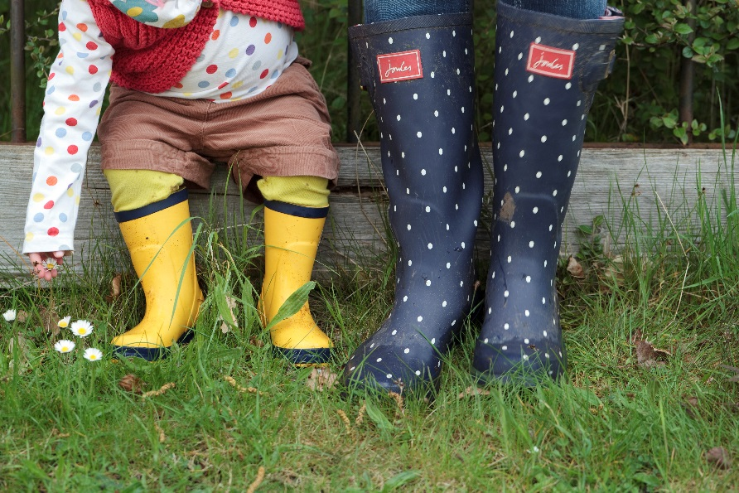
Before the day
Chat with the vicar: 8 out of 10
Talked to family: 55%
Talked to friends with recent experience: 29%
Used web/social media: 40%
Notes:
Having thought about the serious reasons that parents have for having a child baptised, move on to talk about how we help them prepare for the day. This slide shows the range of things parents might do to get information before hand, which includes the importance of talking to their own peer group and using social media. 8 out of 10 have a chat with the vicar, and shortly will be more about what that means to families.

Slide 26

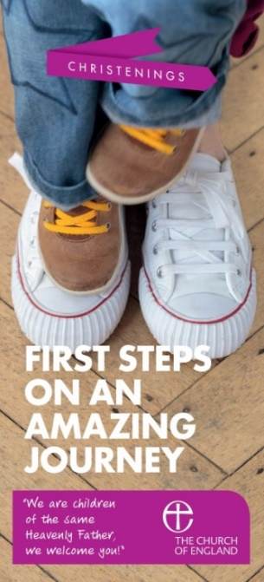
Information needed
Given to families by the church
A reminder to keep about what will happen
Key phrases from the service
Contact details
Notes:
The print resources include a simple leaflet to give to parents once we have met them. It can be customized with the church details at no extra cost and bought on the print hub.
It has simple information about what will happen, with some key phrases. It means they can keep it to hand to refer to between the booking and the service itself.

Slide 27
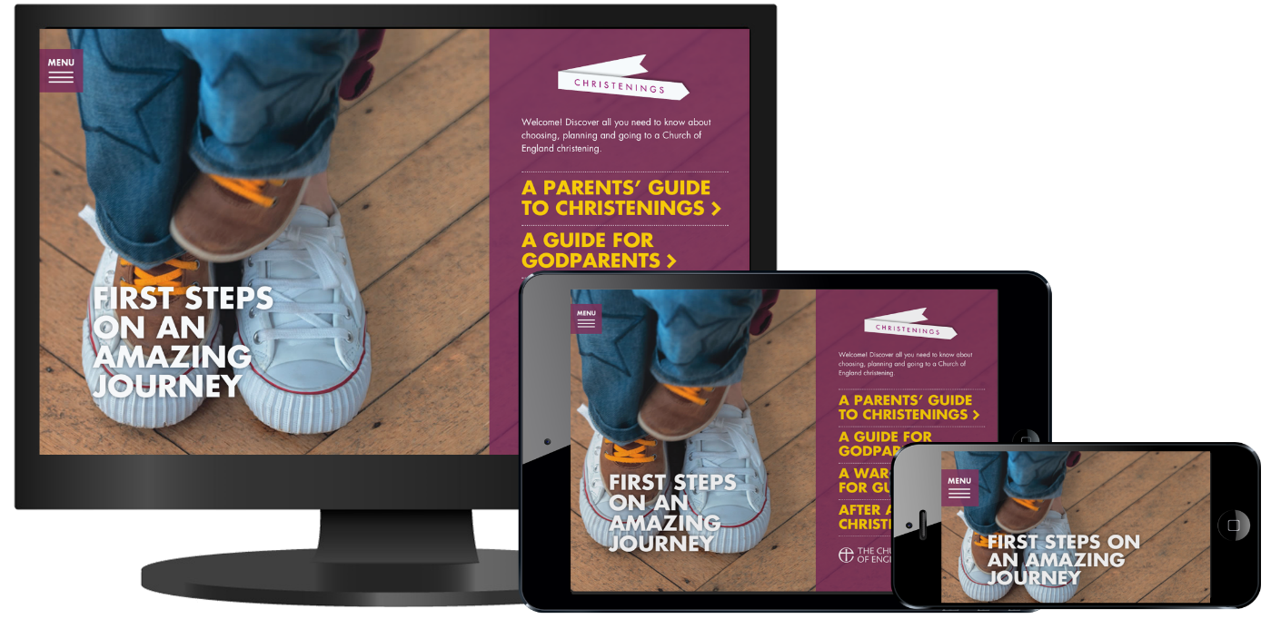
ChurchOfEnglandChristenings.org
For parents
For godparents
For guests
For the day
For the future
Notes:
Another really important tool that is there for parents, godparents and guests is the church of England christenings website. Parents will be searching before they meet you and as the months go by before the day, and the website gives them lots of useful information. Encourage people to become familiar with it so they can confidently recommend it, especially as it has lots of ideas going into the future. A small business-card size card with just the web address on is available on the hub, ideal to give to godparents, grandparents and so on – NB a pack of these are free with the first order placed!

Slide 28
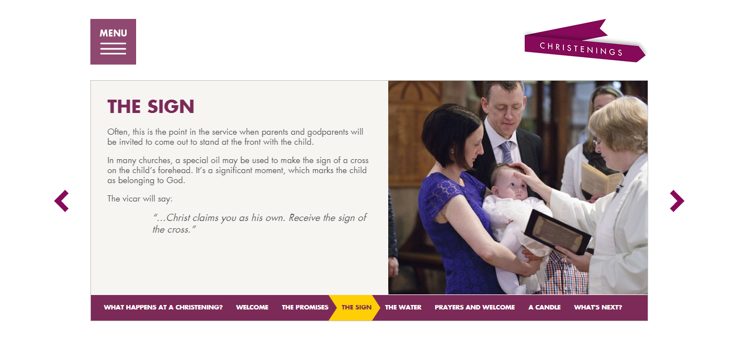
ChurchOfEnglandChristenings.org
Service Walkthrough
ChurchOfEnglandChristenings.org
Walkthrough
Notes:
Note that the website include a walk through of the service so people can become familiar with what happens

Slide 29
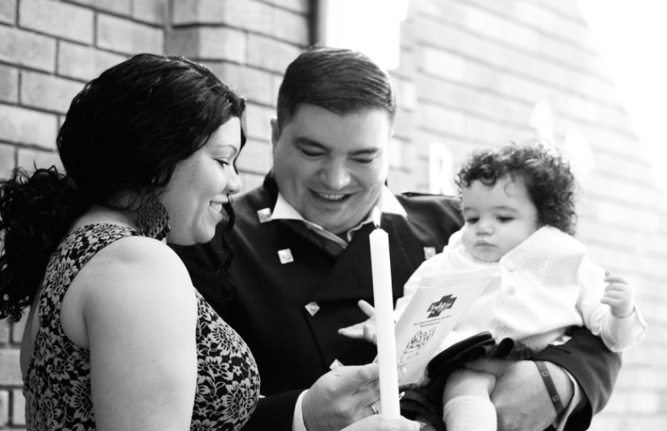
Getting ready…
for the day … 2/3rd agreed strongly that they were well prepared and understood significance
...but for life?
“A couple of weeks before we met with the Vicar to go through what would happen on the day.”
Notes:
One of the things that most churches worry about is whether parents are well-prepared for the day, so this was an area we explored in the research. The response was very positive – 2/3rd agreeing strongly that they were well prepared and understood. But it may be that what they are thinking about is being well prepared for the day. Most adults are really anxious about the mechanics of the day, and want to be reassured about where to stand, what to do, what will happen. And we do that well. But what is less clear is whether we are preparing them for life… One of our respondents said: I can’t say that we really discussed the religious significance of the baptism” and others commented that they didn’t get the same support as you do with getting married.

Slide 30
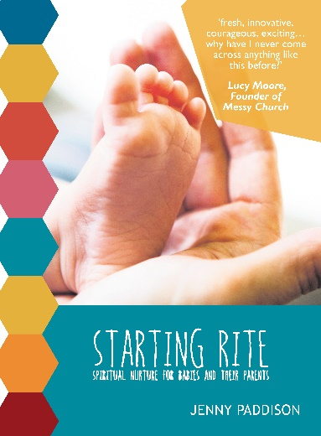
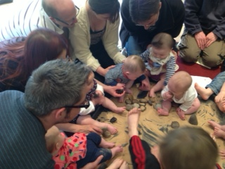
Help is coming…
Starting Rite – a 5 week baby centred course
We welcome you: baptism preparation with families – a more traditional course
single session or three sessions
for use with one or more families
Notes:
Brief explanation of the new courses that we want to test out. Explain they will get to choose or do both if they have capacity.

Slide 31
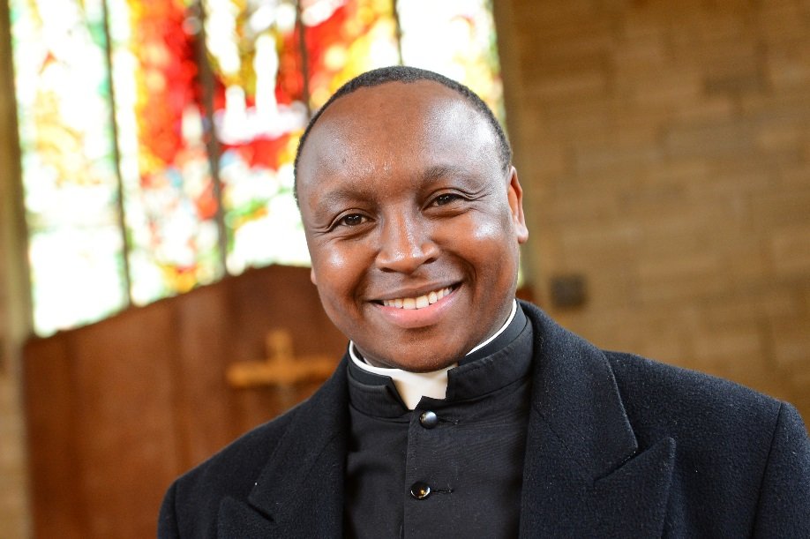
Communicate clearly 2
… with the church
Information, ideas, reflection
Buying resources
Manage the follow up
Notes:
How we communicate with you – church support hub and church print hub – hand over to Tom

Slide 32
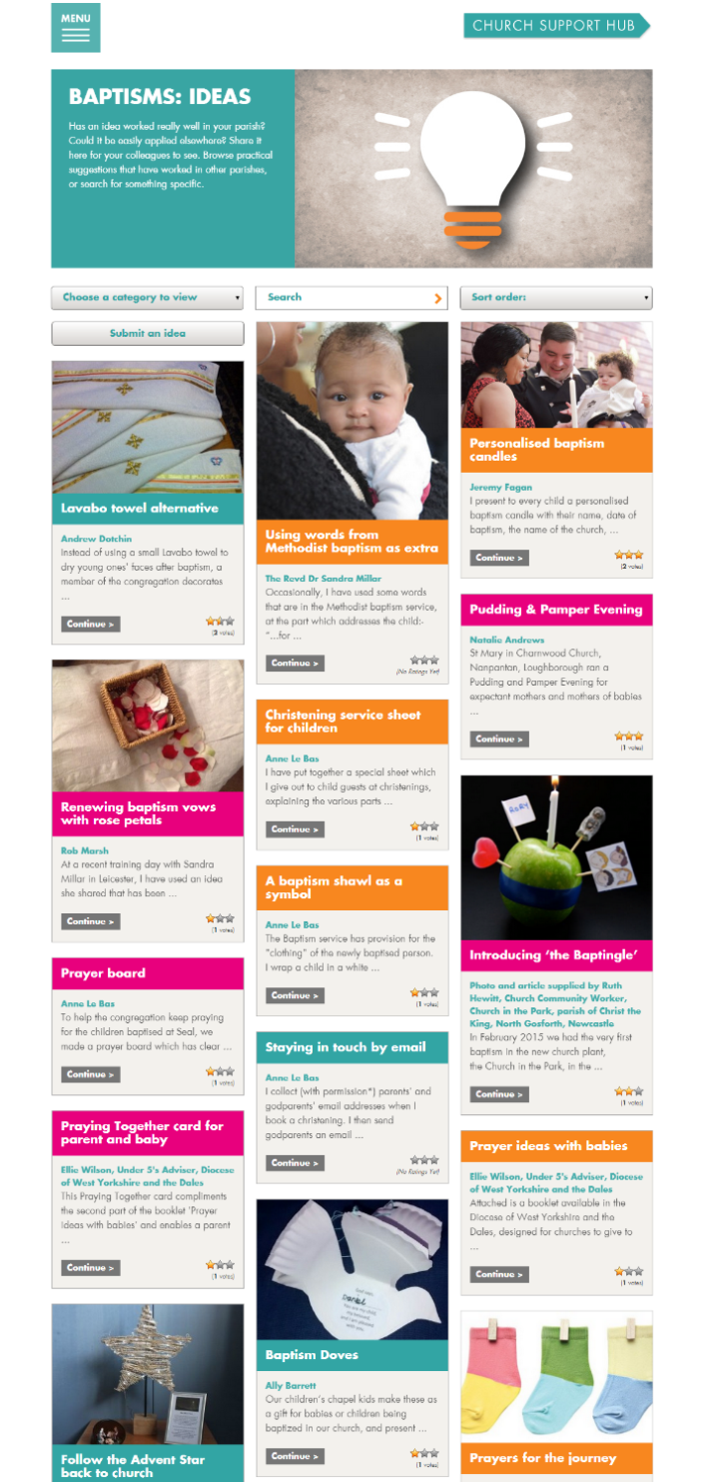
ChurchSupportHub.org
Explore the thinking – read the background
Get downloads – useful and important documents, logos etc.
Read and share articles – longer pieces exploring or explaining issues
Share ideas – practical things that have worked well
Notes:
How we communicate with you – church support hub and church print hub

Slide 33
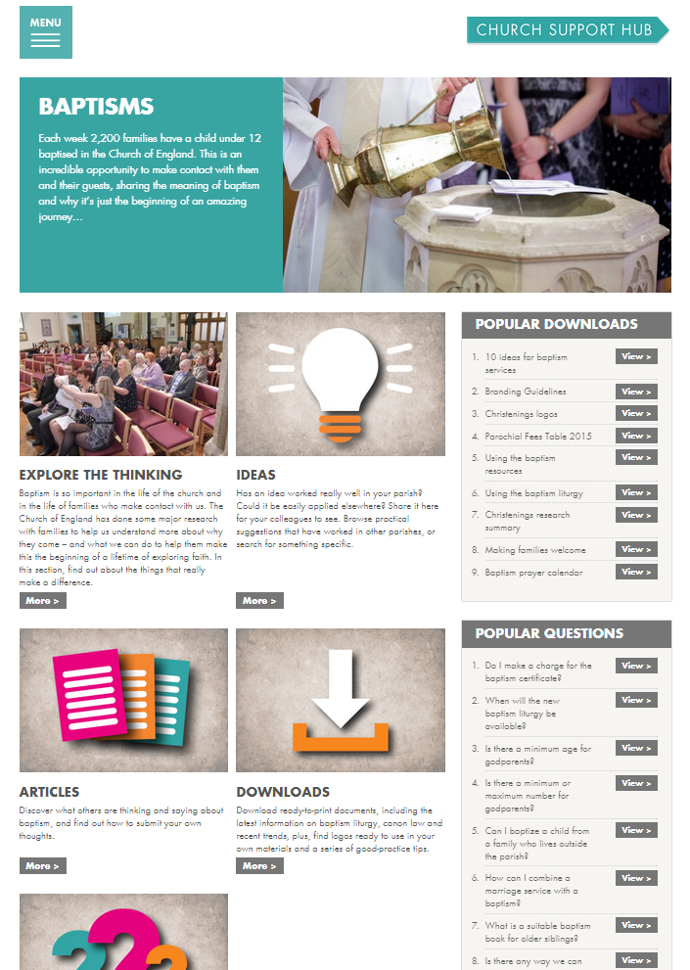
ChurchSupportHub.org
Notes:
How we communicate with you – church support hub and church print hub

Slide 34
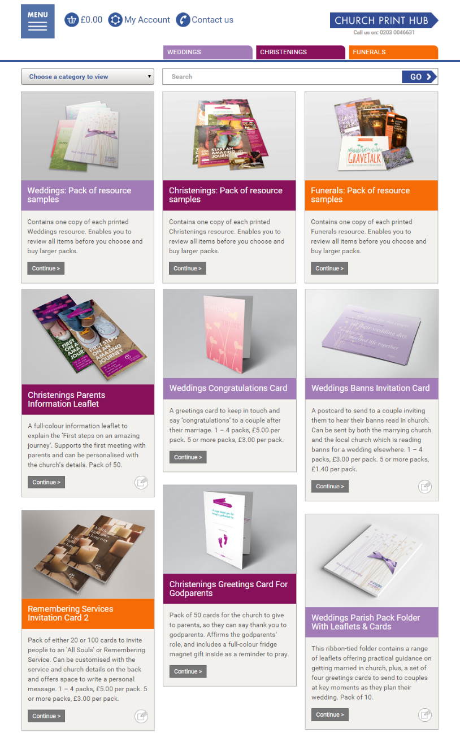
Browse, customise and order resources for your occasional offices at: ChurchPrintHub.org
An on-line shop
Choose
Order
Customise with details
Pay
Delivered
Information leaflet
Godparents card
Web publicity cards
Invitations and more
Notes:
Talk about print hub and remind briefly of all that is there

Slide 35
Browse, customise and order resources for your occasional offices at: ChurchPrintHub.org

Slide 36
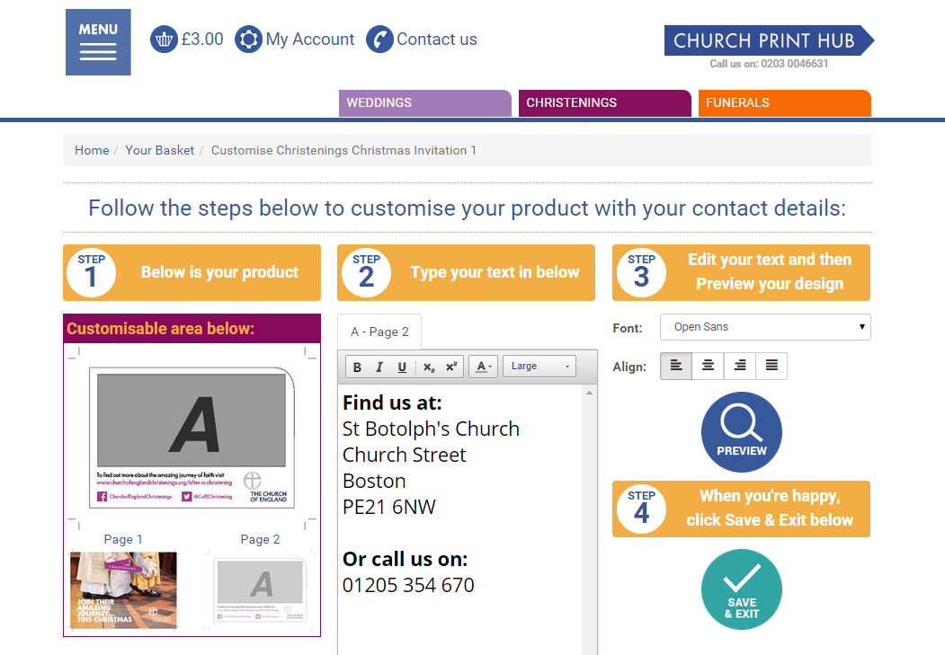
ChurchPrintHub.org
Notes:
church print hub

Slide 37
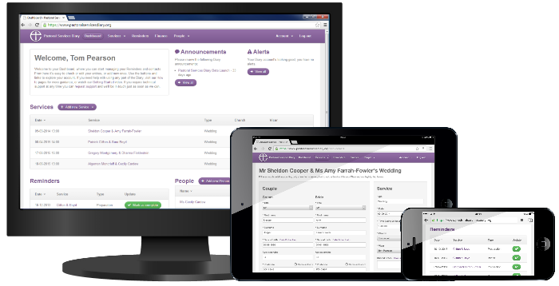
Manage your occasional offices, stay in touch with those involved, and receive Reminder emails to send the associated resources at: PastoralServicesDiary.org
Sign up today to manage Weddings and Banns Services.
Funerals and Baptisms Services arriving in beta Q1 2016

Slide 38
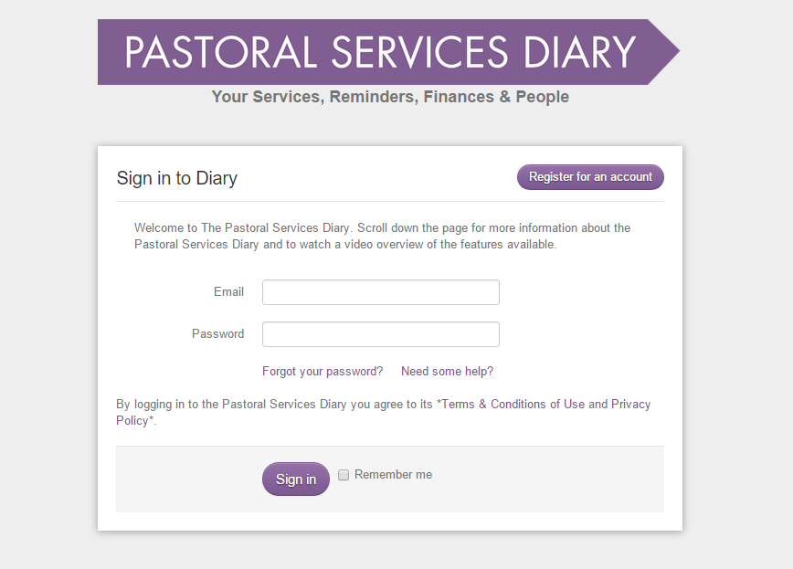
PastoralServicesDiary.org
Notes:
How we communicate with you – church support hub and church print hub – hand over to Tom

Slide 39
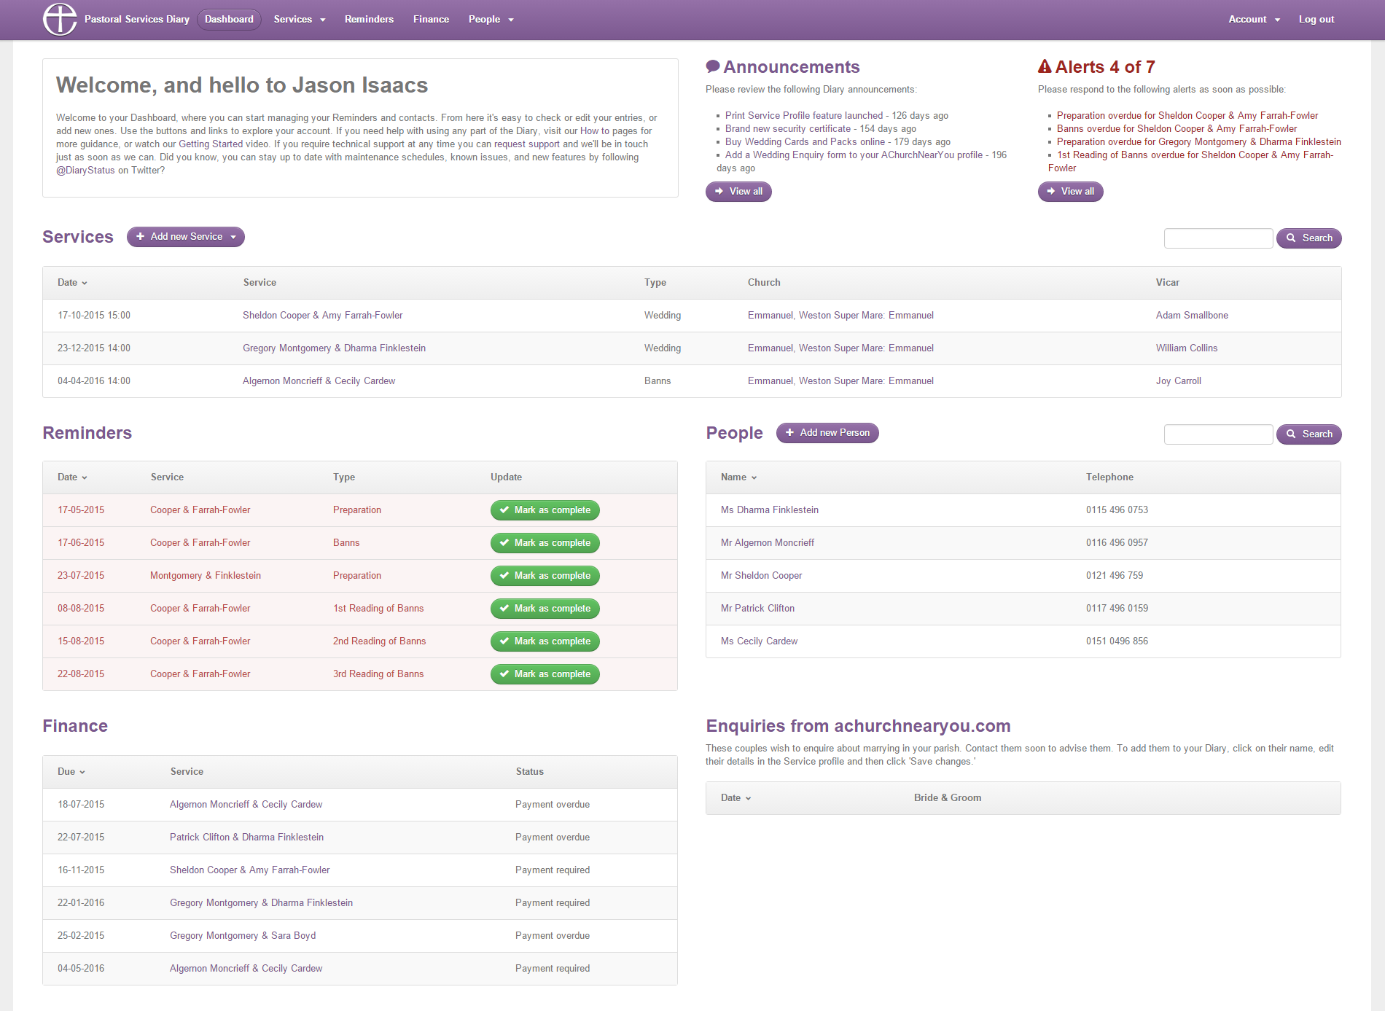
PastoralServicesDiary.org
Notes:
How we communicate with you – church support hub and church print hub – hand over to Tom

Slide 40
PastoralServicesDiary.org
Each Account allows you to add:
Unlimited churches
Unlimited Users (with bespoke permissions)
Unlimited Vicars (other ministers added with Funerals)
Upload and store documents associated with People and Services
Accept enquires into a holding bay direct from AChurchNearYou
Synchronise your Services and Reminders into your own calendar
Coming Soon: Print out labels and download contact data as a CSV file

Slide 41
ChurchOfEnglandChristenings.org
ChurchSupportHub.org
ChurchPrintHub.org
PastoralServicesDiary.org
⋟

Slide 42
Part 3: Symbols speak louder than words
When baptism happens
Significant moments
Making it special
Welcome and warmth
Notes:
This section could be used alone for a general discussion or to introduce any of the other sections, or as the start of the whole presentation. It is the most visionary.

Slide 43
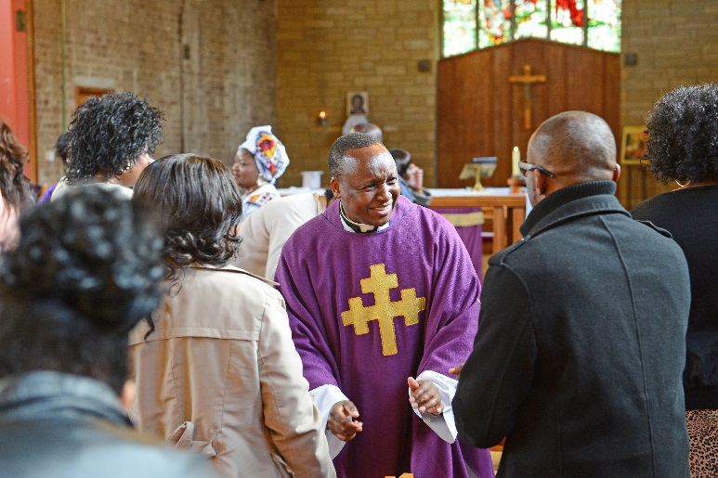
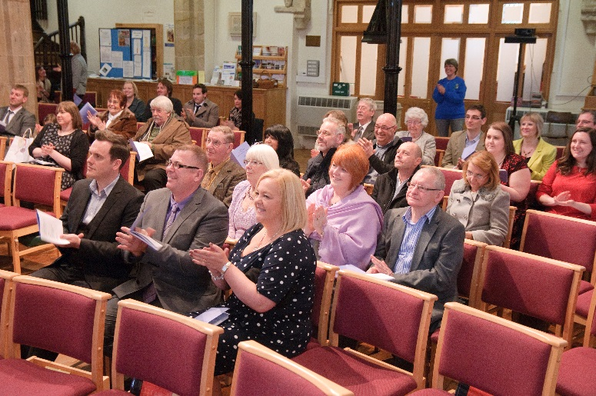
When and who?
38% in a regular Sunday service
Over twice as likely to continue with church
75% of non-churchgoers have a separate service
“We felt that it was nice for the baptism to be part of the service as it welcomed us and our son to the congregation.”
Notes:
The research has helped to give an idea of whether baptism is taking place within a main service or at a separate event. We found that just over a third took place in a Sunday service, and that the response to this was generally positive. Respondents were happy with whatever type of service they had: those who had it separately value the sense of personal occasion, whereas others valued the sense of belonging to a community.
The key thing is that those who had a baptism in a Sunday service were twice as likely to come back to church. This doesn’t mean that all baptisms have to happen in Sunday worship – for many this is logistically impossible. It may mean having more confidence about including in Sunday worship, but particularly it means finding ways of helping families meet other people. For example, some of our pilot parishes began to meet couples after Sunday worship during coffee time rather than on a separate occasion.
The other thing to note is that if people are non-churchgoers, not in regular contact at all, they are much more likely to be offered a separate service, and the chances of them returning are much lower.

Slide 44
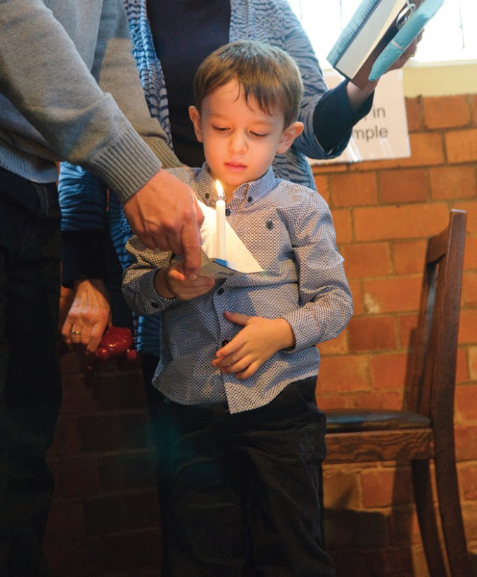
At the service…
Welcome – vicar and others
Godparents
Candle
Water
Prayers
Blessing
Gown
Notes:
On the day itself there are a number of things that are named as being important or significant in making the service special. All of these are normal parts of the service – the warmth of welcome is really important and of course the presence of godparents. After that parents remember the candle and the water, any prayer or blessing using the child’s name and for a small minority the tradition of a christening gown, perhaps a family heirloom, is important.
All of these are visual and experiential

Slide 45
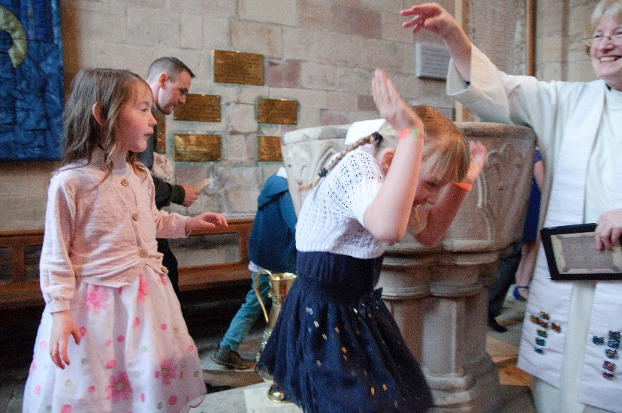
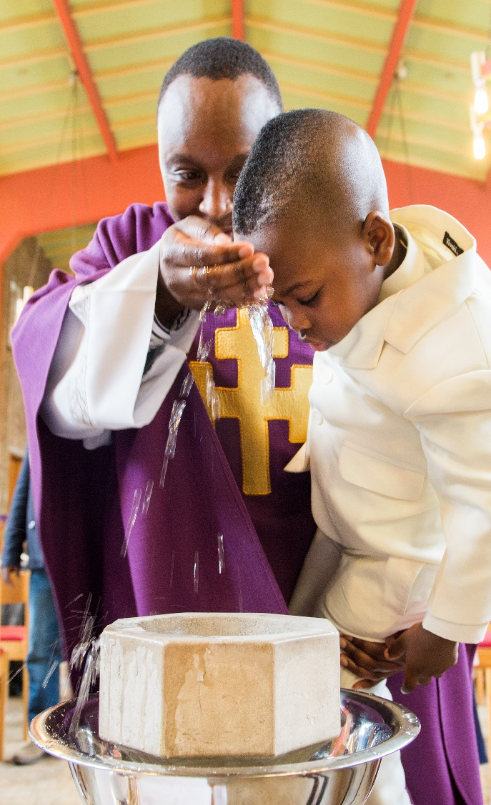
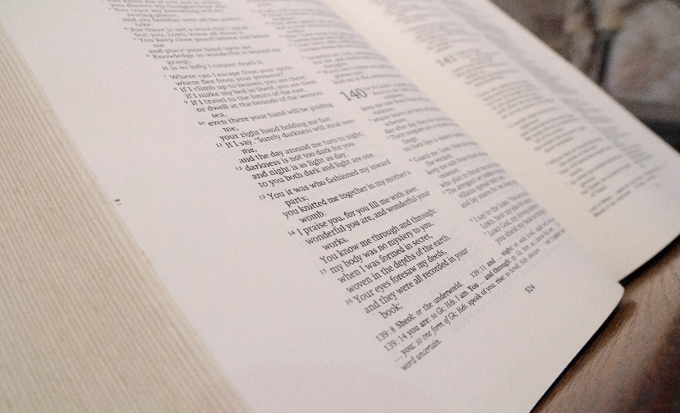
Words and symbols:
Notes:
The church is very concerned about the words of the service, but for those attending the experience of symbolic action is what makes an impact. The words serve the symbols, reinforcing their significance and impact. One respondent told a story of how after the christening she was bathing her baby, and as she held him, gently washing his hair, she talked of remembering the vicar holding her baby and thought of God’s love holding the baby. Spiritual things, emotional things are often experienced beyond words. Talk about how Shakespeare communicates even when people ‘don’t understand’. Teenager making her mother watch Romeo and Juliet, and by the end Mum was weeping with the rest of us, but wouldn’t have been able to identify the transitional line that carried the meaning. It speaks to the heart.
Talk about water as the most powerful symbol, how people often become quieter at that moment, and anything that adds drama reinforces the message.
Allow time for reflection.

Slide 46
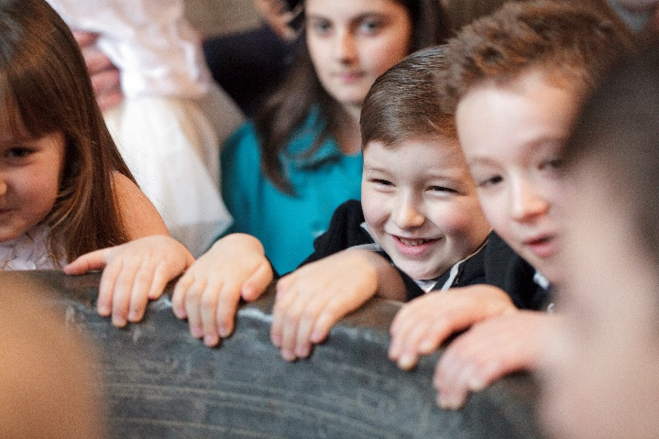
Making it special
Need to be welcomed by the whole church
“ it was part of the everyday life of the church as it should be”
Need to meet people
Needs to be personal
“I want it to be a little bit personal”
Needs to be traditional, relaxed and friendly…
but serious and significant
Notes:
The service is more than the words of the liturgy. The things that make the day special are to do with welcome and people, people who share in the sense of celebration. But also the importance of making it personal, even if there are a number of families being baptized in the same service. Personal doesn’t mean elaborate gestures, it just means the moment when the candle is given by name or prayers are said, names remembered. More important is the balance between traditional and relaxed. These five words are very important and sound almost like a contradiction, but the sense of tradition is very important. The words and the historicity are part of what give the event significance and importance to many families with just over half saying the service should be traditional. How to balance all of this?
The clue may be in how we present. Story of being at conference where person was talking about public speaking, and whether we use ‘dog’ or ‘cat’ mode. Neither is wrong. Dog mode is when we are warm and engaging and go towards people: think Labrador puppy. Cat mode is when we are in our own space, and when we are ready we invite people to join us. As the woman explained these two modes, after the cat description, she added ‘like vicars’. In other words we are perceived to be distant and formal, but we need to use both modes. It is in the balance that we reflect the seriousness and yet remain informal and friendly.

Slide 47
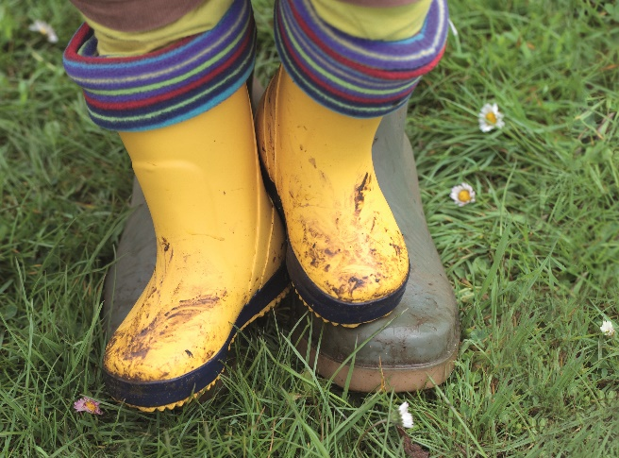
Worrying words?
“To me the Christian faith is about love and being kind to your neighbour and treating people with respect”
“It’s the wrong terminology, ‘repenting sins’ is not appropriate as they’ve just been born”
“it was about us joining them”
Notes:
Research respondents were not anxious or worried about words – fewer than 25% named anything that concerned them, but of those that did the biggest worries were singing out loud, standing out the front and their children misbehaving. When families were asked to comment on words we discover that their understanding of what being a Christian involves may be more about morality and ethics than belief statements. There was some concern about very young children needing to repent of sins, but the reality of mistakes and wrong choices in the future is more understandable. Finally, reflecting the need for the service to have a sense of tradition, there was a sense that if you are joining someone you use their language, which is part of the process of belonging.

Slide 48
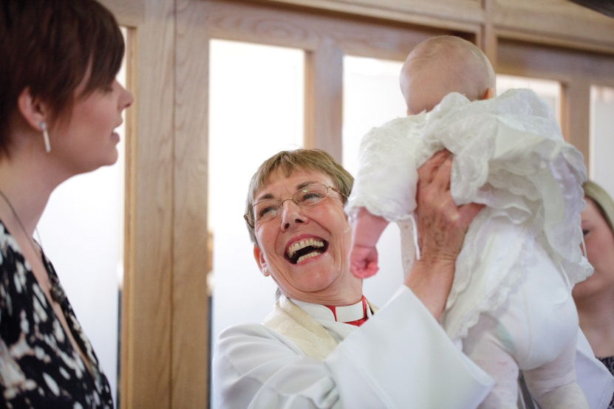
Setting the scene:
“Vicar makes a difference... their character... Such good atmosphere yet still doing their job”
“The vicar was a lovely lady... She made other parents feel comfortable in church”
“…they allowed us to have him christened there which honestly meant the world to us: it was such a very special day making my son safe in God’s arms”
Notes:
Welcome and warmth are key elements to the day and the tone is set by the vicar, who is really important in making families experience the day as special and significant. The quotes show that sometimes people are surprised by the warmth, and how important children and guests are to the day. The use of word ‘allowed’ is interesting: we are often in the position of being able to make a day part of a family’s story and helping them to have a positive experience of God and God’s people.

Slide 49

Guests matter
Celebration and party
Family and belonging
Encourage guests to ‘light a candle’
Hand out at the door
200,000 contacts
Notes:
A reminder of the importance of guests. They are friends and family, so they need to be respected and involved. One of the ways of involving people is through prayer. The special bookmark, which can be customized with any information or message such as church details, is designed to be handed out to guests as they leave. It invites them to pray for the child by lighting a candle on line if they wish. NB if it is left in the pew, it will be left in the pew! It needs to be introduced as something special to do during the service and placed in hands… Also if possible join in the party.

Slide 50
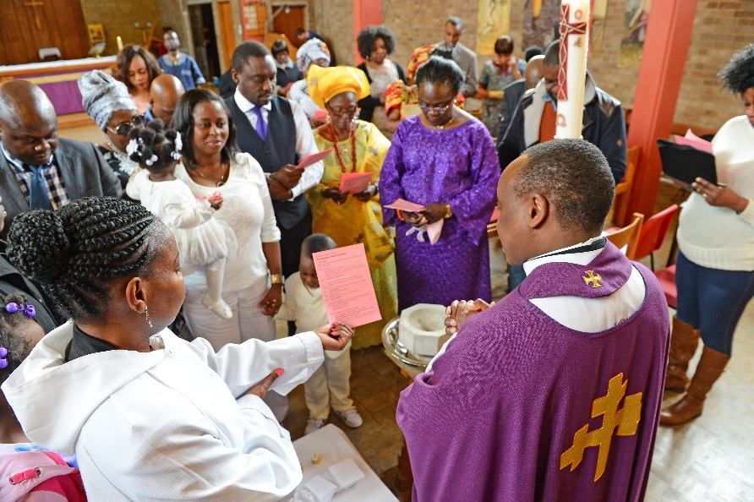
Loving liturgy
Gathering: creating community
Telling the story: relevant words
Doing the baptism: actions and symbols
Responding: prayers without words
Going out to live with joy
⋟
Notes:
Optional slide: a simple look at the shape of the liturgy, which is essentially an all-age worship service. Talk about how the opening creates a sense of community and belonging to that day, warmth and informality, celebration and joy are important. Telling the story, both reading of scripture and any talk/sermon grounded in the experience of people’s lives, linking events from long ago to today. One example might be from the 2012 Olympics when the father of Olympic swimming champion Chad le Close was interviewed by Clare Balding and simply said : “that’s my boy, my beautiful boy.” Link to God’s words about Jesus at baptism and God’s words to every child as he looks on them with love and delight.
The baptism itself – make the most of actions and symbols, using movement where possible to echo the liturgy eg turning to repent, journeying to and from the font.
Responding in prayer – this can be one of the most engaging and creative times in the service. Check out the churchsupporthub for ideas. Share one or two on the day eg Hand everyone a luggage tag. Invite them to write their name on one side, then hold it and pray for the child. Collect them in and place them in a box as a reminder of all those who prayed that day.
End the service on a note of celebration and joy.. Balloons are always a good sign of a party mood!

Slide 51
Part 4: follow up and the people of God
The baptism day is just a beginning
The importance of other people
Invitation, response and obstacles
Involving the whole church
What next?
Notes:
This section could be used alone for a general discussion or to introduce any of the other sections, or as the start of the whole presentation. It is the most visionary.

Slide 52

“the building blocks of faith”
Notes:
Use this clip to listen to clergy talking about baptism ministry, and in particular the link to the future and the journey ahead.

Slide 53
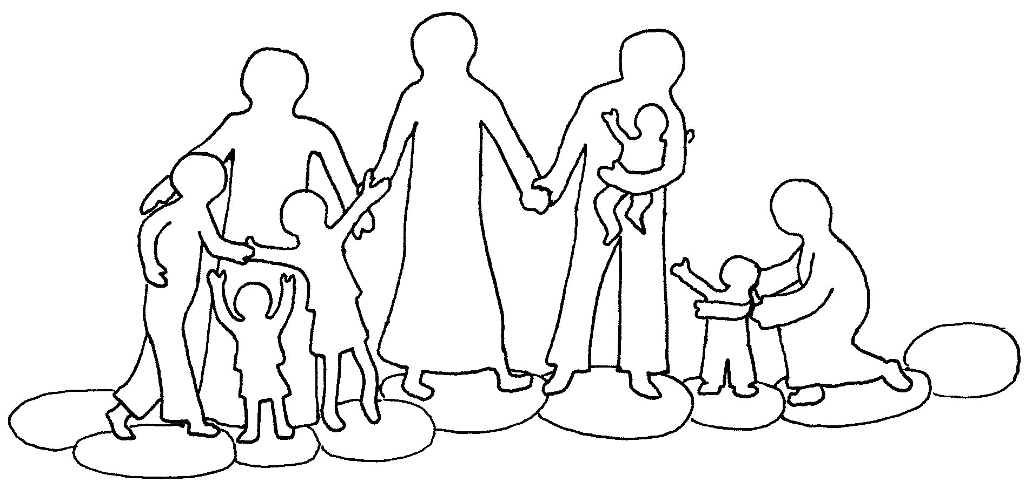
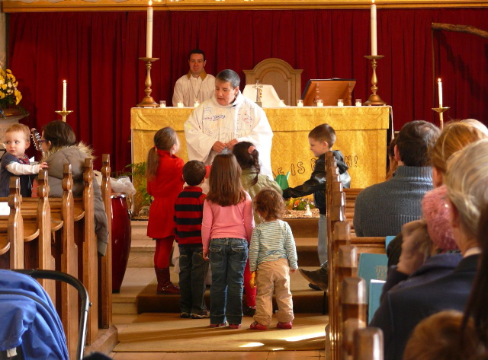

Others matter
“They talk about them and everybody claps and that’s really lovely”
“A photograph of our daughter.. was displayed on the notice board for a month so that people from the church could pray for her”
Party matters
Notes:
One of the most important things is to help families meet other people – it makes a real difference to their experience. Sometimes that means inviting them to return to a service where they receive a certificate and a welcome, and the experience is the research was that if this is also made to feel special and important it makes an impact. Simple things like being welcomed by name, applause, special cakes being made, all help to integrate this into the baptism. Then parents talk to other parents about how good it was.
Another idea here – although check on permissions and privacy – is to encourage prayer. Many churches routinely include those who have been bereaved for a month or so, and then again at the first and sometimes subsequent anniversaries, but we rarely include the names of the baptised after the day itself. Going to the party, or coming to the service, isn’t just the work of the vicar.
Young families like to meet others and be part of a cohort going through the same experience – often friends made through something like NCT groups last a lifetime – and helping parents to meet othes whether at church or at preparation can be really helpful.

Slide 54
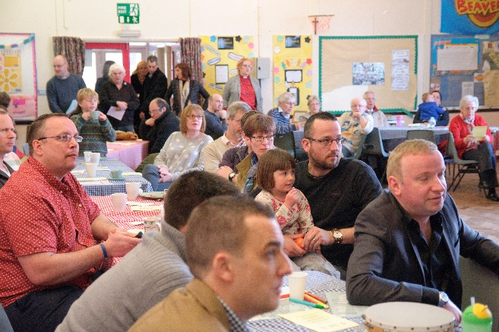
Wanted and informed
Fewer than 1 in 10 didn’t want to keep in touch
2/3 of those who came back expected the church to keep in touch
Christmas, Harvest, fete all important
Real mail and social media matter
“I would have liked to have gone to the harvest festival to be honest, but we haven’t had any information through about it.”
Notes:
One of the most significant findings across all the research is that those who have had some contact with us are very receptive to further contact. And this contact is key to engaging people on a journey and involving them in church. More than 90% of respondents said they would like the church to keep in touch – and those who expect this to happen are more likely to return.
The key events that they return for are Christmas, Harvest festival and perhaps a family friendly fete. Intentionally inviting to these events is important, and using both real mail and social media is also crucial.
Today organisations that we have contact with regularly contact us with emails of information. The onus is on us to decide if we don’t want to be in touch, and whether we are actively involved or not they keep sending us the information. It can take a long time from first contact to second and then full involvement - tell a story from your experience to illustrate this. But it doesn’t mean you aren’t interested. Think about how you keep contact with baptism families and how you publicise events, remembering that people need to have opportunities to see a message around 7 times, which will include Facebook etc.

Slide 55

Follow up and follow up
Families want the church to keep in touch
“I don’t think I’ve heard from them since the christening... It would have been nice to have a little reminder they are still there.”
“I felt I had been invited to church so
could now go on a Sunday and
people would accept me”
Help for the journey
“it has made me think more,
trying to teach her values”
Notes:
This is so important it needs reinforcing – 9 out of 10 want to keep in touch but only 3 in 10 have any expectation that we will. At a very basic level we need people to come to church to discover what it is like and only around 1 in 6 respondents felt they had been encouraged to come to church. Invitation is very important and keep on inviting. Many churches send anniversary cards for one or two years, but stop just as the child would be starting school. Starting school or nursery is a stage when families may well engage with family friendly activities again, and it’s a time when they need prayer and support.
Families also wanted church to offer some practical help – things like how to pray, what bible stories to read, and how to pass on values and help a child make good choices.
The invitation is available and can be customized with church details – can use it in the first months after the baptism, and new designgs will be added for future use. Buy on the print hub.

Slide 56
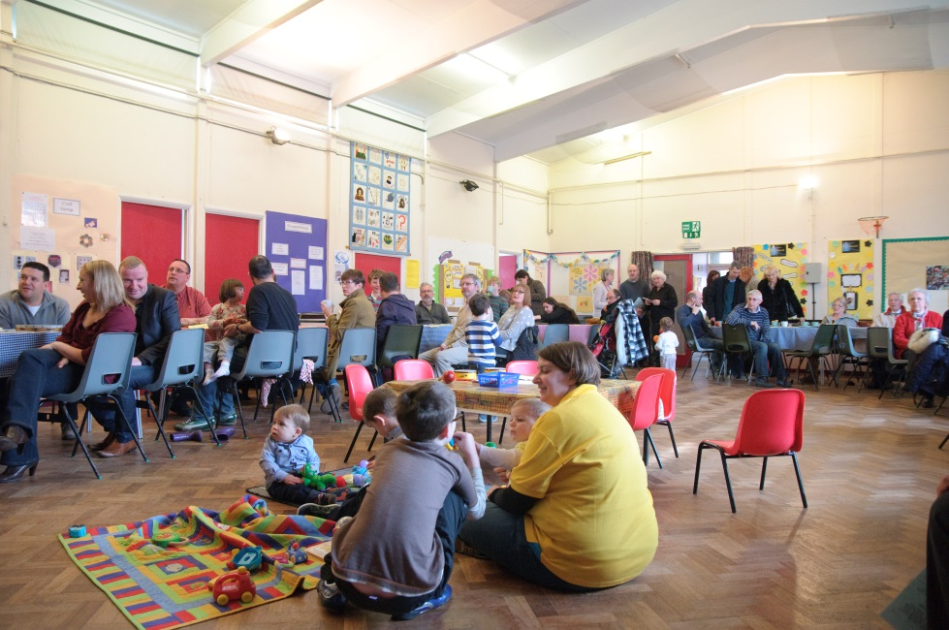
What stops them?
Don’t know what is happening
Not small child friendly
Not a good use of precious time
Will come when they are older
“We always have good intentions of going to church but somehow life just seems to take over.. Which is quite sad.. As I do feel its and important part of their lives. The church didn’t keep in touch with us either.”
Notes:
There is such a lot to explore about why young families find it challenging to come back to church. But the top reasons given include the lack of information, and then the perception that church is not small-child friendly. Family life is often pressured and the challenge of children and church may not seem like a good use of time, and many suggest they will come when they are older. SO it is important to keep the flow of information and invitation going.
It also means thinking about how your church is going to be welcoming to families, which may mean re-thinking areas like a children’s corner so it is of high quality, giving opportunity for awe and wonder in the midst of play. It may mean more smiling and lots of reassurance to those who bring lively toddlers, and it may mean developing opportunities like Messy Church. Quote reinforces the idea that there can be a gap between intention and action, a gap that may get wider if we don’t keep in touch.

Slide 57

All on board
It’s a ministry of the whole people of God
Get the regulars praying
Help them to welcome families
Notes:
One of the key ways of involving the whole congregation is prayer – prayer is a relationship, and once we pray for people attitudes begin to change. One of the pilot parishes tells of a complete change of attitude amongst those who would stay away if a baptism was taking place on Sunday morning. Now they are making gifts, praying for a child by name, and wanting to be sure they can be there on the day. This card is to be taken away and act as a reminder to the congregation that they are part of the baptism journey of the families whom we meet.

Slide 58
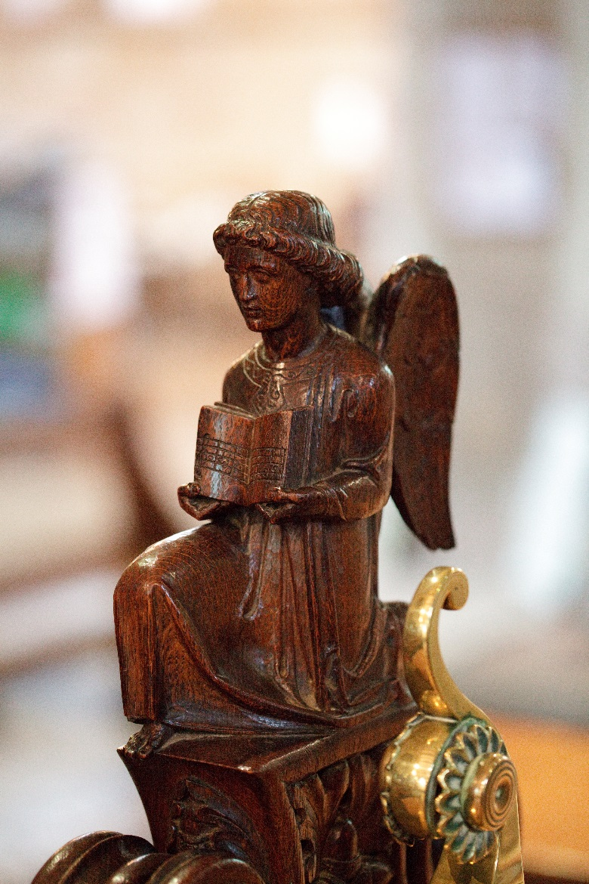
Coming soon
Certificates
Anniversary cards
Thanksgiving leaflet
Notes:
New items are being added to the print hub – encourage people to sign up on the churchsupporthub for a newsletter so that they get information when these items become available.

Slide 59
Core messages
Language that connects
Parents are seriously motivated
Godparents really matter
Symbols speak louder than words
It’s about the whole people of God
Follow up, keep contact, make friends
Notes:
Reinforce core messages

Slide 60


It’s an amazing journey…
Notes:
End with amazing journey phrases and prayer.

Slide 61
Sandra Millar
Head of Projects and Developments
sandra.millar@churchofengland.org
Tom Pearson
Technical Project Manager
tom.pearson@churchofengland.org
Notes:
Contact details for us if needed

