Slide 1

WHAT IS A CHRISTENING?
ENJOY A CUPPA AND CHAT AS PEOPLE GATHER
Notes:
Speaker notes are held in the file ‘What is a Christening - Presentation notes.docx’

Slide 2
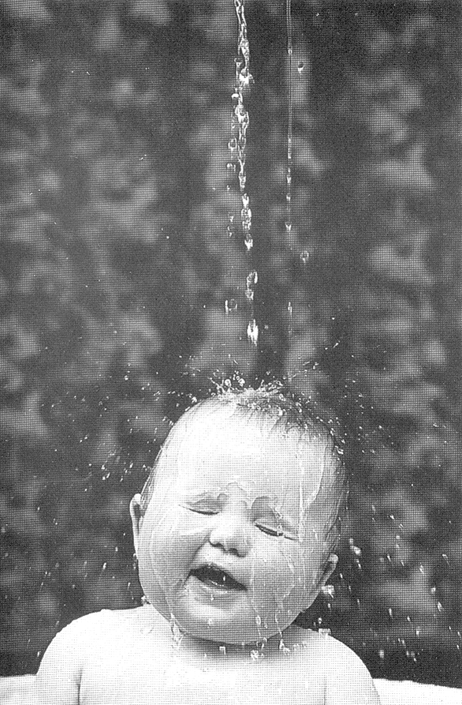
WHAT IS A CHRISTENING?
Your child will be baptised with water.
It’s the start of an amazing journey of faith for your child and a special day for all your friends and family.

Slide 3

QUIZ
What is the difference between Baptism and Christening?

Slide 4
Jesus was baptised in:
A church?
The temple?
The river?
The bath?

Slide 5
Who baptised Jesus?
The vicar?
The Pope?
John the Baptist?
Pontius Pilot?

Slide 6
How old do you have to be to be baptised?
Under 3 months?
Under 3 years?
Over 18?
Under 200?

Slide 7
What do you have to wear to be baptised?
Swimming costume?
White robes?
nothing?
anything?

Slide 8
What is a Christian name?
A name out of the bible?
A name the vicar gives you?
A first name given at birth or at christening?
Your full name?

Slide 9

Congratulations you’ve finished the quiz!

Slide 10
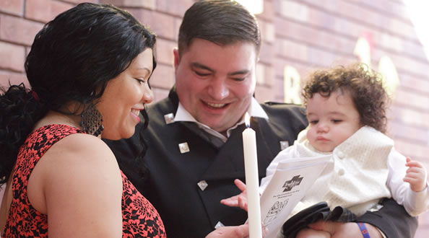
YOUR CHILD IS PRECIOUS TO YOU AND PRECIOUS TO GOD..

Slide 11

OVER THE YEARS TO COME, IT’S A JOURNEY YOU’LL SHARE TOGETHER WITH YOUR CHILD BY:
Being there for your child
Praying for your child
Showing them practically
Helping them to learn

Slide 12
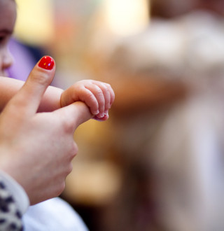
SO IT’S A COMMITMENT TO START AS YOU MEAN TO GO ON.

Slide 13
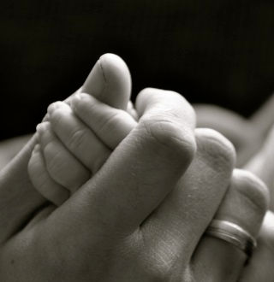
DISCOVERING PRAYER
THESE ARE SOME EASY WAYS TO BEGIN TO PRAY…...

Slide 14
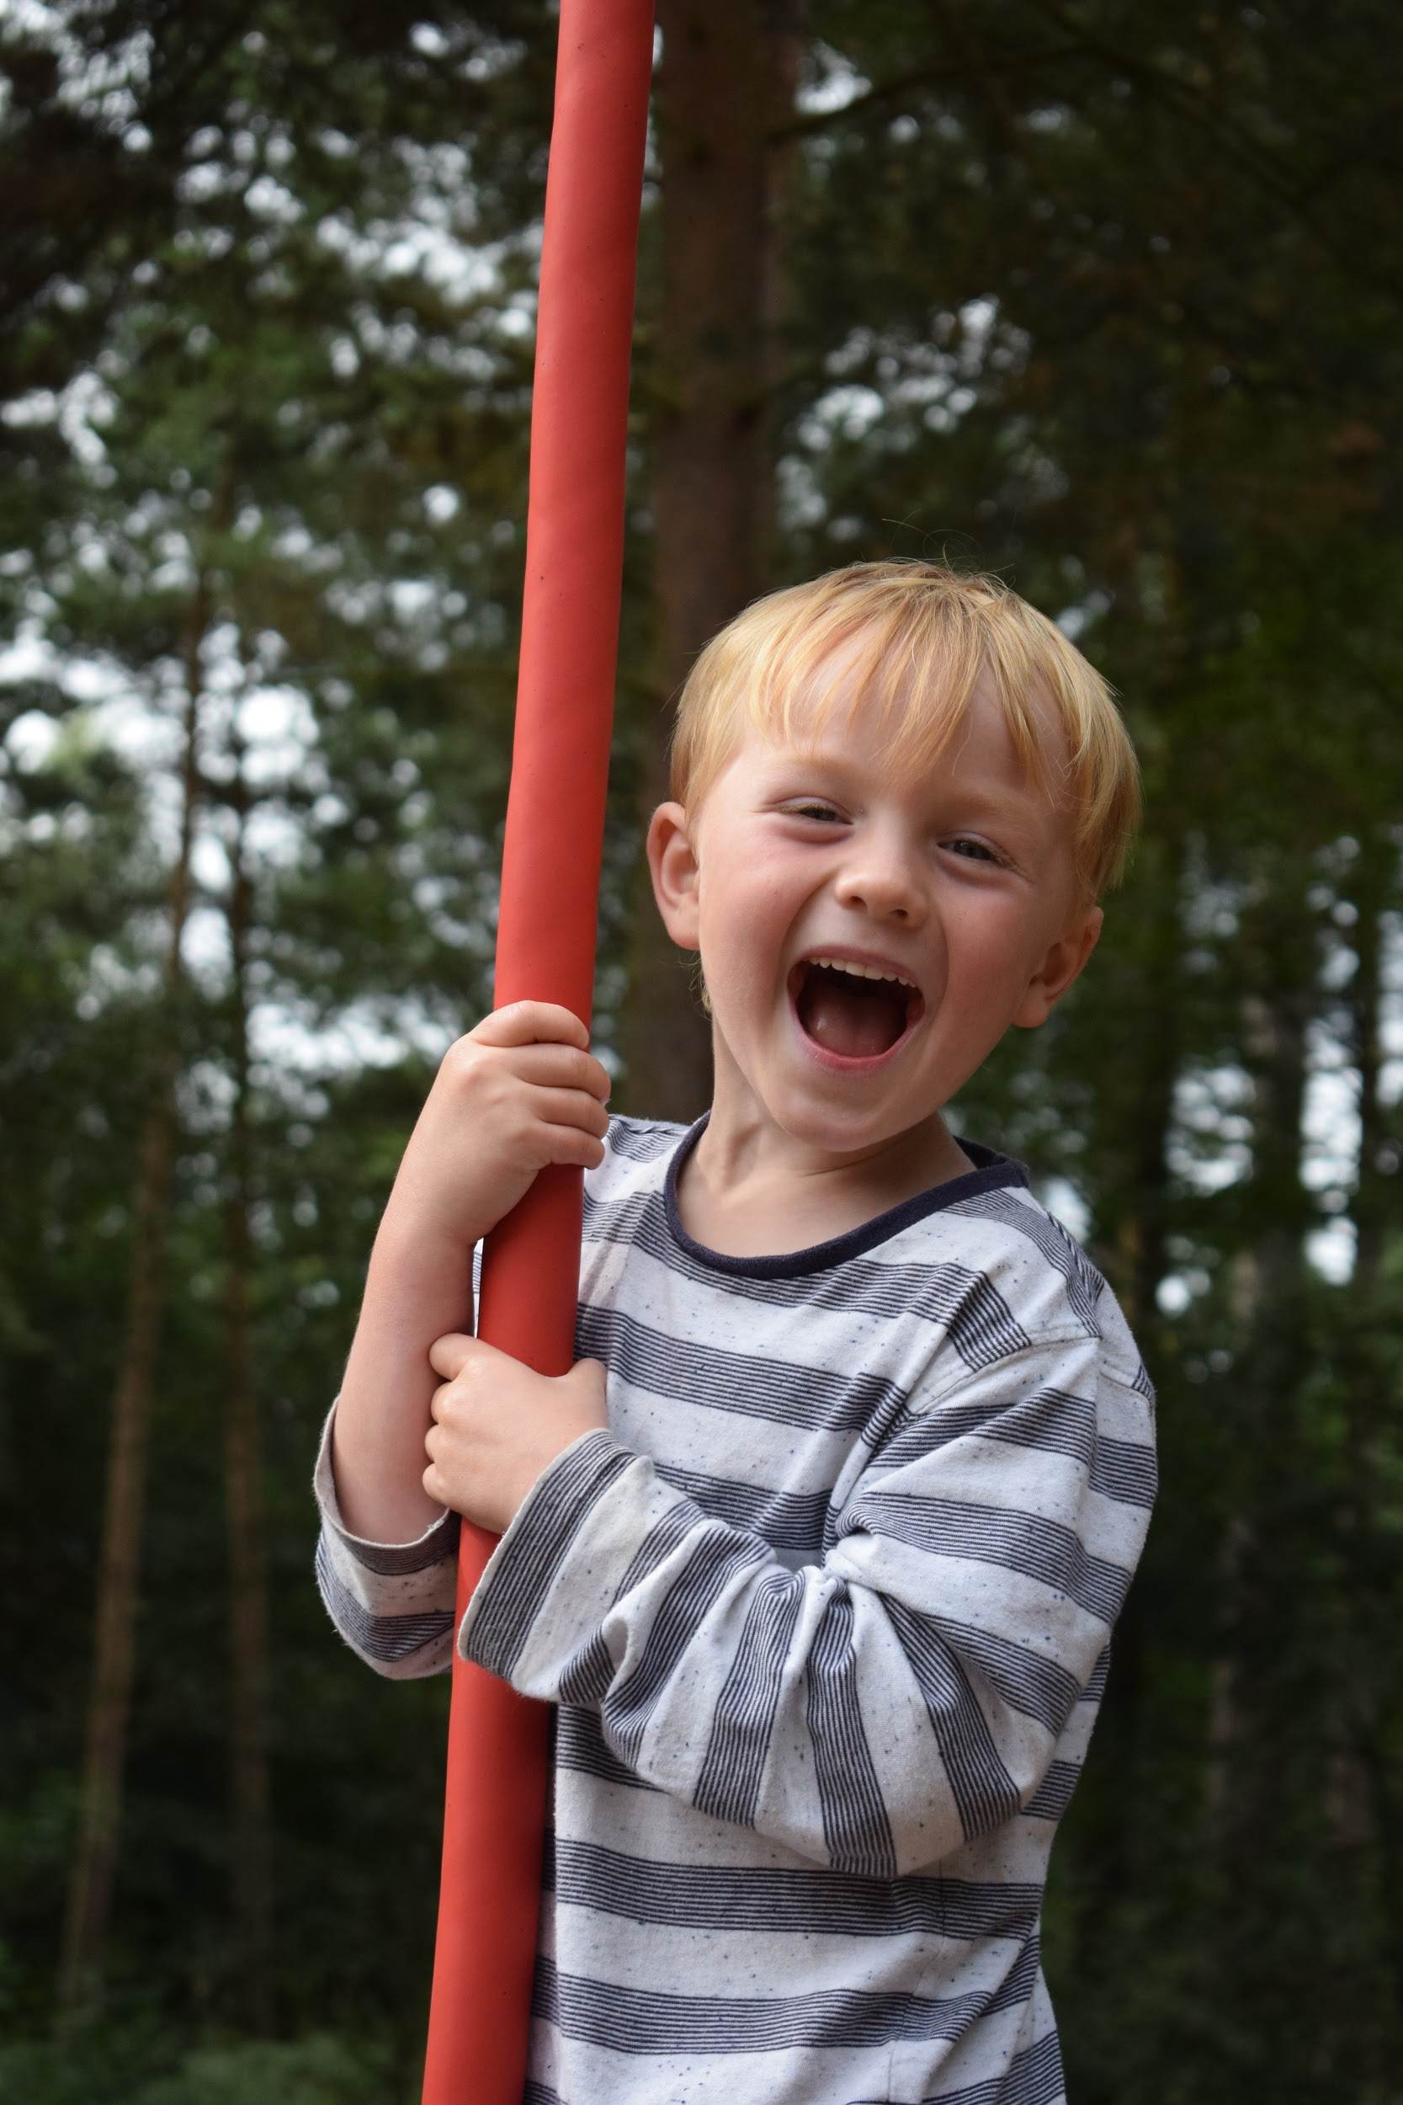
Hold or look at a photo

Slide 15

Light a candle

Slide 16

Talk to Jesus as a friend

Slide 17
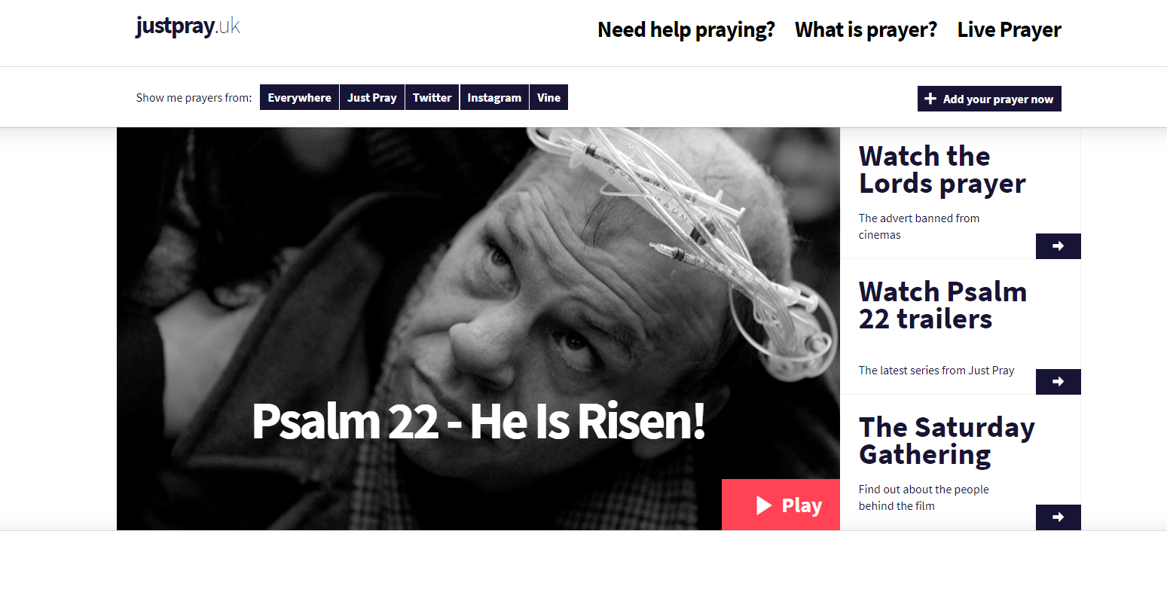
Try justpray.uk for more prayer help and inspiration, or to post prayers online.

Slide 18
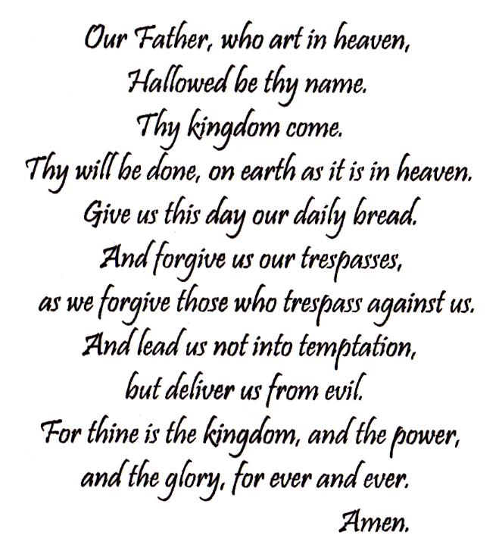
HELPING CHILDREN TO PRAY
Lord’s Prayer
Notes:
Separate out

Slide 19
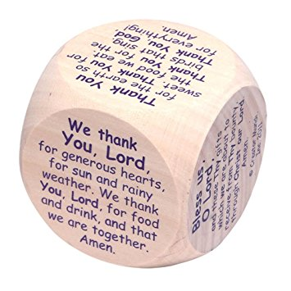
HELPING CHILDREN TO PRAY
Prayer cube

Slide 20
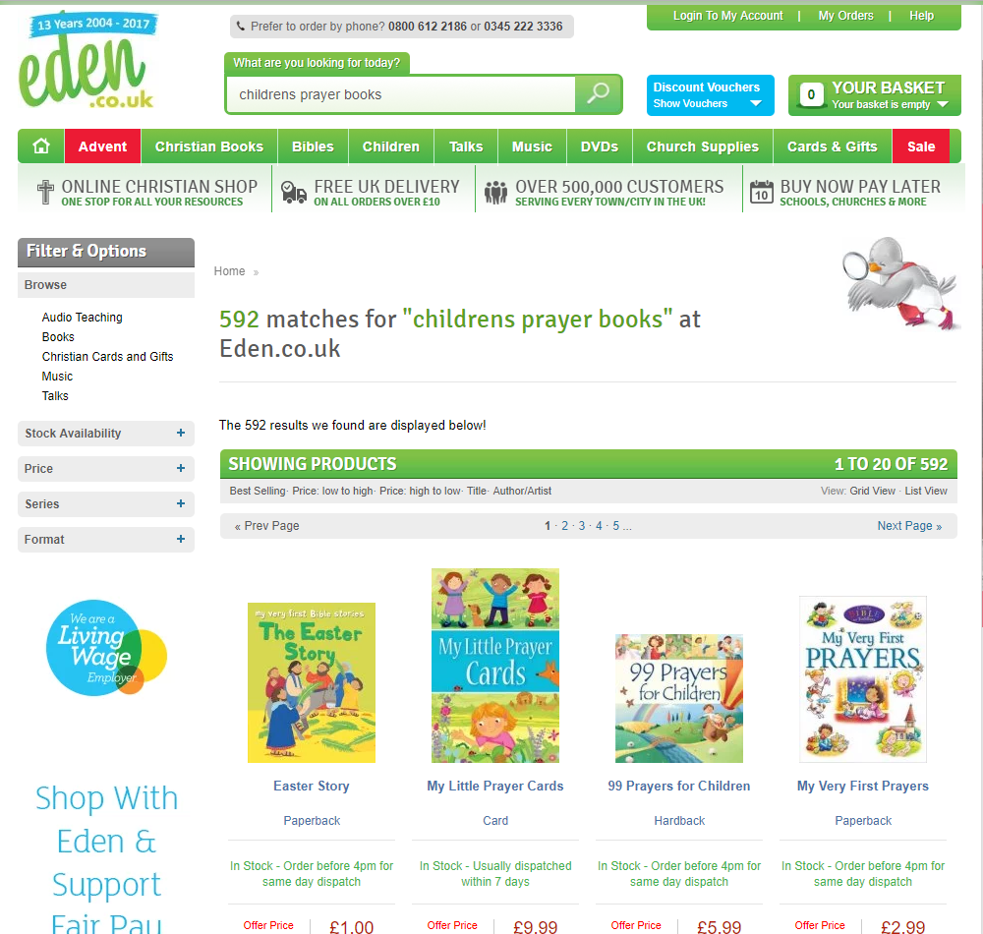
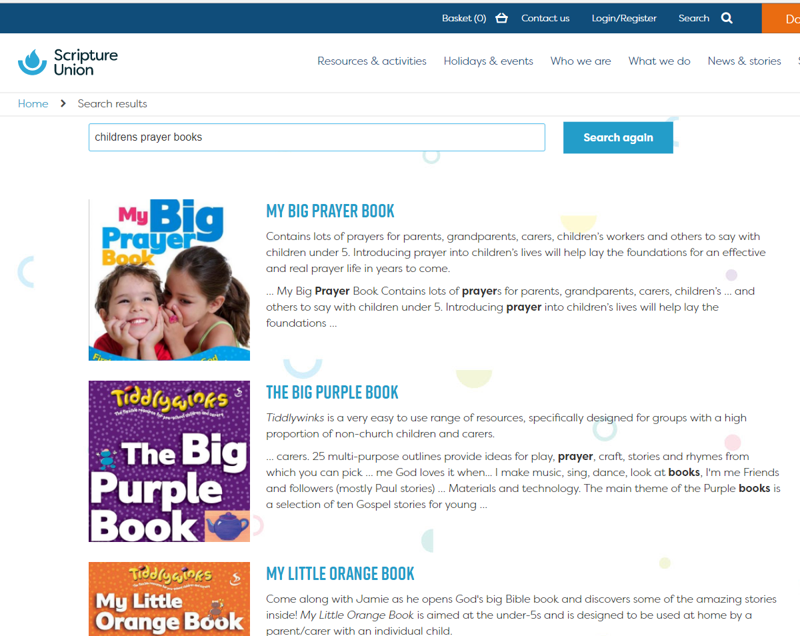
HELPING CHILDREN TO PRAY
Prayer Books
Giving them a prayer book to suit their age. There are many available; Eden and Scripture Union have a wide choice.
Notes:
Separate out

Slide 21



HELPING CHILDREN TO PRAY
Types of prayer
Notes:
Separate out

Slide 22
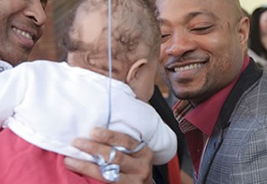
GODPARENTS
Give time
Model Christian values
Pray for your godchild
Demonstrate how to make good choices
Support learning more about the Christian faith

Slide 23
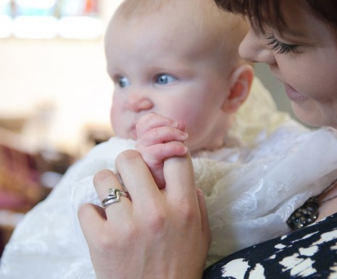
STEP BY STEP THROUGH THE SERVICE

Slide 24
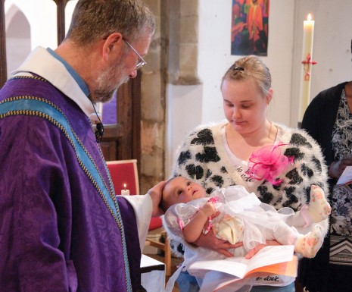
WELCOME

Slide 25

PRAYER AND BIBLE READING
Let us know if you would like to do a bible reading

Slide 26
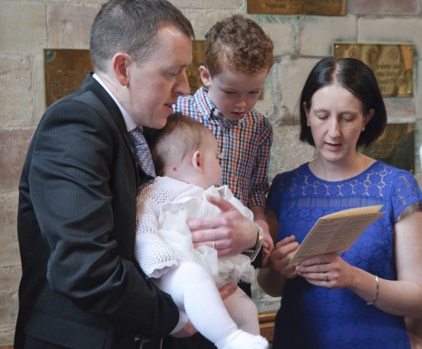
THE PROMISES

Slide 27
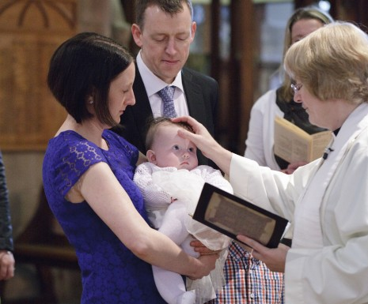
THE SIGN OF THE CROSS

Slide 28
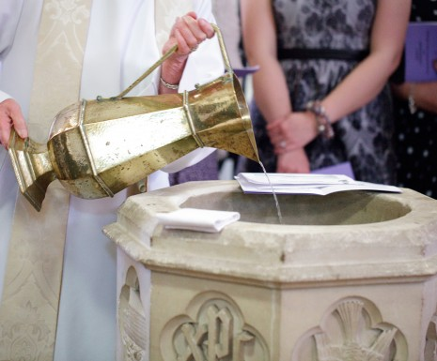
THE WATER
Notes:
Older child can pour the water

Slide 29
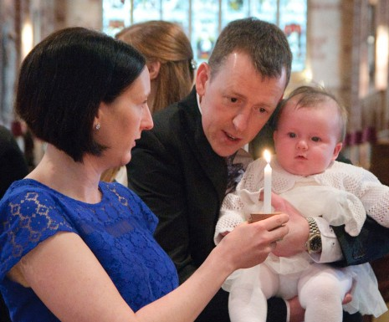
A CANDLE

Slide 30
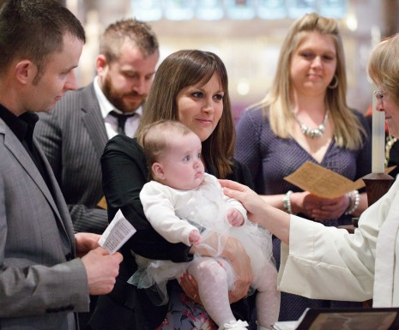
WELCOME AND PRAYERS

Slide 31
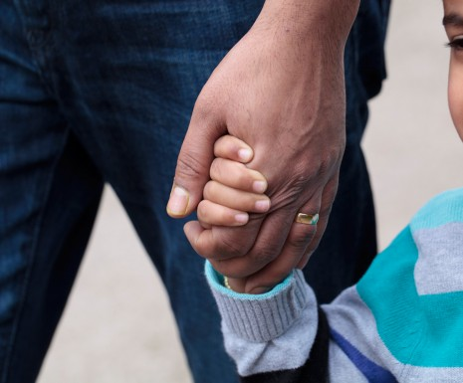
WHAT’S NEXT?

Slide 32
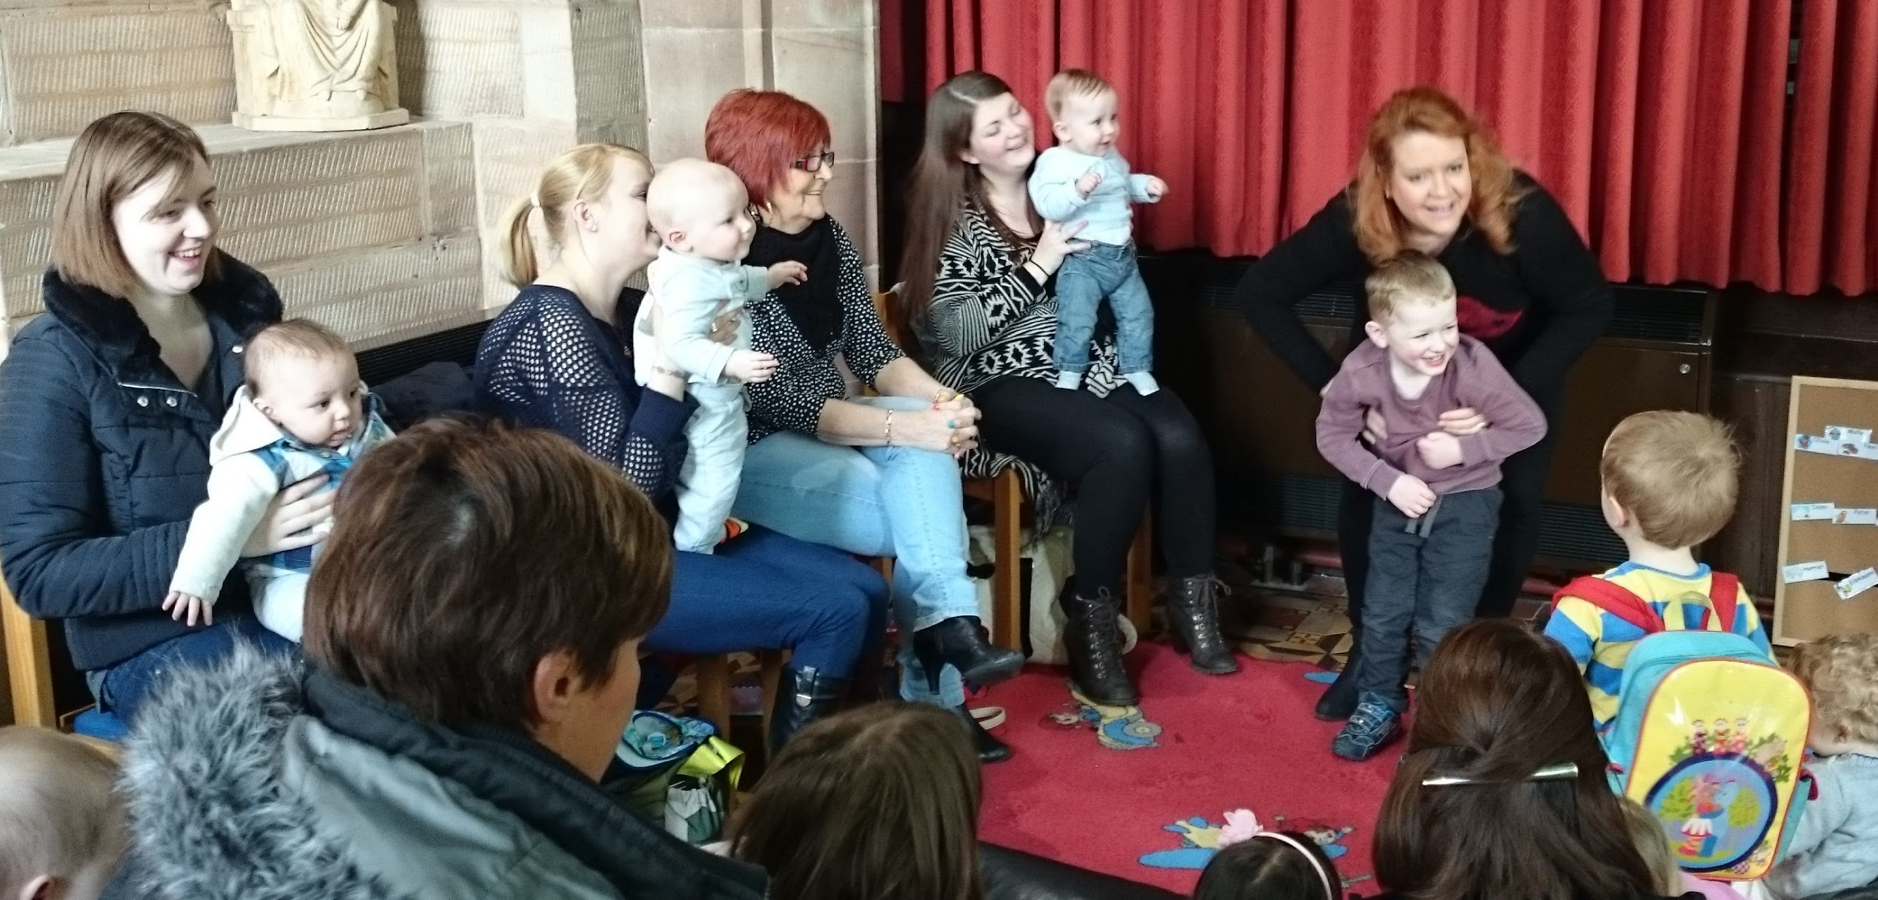
LITTLE FISHES
Is a lively social, fun group for babies, toddlers and pre-schoolers and their parents
Every Wednesday at 9:30am during term time.
Each session starts with a story, songs and prayers in the lady chapel followed by craft, a cuppa and time for a chat in the Brooke room
Every year we have the very special little fishes nativity

Slide 33

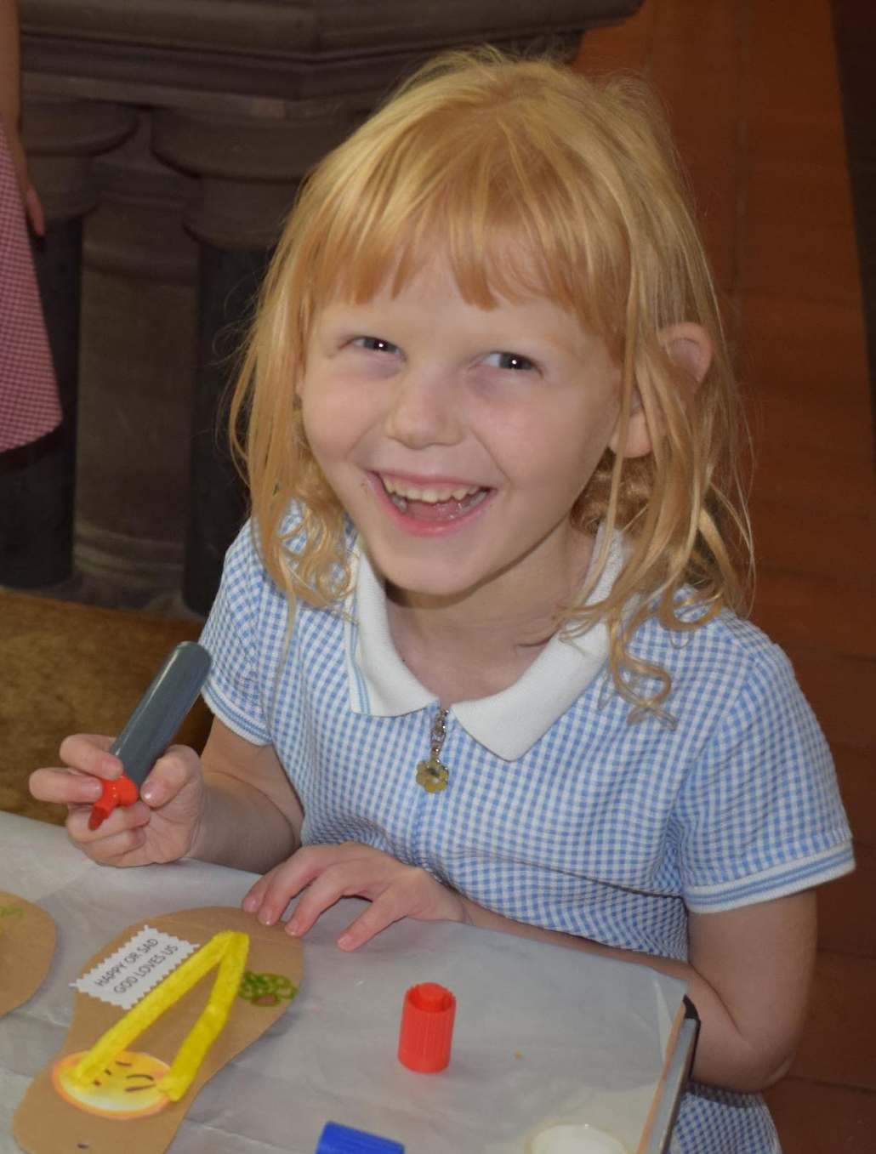
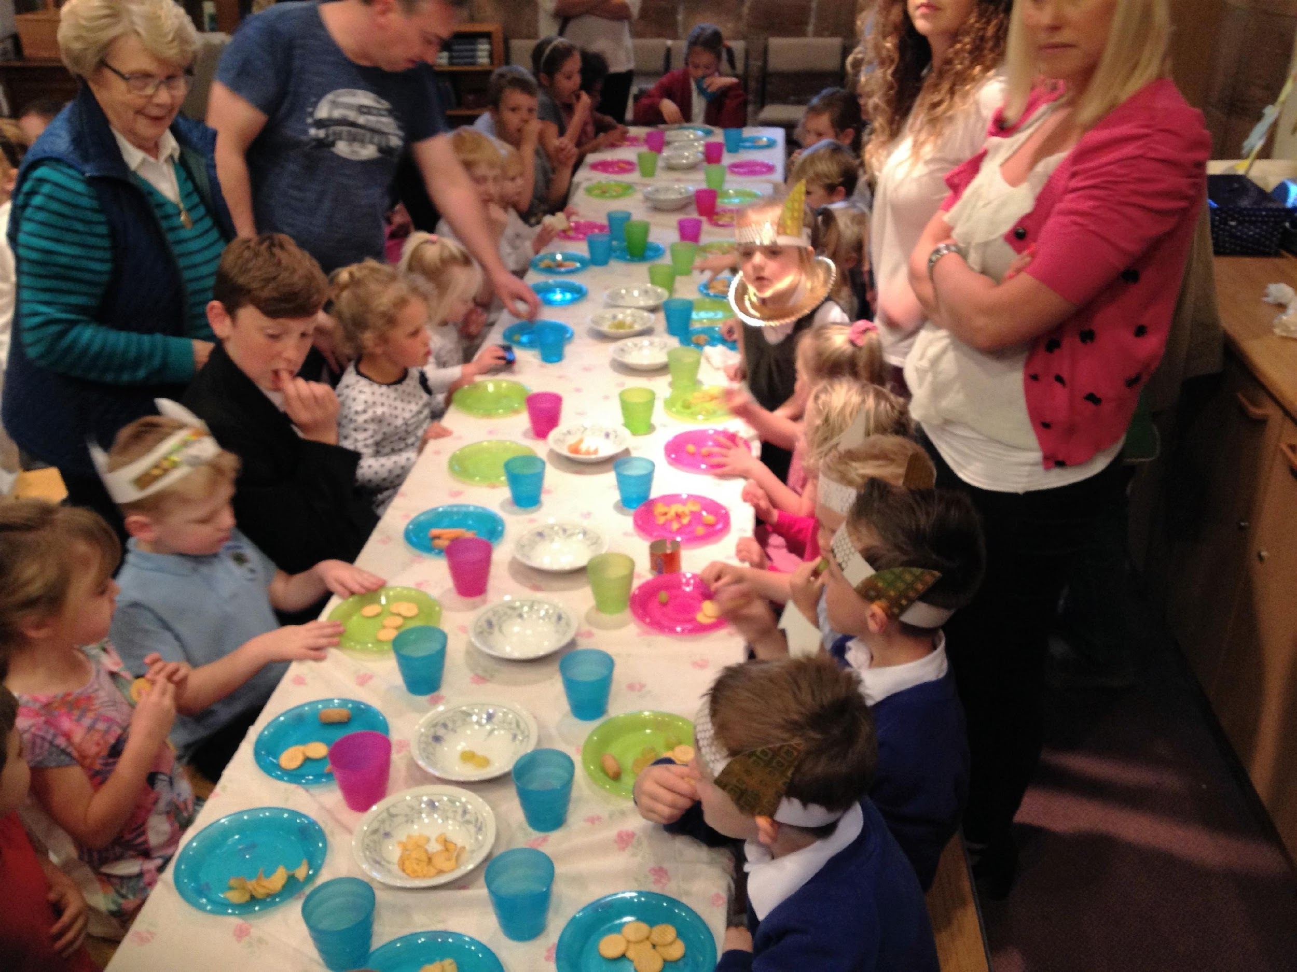
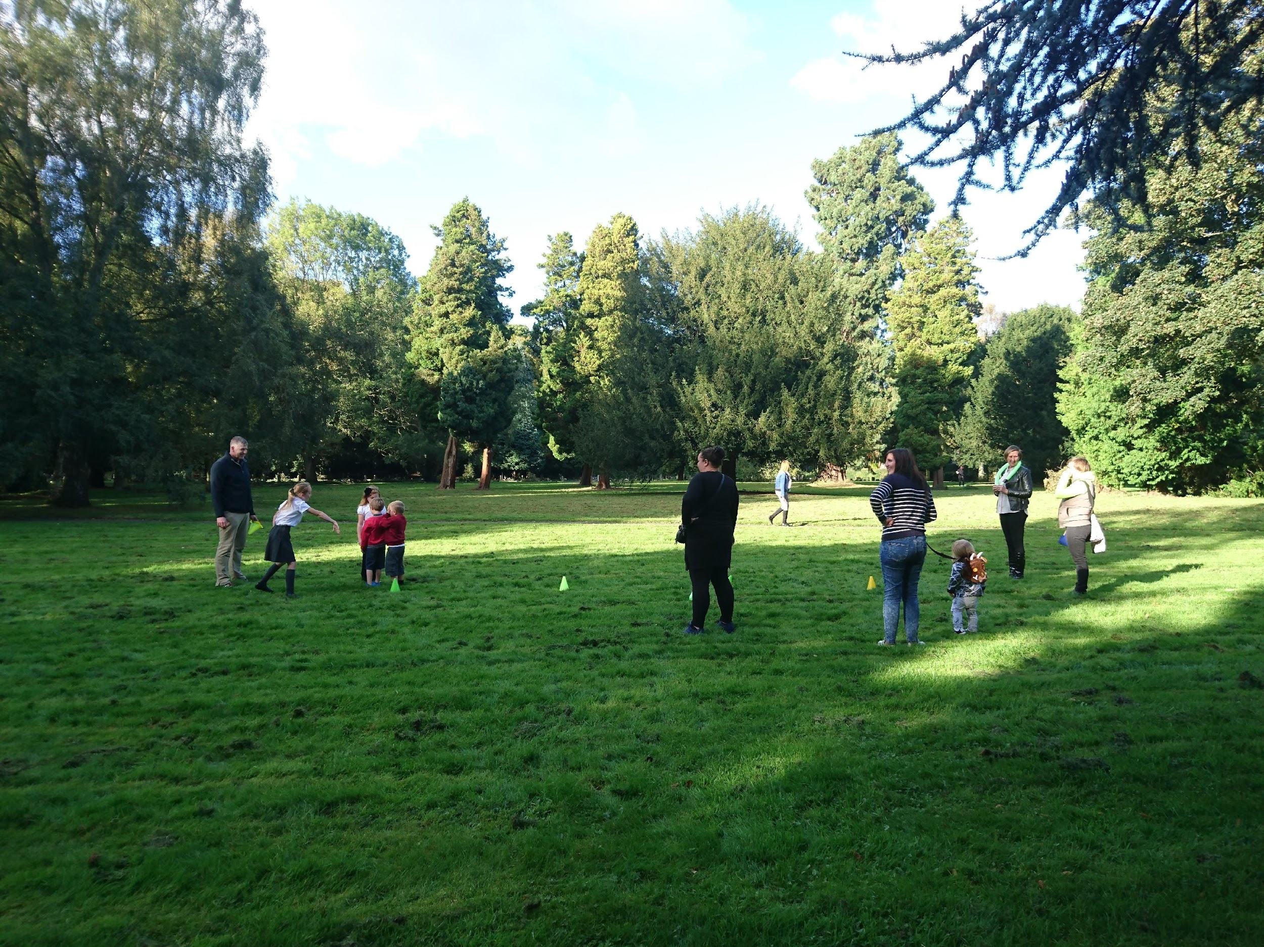
All ages
Once a half term on a Thursday after school.
We share stories, prayer and songs and families have fun doing the crafts and activities around the church – big art, cake decorating, challenges, messy play, treasure hunt, over 10s activities, lego …. and lots more!
We finish up with a tasty sit down tea
The highlight of the year is the Good Friday Messy church

Slide 34

YOUNG CHURCH
Every Sunday alongside the morning service
Children explore the theme of the service through stories, song, craft and activities.
Children get to share what they have learnt with the congregation towards the end of the service
Notes:
Big this up as it is a fantastic thing!

Slide 35
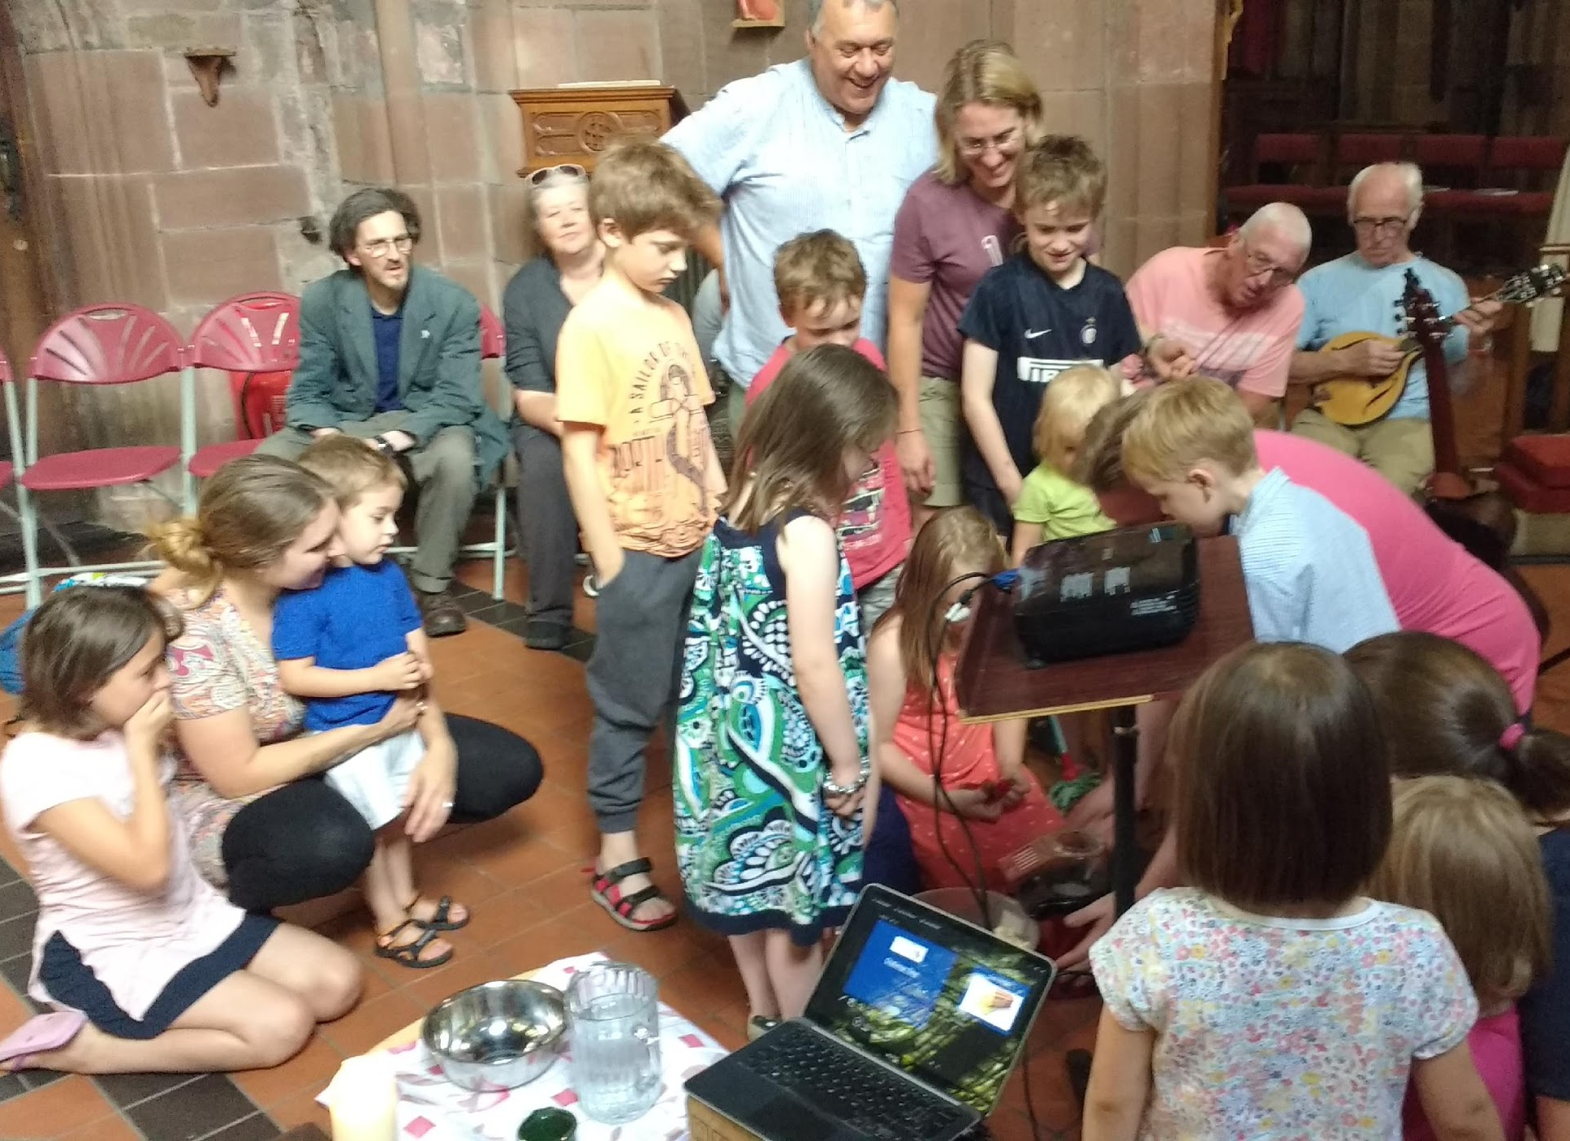

FAMILIES@FIVE
5pm every 2nd and 4th Sunday of the month
A relaxed, informal, short family service followed by a bring and share tea

Slide 36
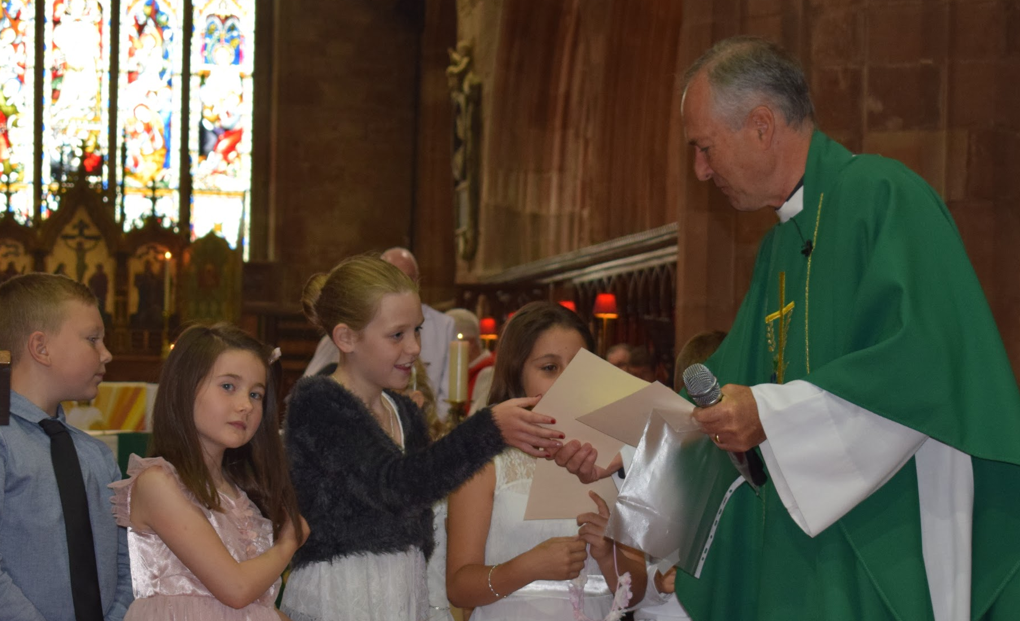
COMMUNION BEFORE CONFIRMATION
Children who are regularly coming to church can prepare for receiving holy communion when they are 8-9 years old (KS1 years 3 to 4).

Slide 37
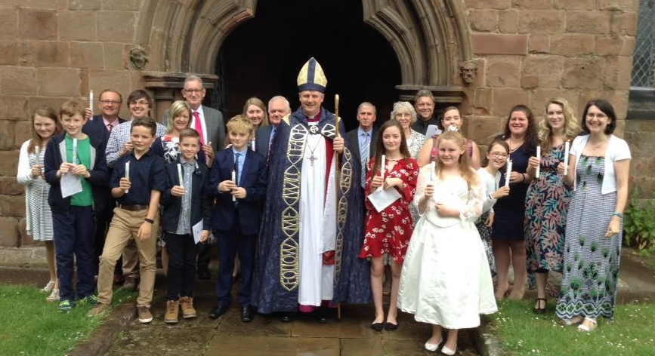
CONFIRMATION (year 6 and above)
From the age of 11 children can affirm the promises that were made on their behalf at baptism at a confirmation service.

Slide 38
Other ways to participate in church life
Join the choir
Become a server
Help at events e.g. summer fair, Christmas services, harvest supper
Offer your services or expertise!
Notes:
Any more?

Slide 39


