Slide 1

The
Church Development Tool
Communication pack for dioceses

Slide 2
Contents
Background .................................................................................................................. 3
What is The Church Development Tool? ..................................................................... 4
What will the CDT tell you about your churches ..………………………………………………….. 5
Why is The Church Development Tool important? ..................................................... 6
How could the Church Development Tool work in your diocese? .............................. 7
How do churches sign up? …………………………………………………………………………………….. 8
Developing the CDT into the future ............................................................................ 9
Contact details .............................................................................................................10

Slide 3
Background
In 2020 we were due to launch The Big Church Survey.
We listened to church leaders who said that due to the pandemic we should postpone the launch.
We were then able to reflect and make amendments to The Big Church Survey to ensure that the tool was as helpful as possible for churches and dioceses, and aligned to the vision and strategy.
So, we did the following:
  Change of name to The Church Development Tool
  Made the tool accessible via A Church Near You
  Worked on a follow-up resource for churches based around From Evidence to Action

Slide 4
What is The Church Development Tool?
The Church Development Tool is...
Part of a suite of resources designed to help churches reflect and plan for the future.
An opportunity for churches to understand how their congregations are living out their faith in their everyday life and how church leaders can help support their congregations in their individual faith journeys
A way for churches and dioceses to be part of a bigger conversation around how we become a Church of missionary disciples, younger and more diverse, where mixed ecology is the norm.

Slide 5
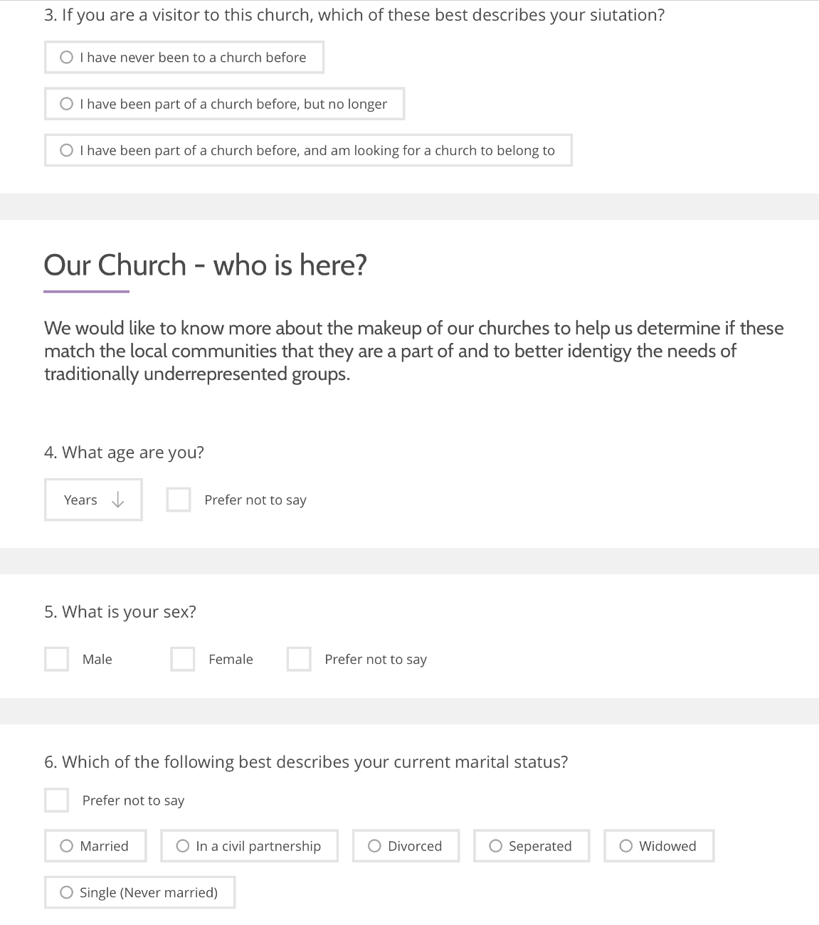
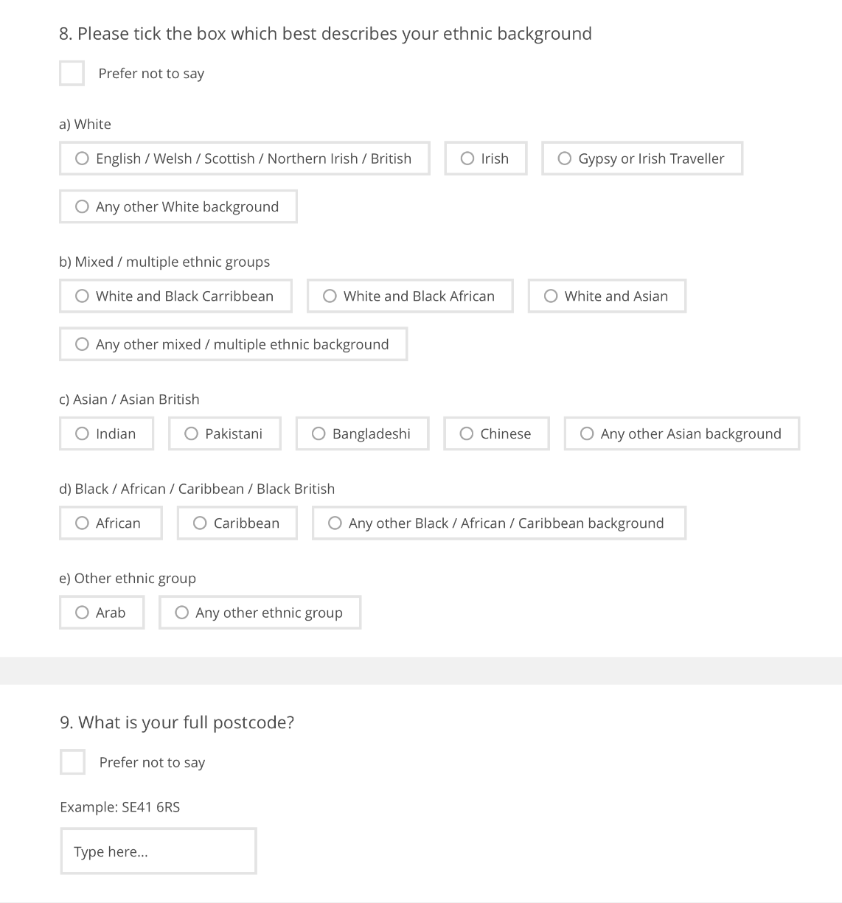
What will the CDT tell you about your churches?
Age
Ethnicity
Postcode
Lay ministry
Gender
Living arrangements
Discipleship
Marital status

Slide 6
Why is the Church Development Tool important?
It is our hope that the Church Development Tool and resources will make planning for a post-pandemic future a little bit easier as it will provide:
1. Detailed data on the demographic mix of each participating church
2. Previously unavailable information on the discipleship journey of the congregation
3. Links to resources including From Evidence to Action to help church leaders respond to this learning

Slide 7
How could the Church Development Tool work in your diocese?
2.
Enable data-rich discussions about priorities and resource allocation
3.
Allow dioceses to measure progress
4.
Contribute to the shaping of strategy at every level
5.
Diocesan leadership encouraging participation
1.
Support diocesan vision and priorities

Slide 8
How do churches sign up?
The survey is completely anonymous and can be completed online in 10 minutes. It has been purposefully designed to be as straight forward and simple as possible, so lots of tick boxes! Below are the basics steps needed to successfully set up the survey in a church.
Step 1
Step 2
Step 3
Step 4
Step 5
Their registration will then be authorised by existing ACNY editor
Church champion then finds their church on ACNY
Click on ‘edit this church’ and register
Once authorised they will be able to access the CDT
Identify a church champion for a church

Slide 9
Developing the CDT into the future
2021 a ‘soft launch’ which will allow improvements for 2022
Ideally used in same churches every year or so to track progress
Children and youth aspect will receive further refinement post-2021
Additionally follow-up resources added to Church Support Hub
Ties with broader conversation about what we measure going forward

Slide 10
Contact details
If you would like to know more about the Church Development Tool then please contact either
Charlotte Sibtain
charlotte.Sibtain@churchofengland.org
The Revd. Dr Stephen Hance
stephen.hance@churchofengland.org

