Slide 1


Slide 2
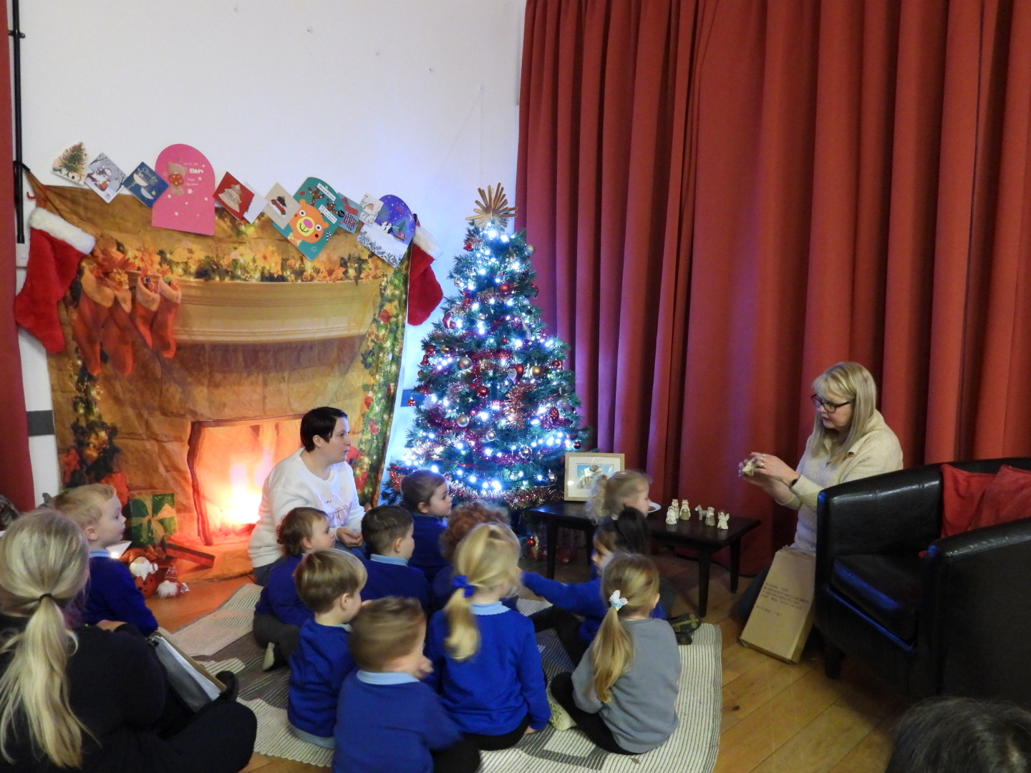
Zone 1: Christmas Present

Slide 3
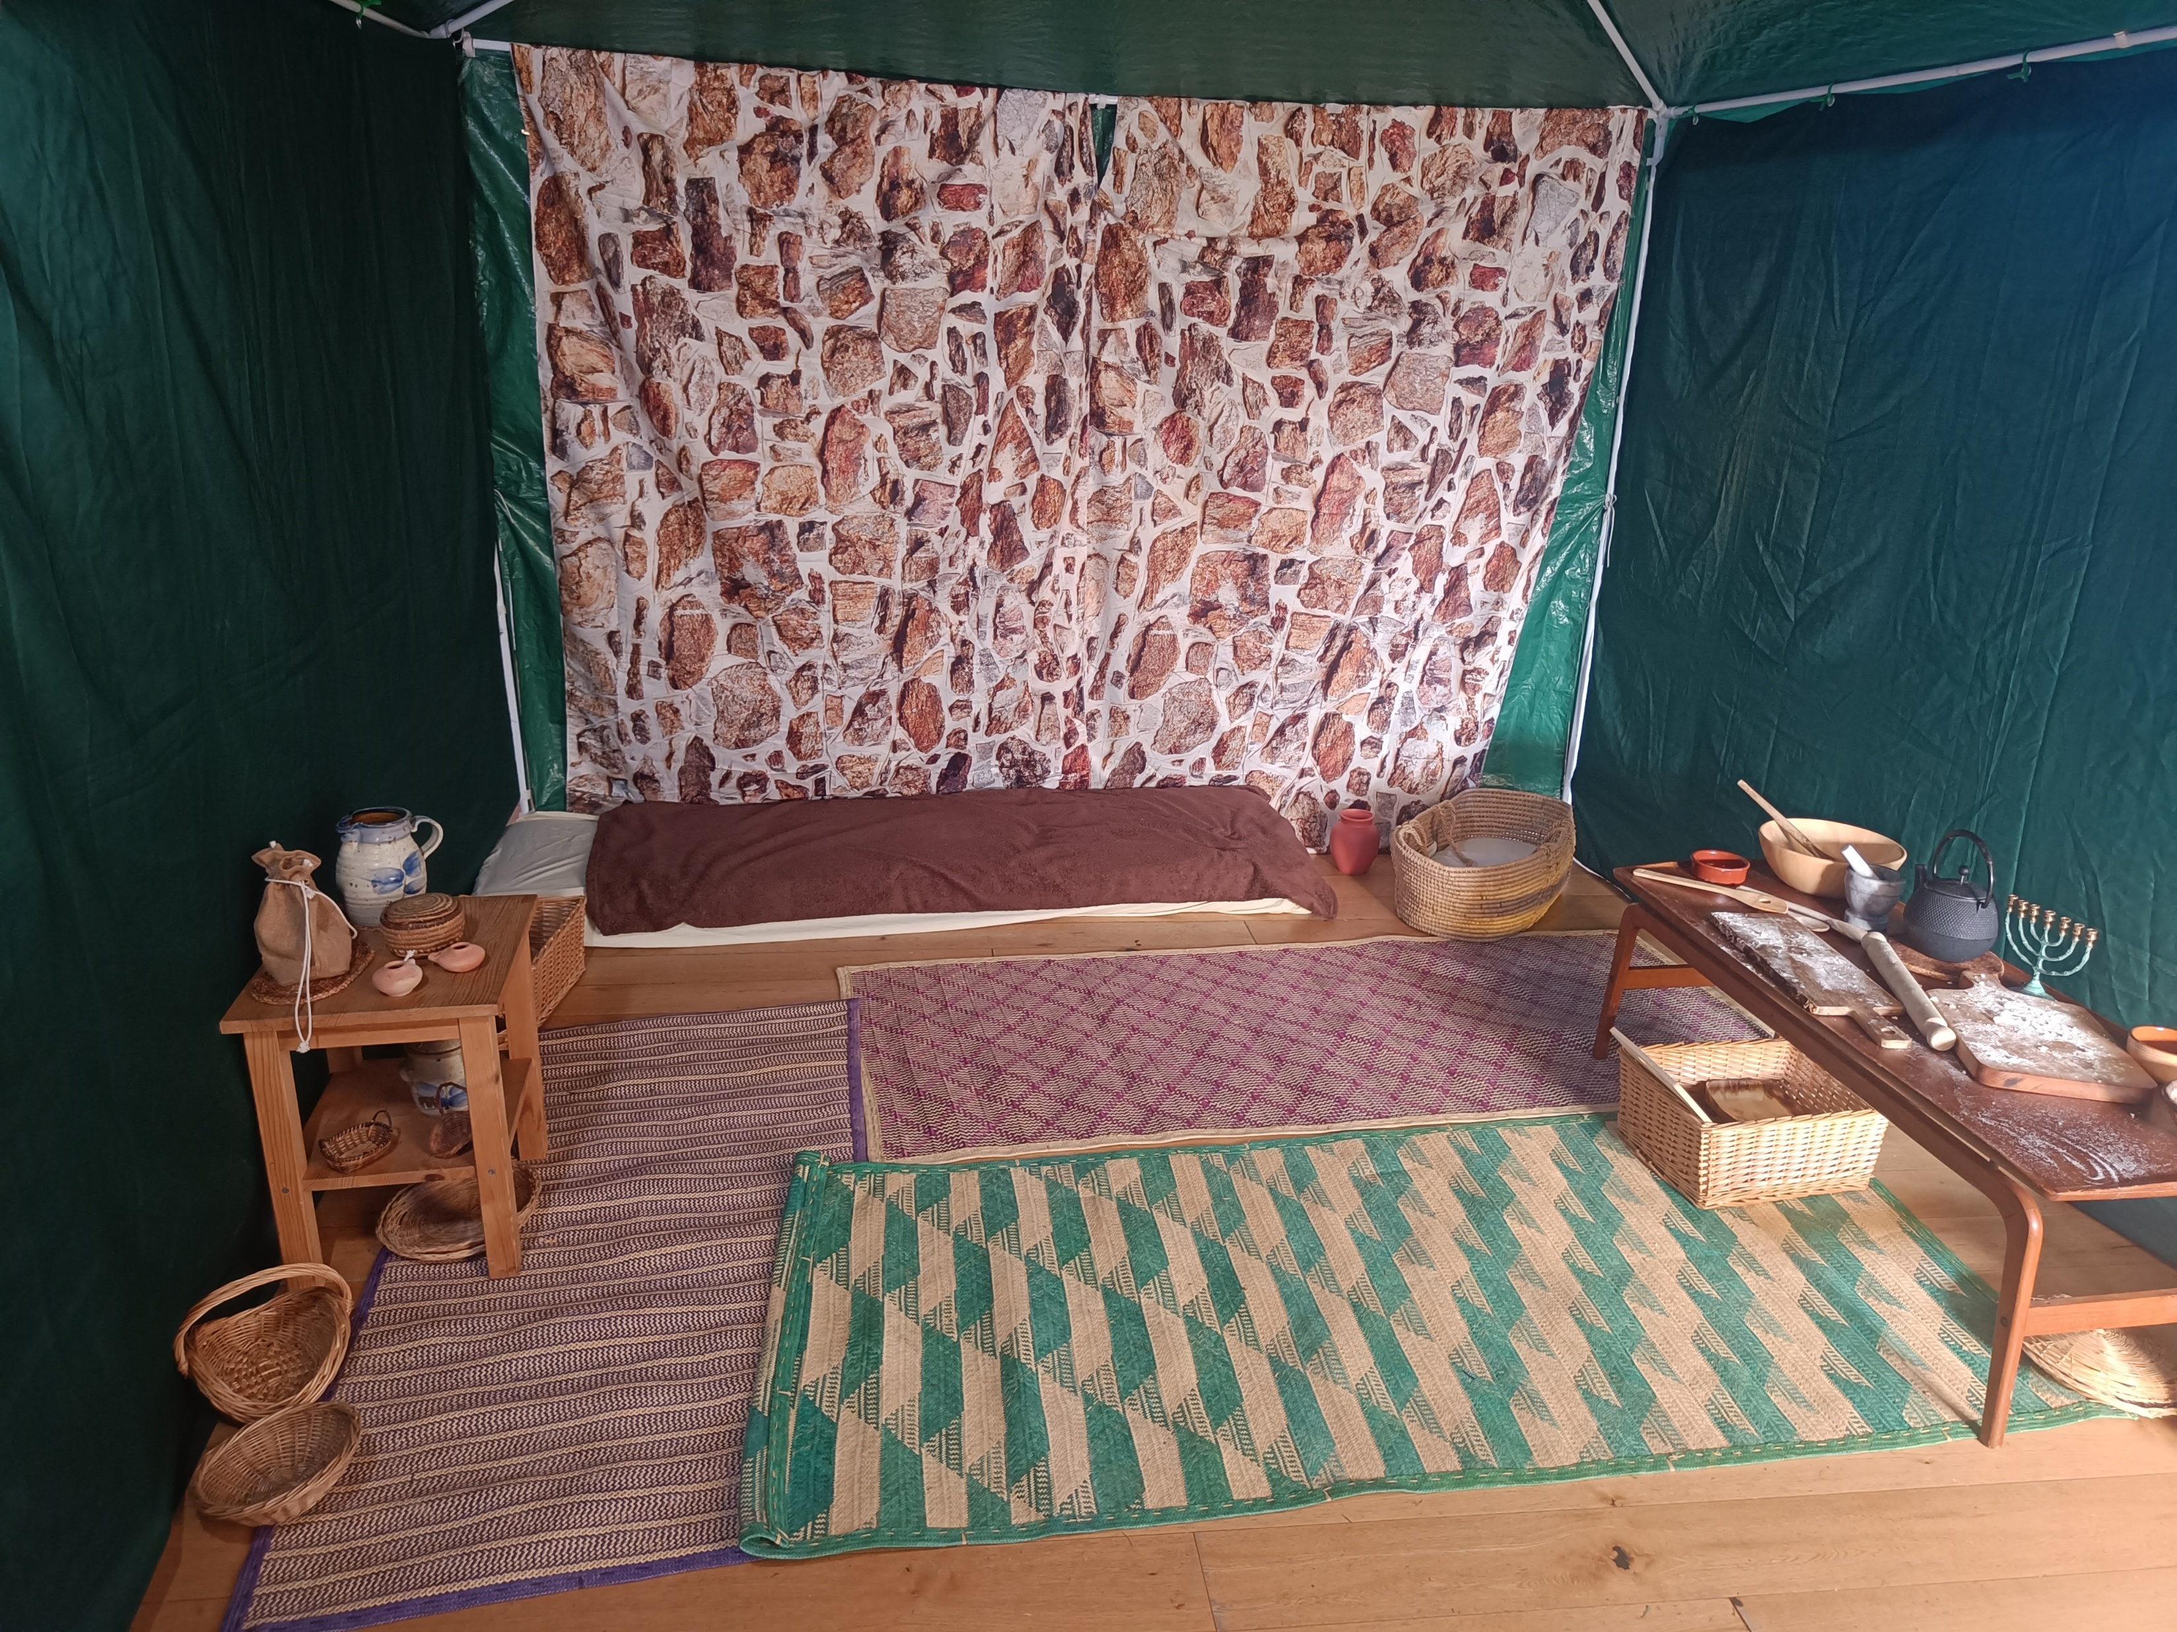
Zone 2: Mary’s House

Slide 4
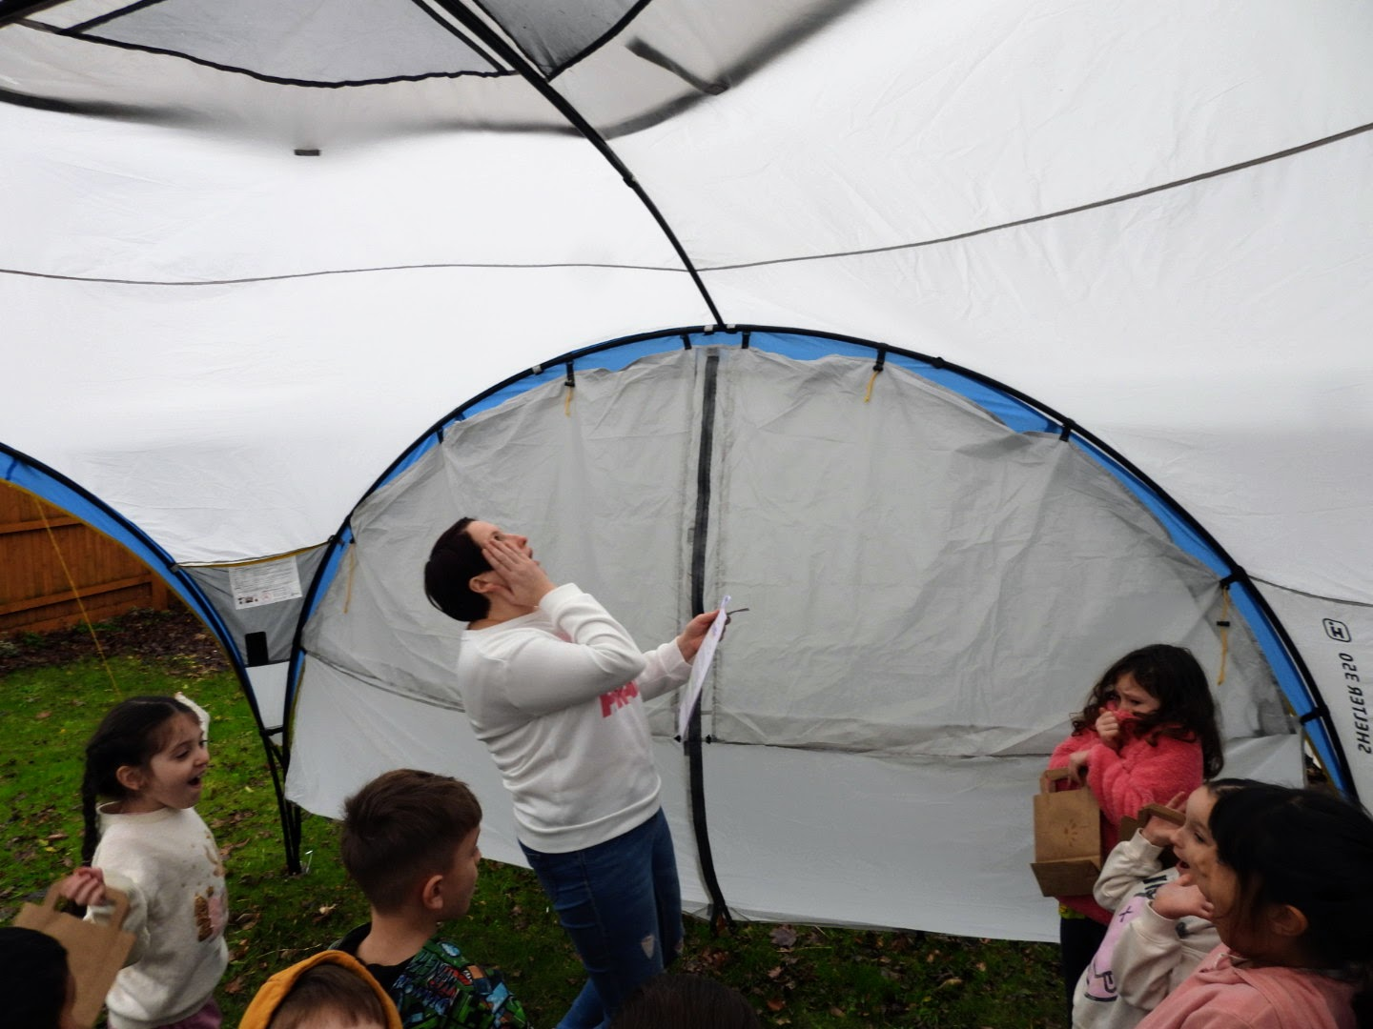
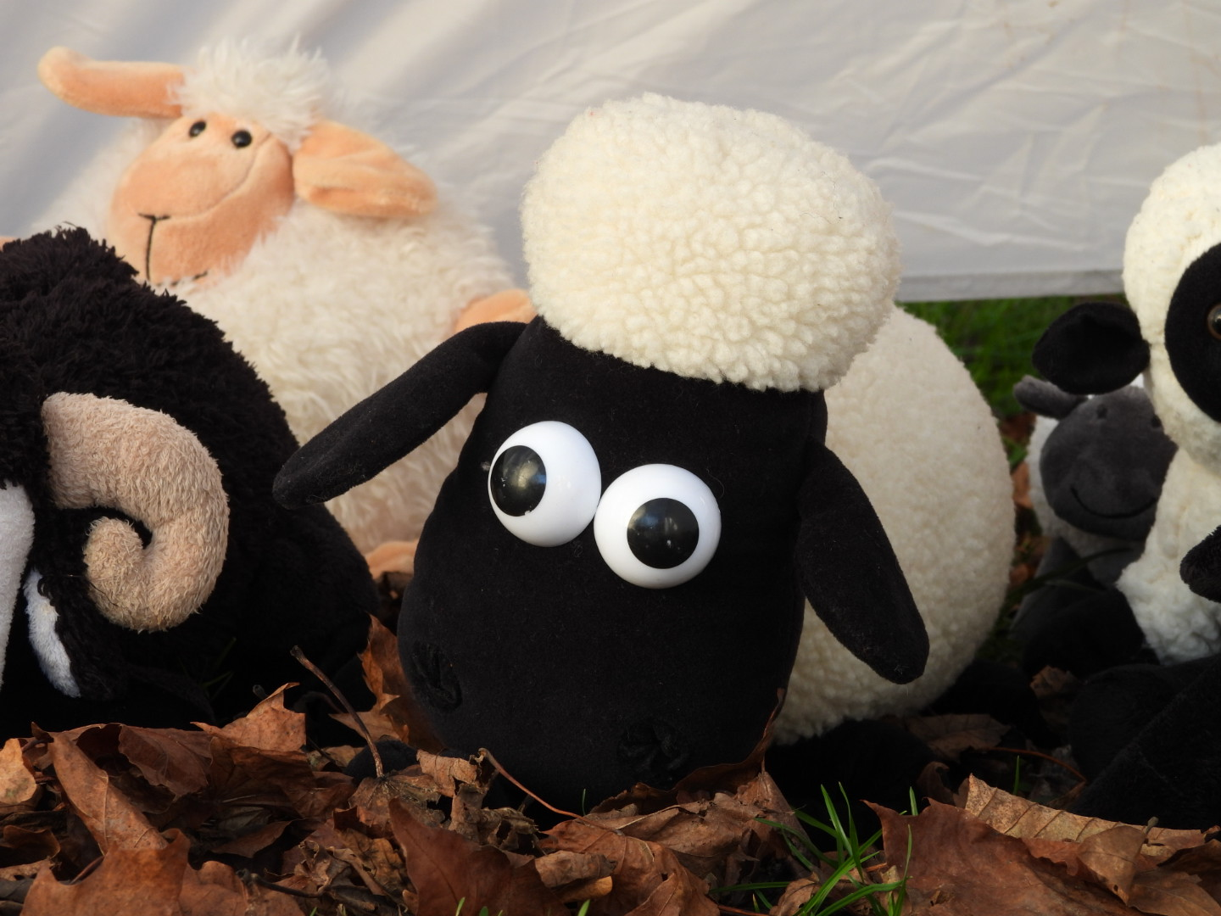
Zone 3: The Shepherds’ Field

Slide 5
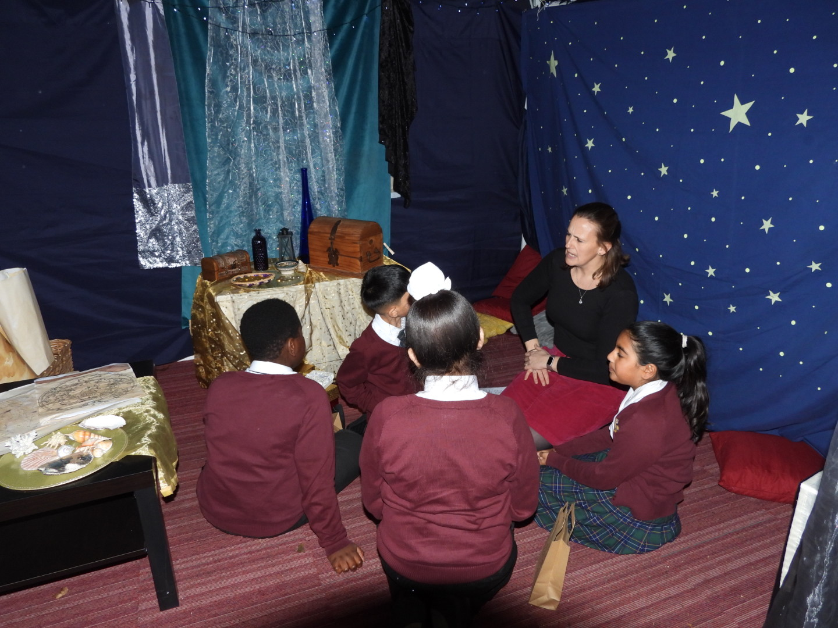
Zone 4 :The Magi’s Observatory

Slide 6
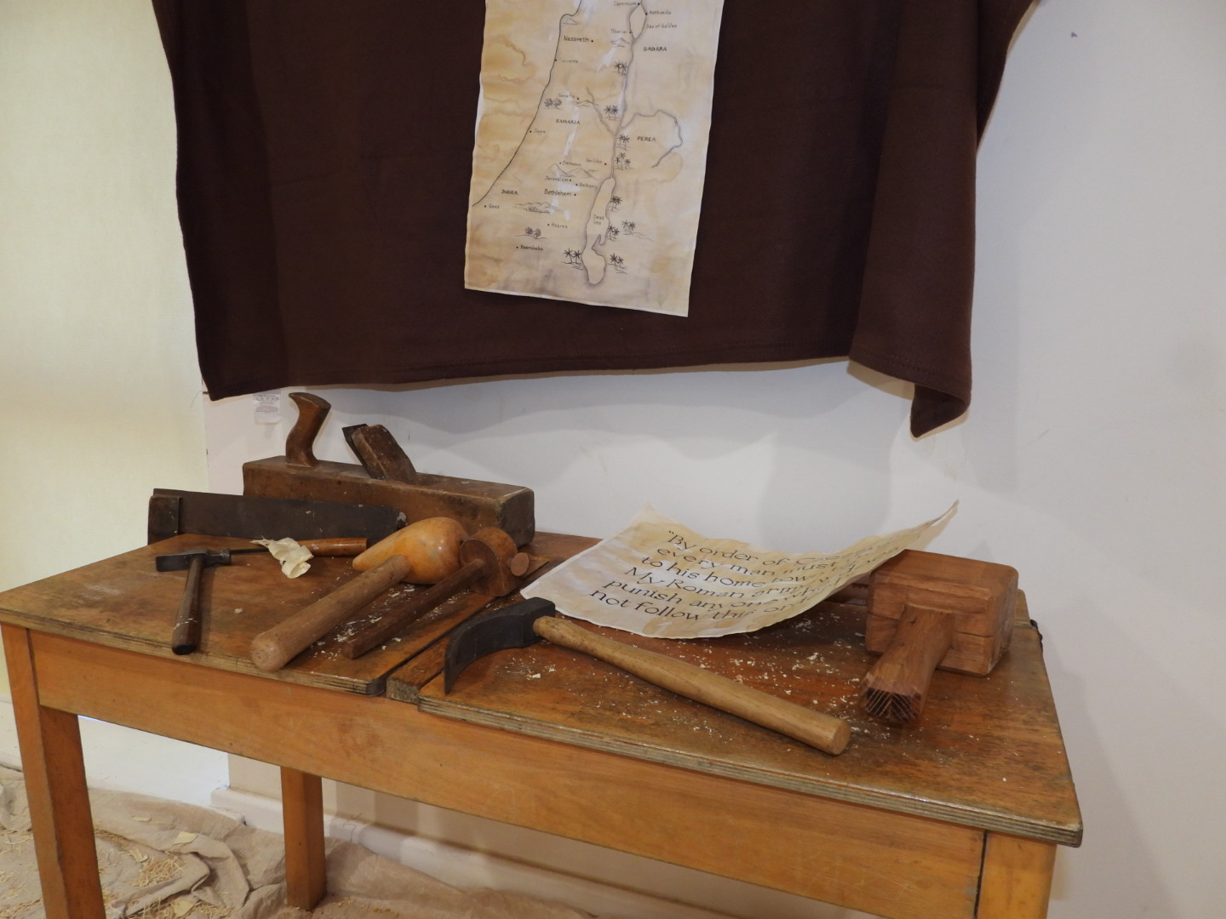
Zone 5: Joseph’s Workshop

Slide 7
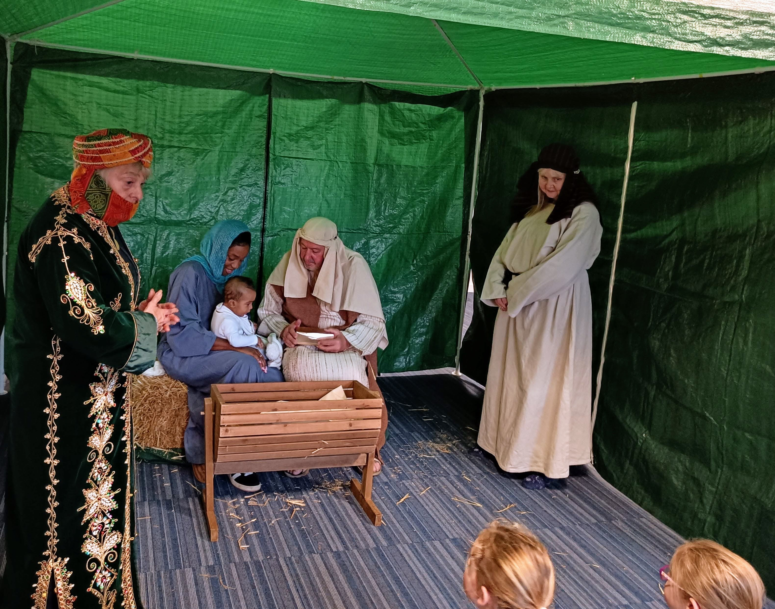
Zone 6 : Bethlehem

Slide 8
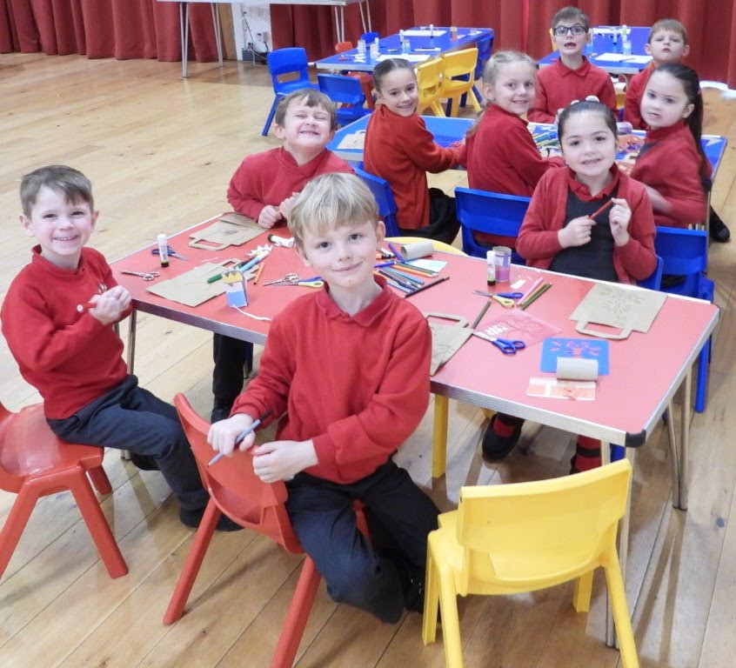
Holding Area

Slide 9
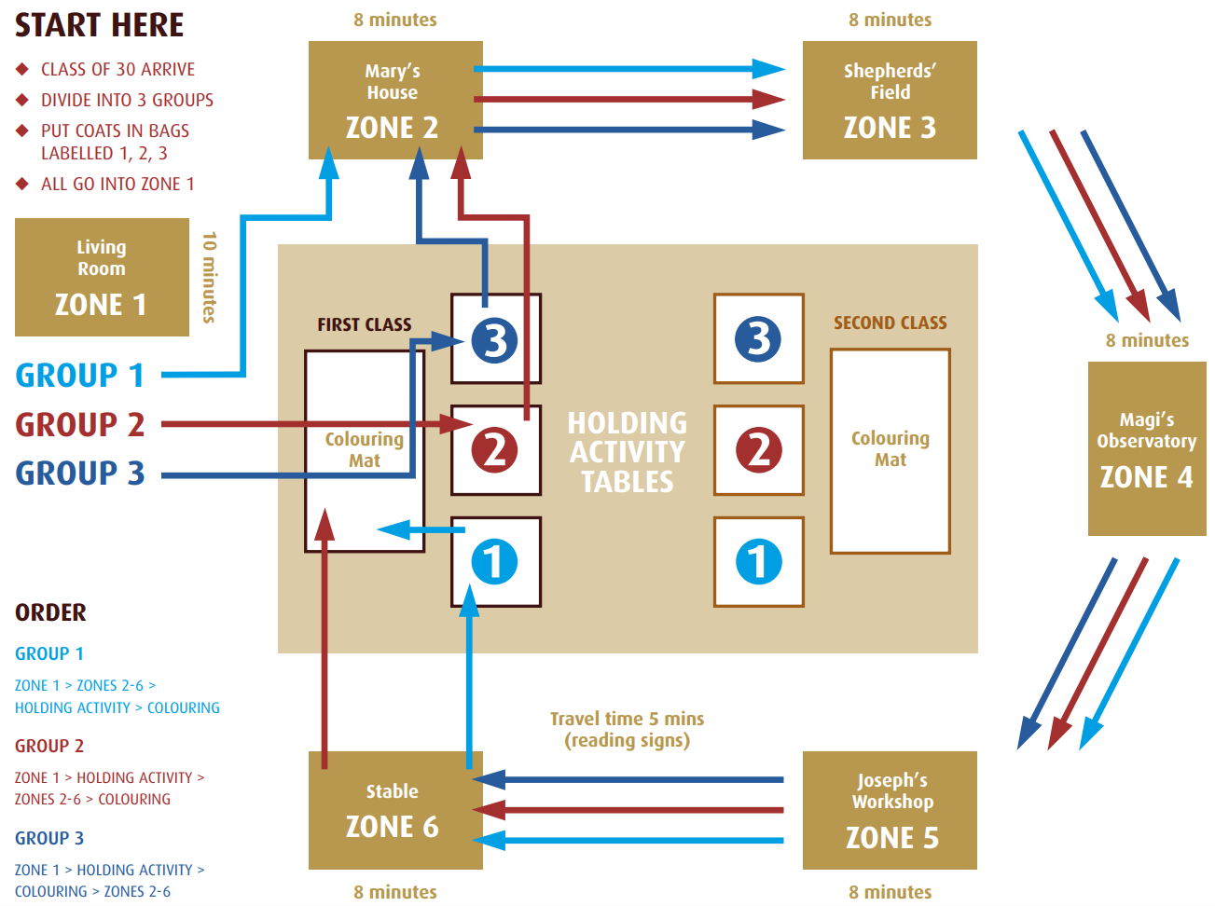

Slide 11

www.childrenssociety.org.uk/how-you-can-help/fundraise-and-events/christingle

Slide 12


https://www.bdeducation.org.uk/?s=christmas

Slide 13

https://www.faithinkids.org/resources/sunday-school/the-christmas-story-brick-by-brick/
https://www.faithinkids.org/resources/sunday-school/the-christmas-story-brick-by-brick

Slide 14
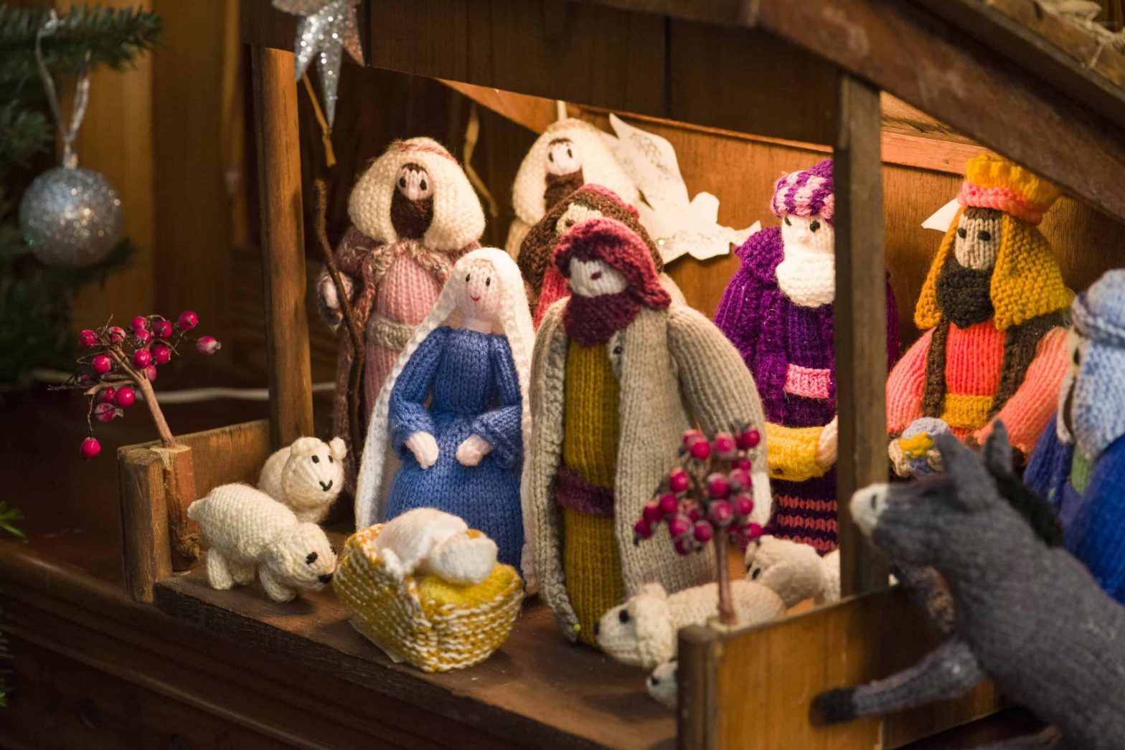
https://churchsupporthub.org/all-resources/how-to-use-posada-to-build-community-during-advent/

Slide 15
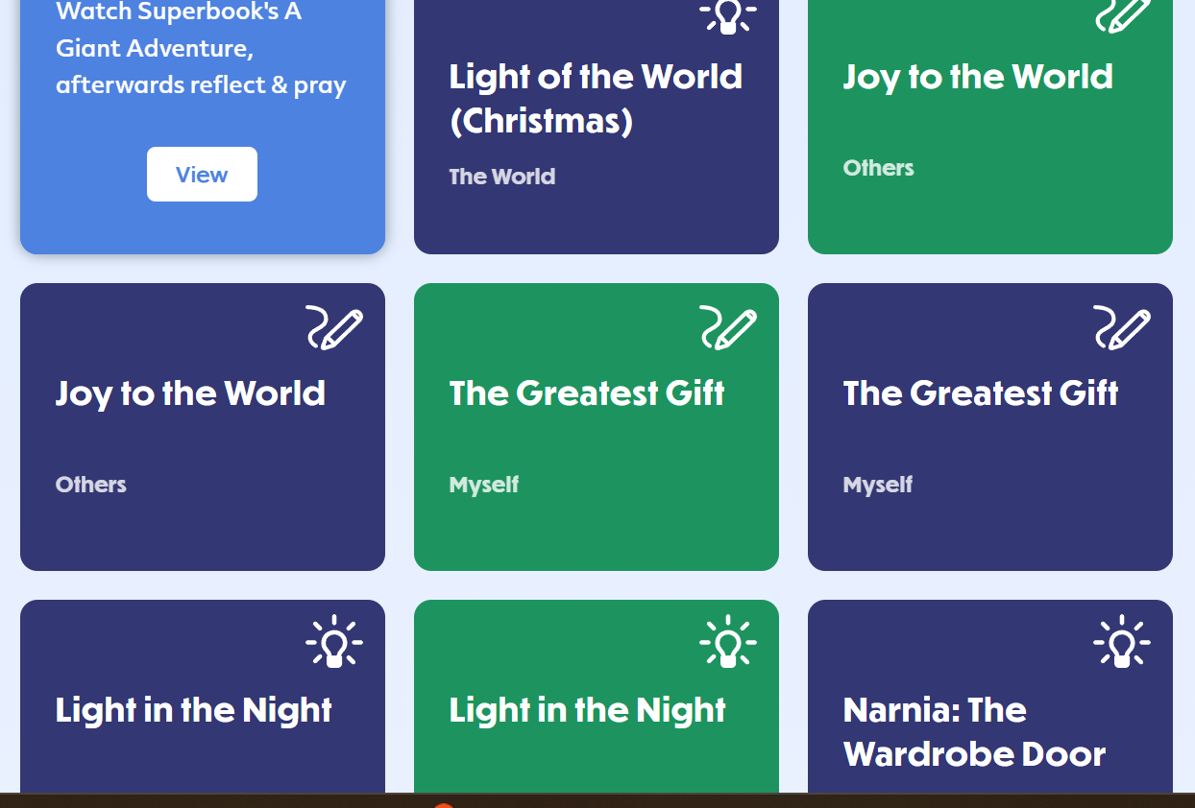

https://prayerspacesinschools.org/resources?s=advent
https://prayerspacesinschools.org/resources?s=advent

Slide 16

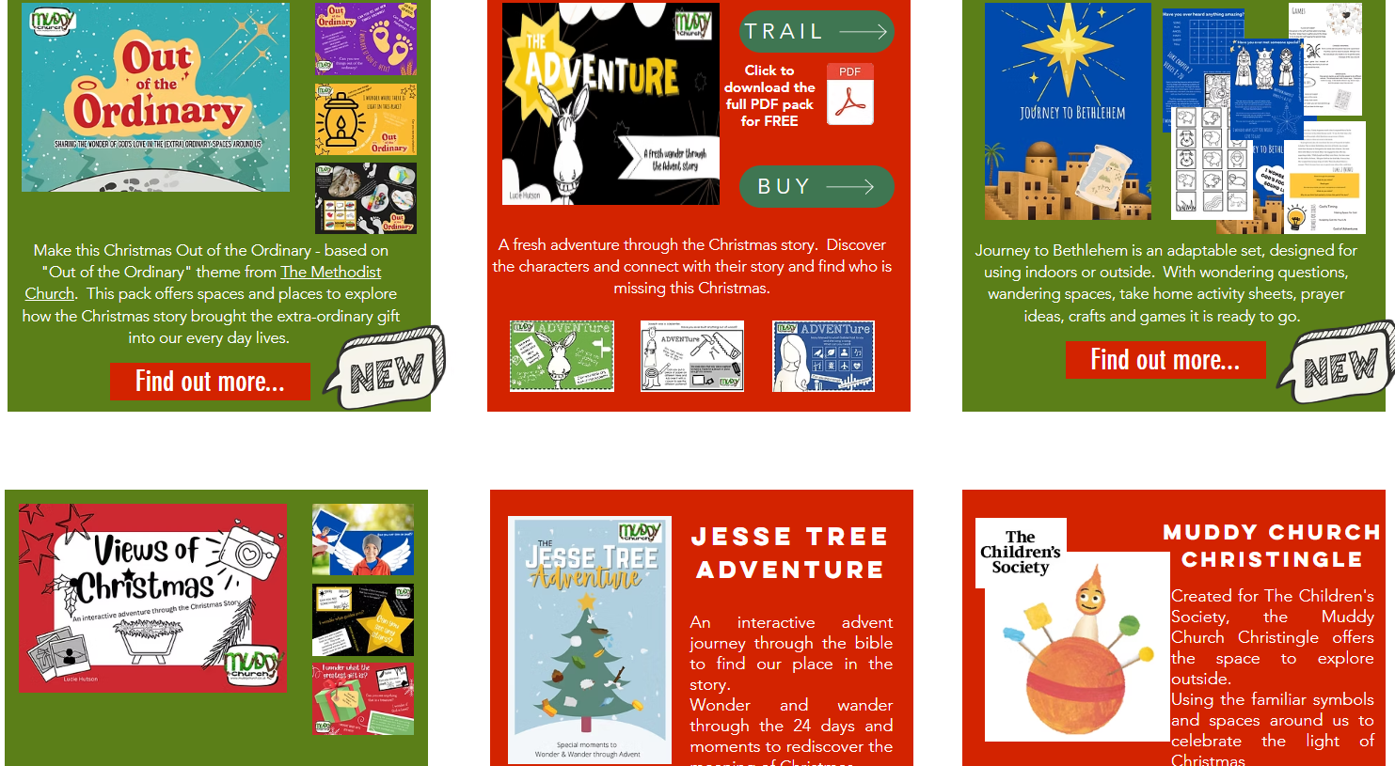
www.muddychurch.co.uk/copy-of-resources

Slide 17
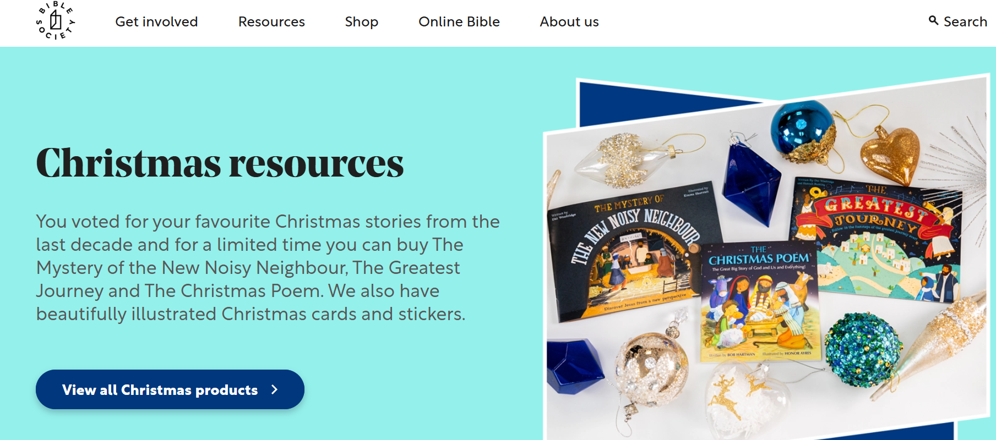
https://www.biblesociety.org.uk/resources/christmas-resources

Slide 18
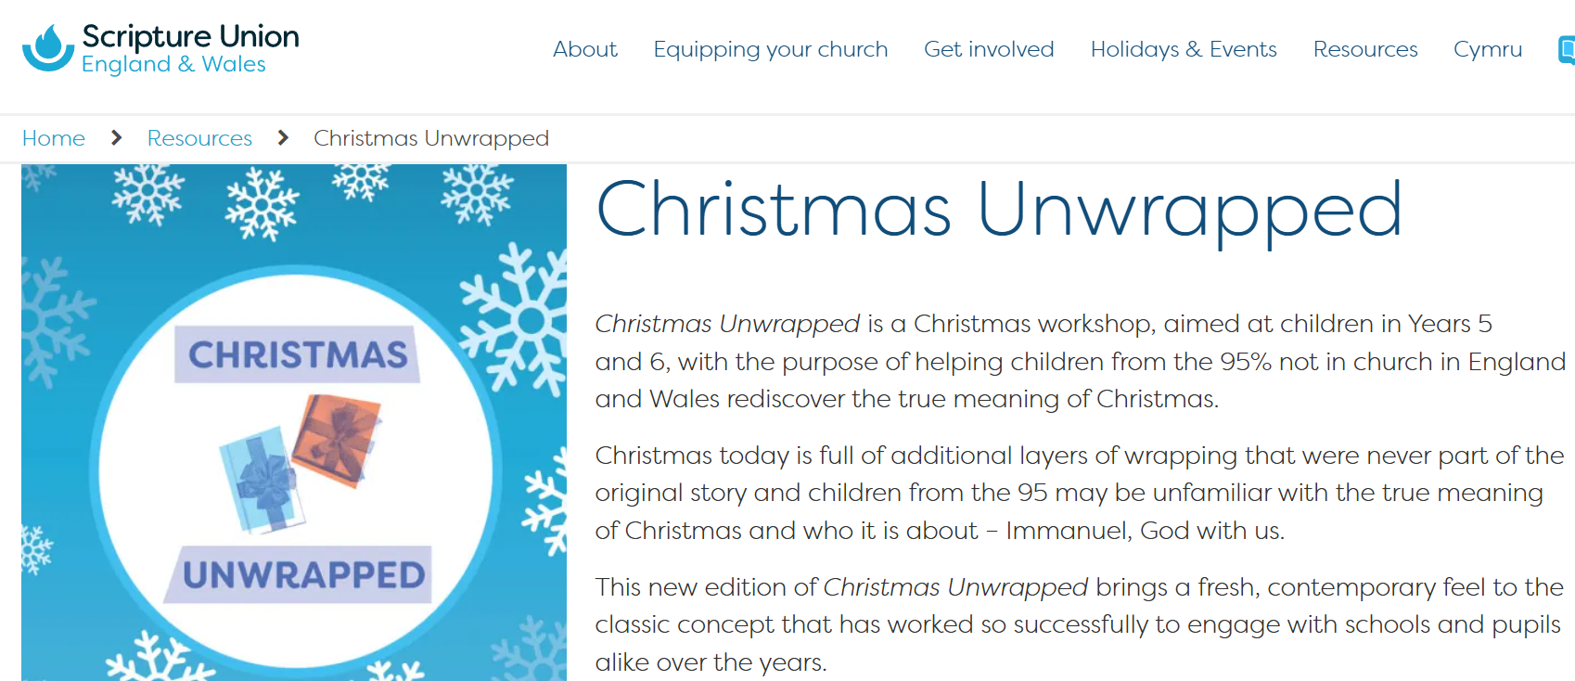
https://content.scriptureunion.org.uk/product/158

Slide 19
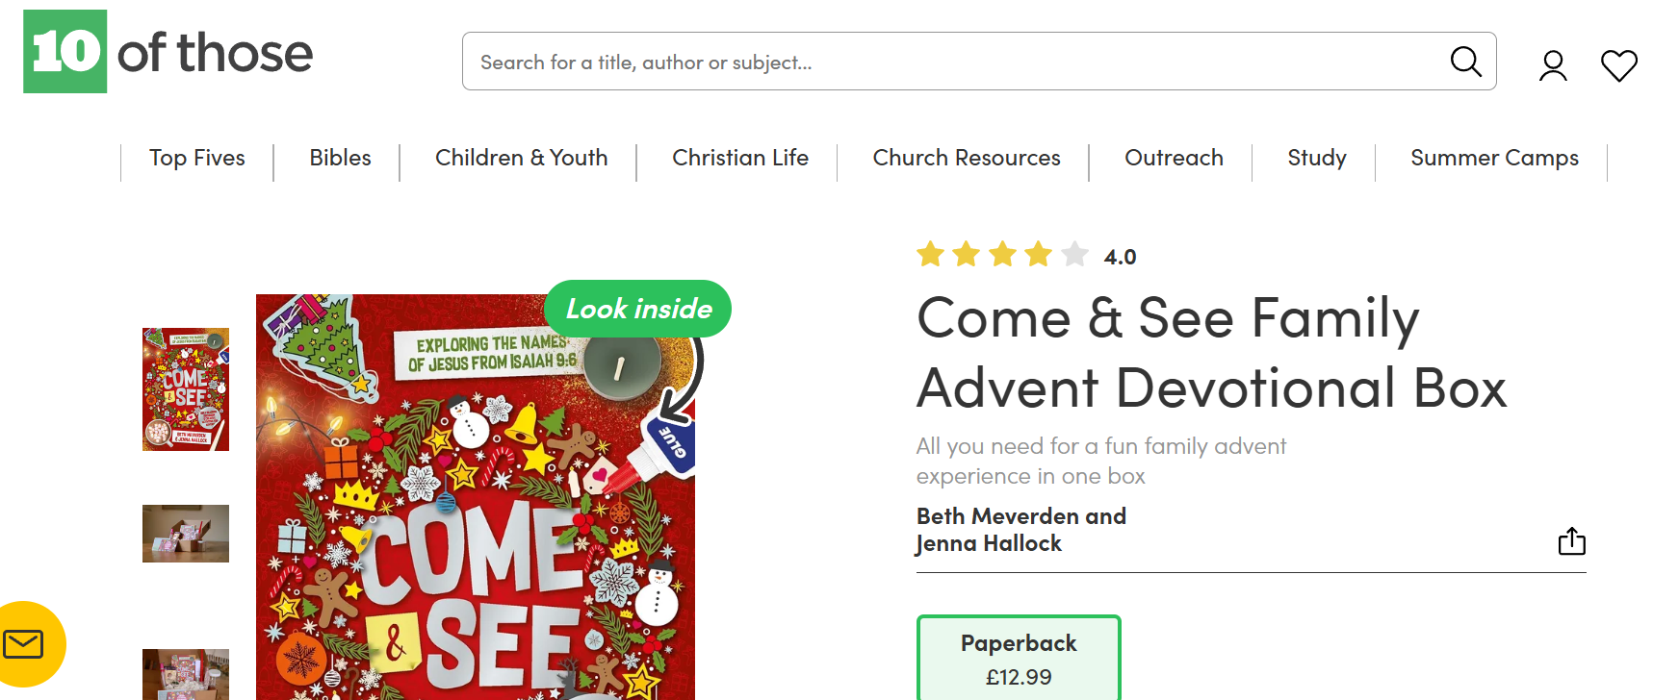
https://uk.10ofthose.com/product/9781915705303/come-see-family-advent-devotional-box-paperback

Slide 20
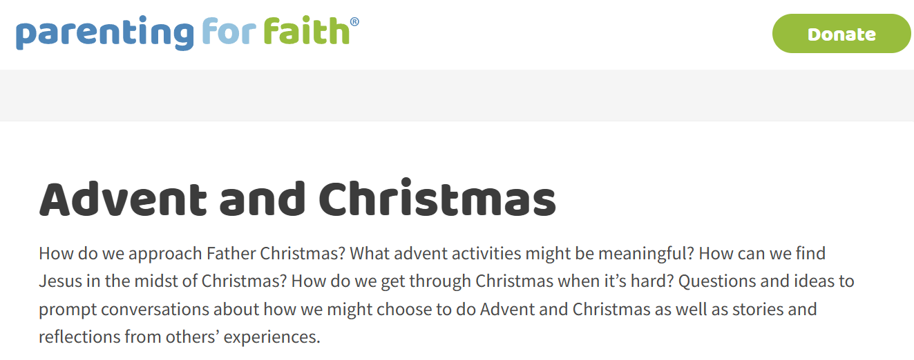
https://www.parentingforfaith.brf.org.uk/topics/advent-and-christmas/

Slide 22


Church & Community Donation Boxes
Place a donation box in your church or community space to collect small packs of sweets and chocolate from local people.
This can be a great way to involve older members of the church, giving them an opportunity to contribute to the events and encouraging them to pray for the people and families who will attend.
Tesco
Take a church-headed and dated letter into your local Tesco store. They will often be able to support local community events with around £30 worth of sweets or food.
FUNDING OPPORTUNITIES

Slide 23



SPAR
You can apply online for support through the SPAR community funding scheme for an in-kind donation:
https://afblakemore.com/about-us/our-community
They often provide a £60 voucher to spend in store on sweets, food and drinks.
Top tip: Apply at least one month in advance.
Morrisons
Take a church-headed letter into your local Morrisons and ask if they can support your event.
They may be able to donate items such as large boxes of Haribo sweets. They often like to take a photo of you and the donation as part of their community support.
Aldi
Visit your local Aldi with a church-headed letter explaining the event and what you are requesting.
They may be able to provide around £50 to spend in store on food and sweets for your event.
FUNDING OPPORTUNITIES

