Slide 2

AIMS
why?
what?
how?
when?
Notes:
Structure of presentation: why LLF? What are the resources? How will people engage? When will all this happen?

Slide 3
AIMS
why?
what?
how?
when?

Slide 4
Christian teaching & learning
about identity, sexuality,
relationships & marriage
being human
learning
whole church
Notes:
3 ways in which LLF is a new approach: 1. the bigger framework of the Christian understanding of ‘being human’ 2. it’s about learning together – acknowledging complexity and understanding different perspectives better 3. engaging the whole church in learning that feeds into discernment, decision-making – quite radical for the CofE!

Slide 5
Christian teaching and learning
about identity, sexuality,
relationships & marriage
learning journey
multidisciplinary
real life stories
different perspectives
Notes:
So how have these distinctive aspects of LLF shaped the resources? 1. Pedagogically shaped (learning journey) so inviting learning, not a statement; 2.The Bible has a lot to say about what it means to be human, but so do other disciplines _ therefore a multidisciplinary approach (Bible, theology but also sociology, biological sciences, history) which enriches our understanding; 3. always against the backdrop of real life stories to remind us these matters affect people profoundly; 4. presenting different perspectives as faithfully and as positively as possible – may not have succeeded, but this was/is the intention of the diverse group who contributed

Slide 6
AIMS
why?
what?
how?
when?
Notes:
What is in this suite of resources?

Slide 7


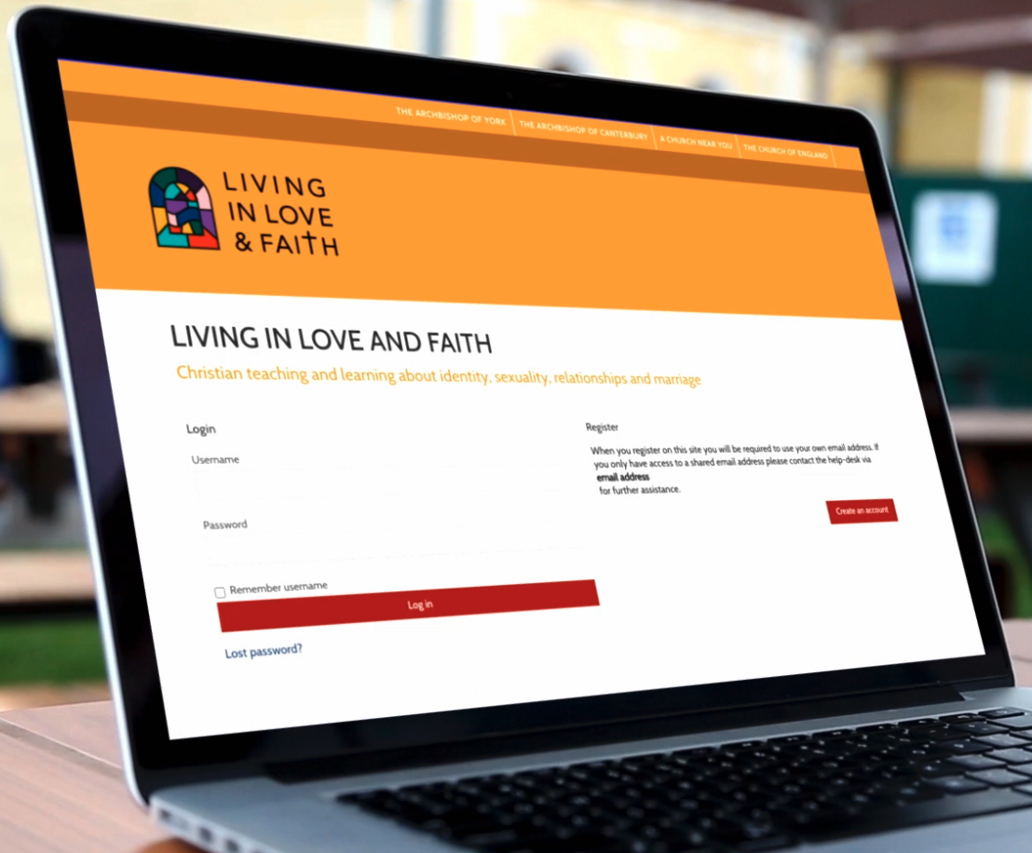





Christian teaching & learning
about identity, sexuality,
relationships & marriage
Notes:
The suite of resources, starting with the book & podcasts by contributors; the course as an accessible form for groups; films – the importance of learning in the company of people we may otherwise not have met; a library of 300+ resources for those wating to go deeper – different disciplines, topics, perspectives, including 50+ essays written by LLF team members, in different disciplines, different perspectives

Slide 8
An invitation
Reflecting: what have we received?
Paying attention: what is going on?
Making connections: where are we in God’s story?
Seeking answers: how do we hear God?
Conversing: what can we learn from each other?
An appeal
1
2
3
4
5
Notes:
BOOK: Begins and ends with bishops’ invitation and appeal; go through the parts (1. looking “in”; 2. looking “out”; 3. making connections to understand how we in 21st century England in relation to these matters are part of God’s story; 4. how is it that we come to different conclusions?; 5. model discussions using the material in the book) in between each part are vignettes of people’s stories – accompanying/disrupting our journey through the book.

Slide 9



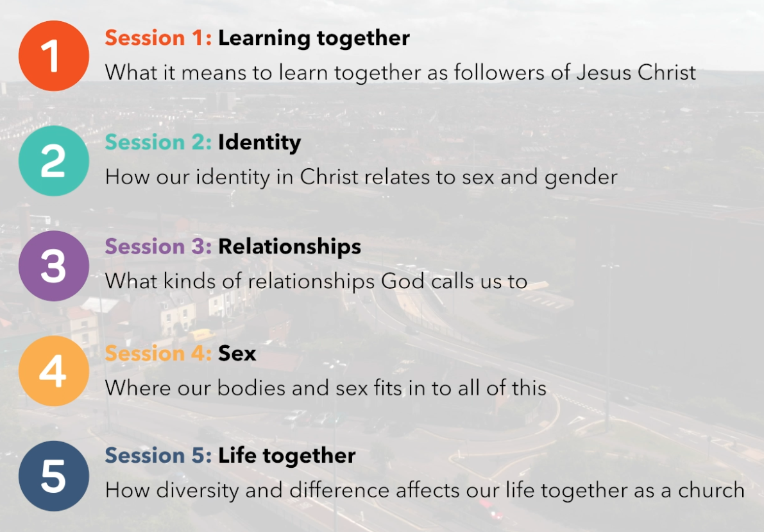
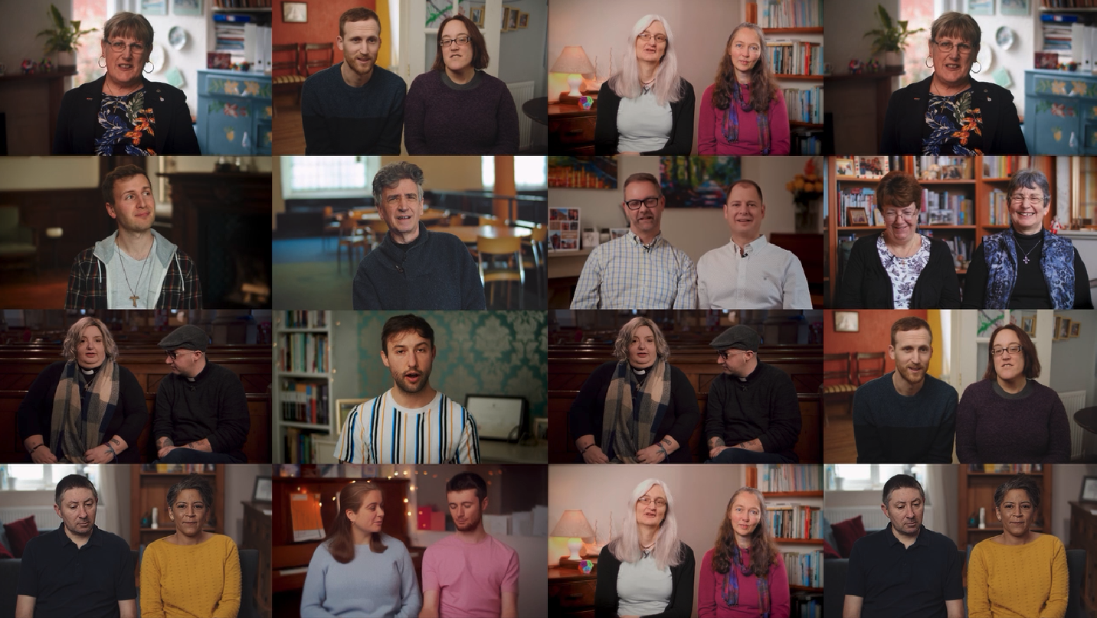
Pastoral Principle
Teaching
Bible study
Prayer & reflection
Story films
Notes:
COURSE designed for learning together in groups; – different, more thematic structure. Each session has 4 components plus story films embedded in each one.

Slide 10
AIMS
why?
what?
how?
when?
Notes:
How do we hope people across the church will engage with the resources?

Slide 11
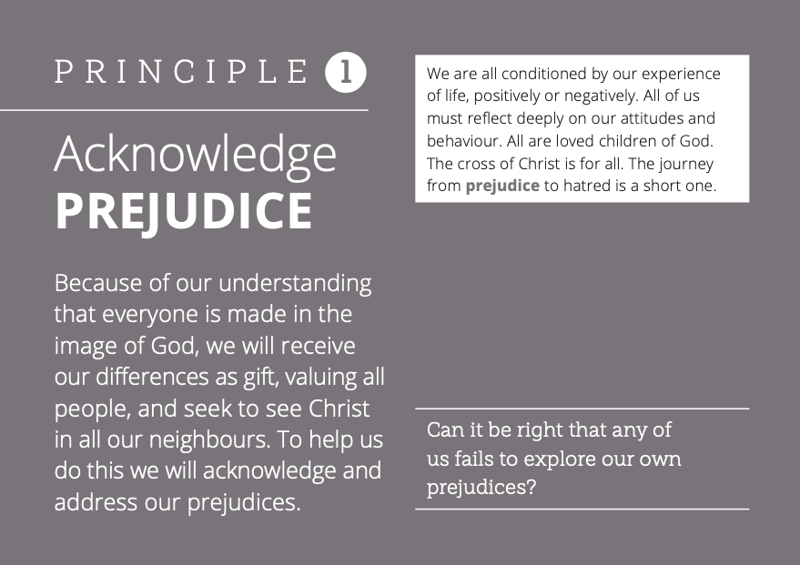
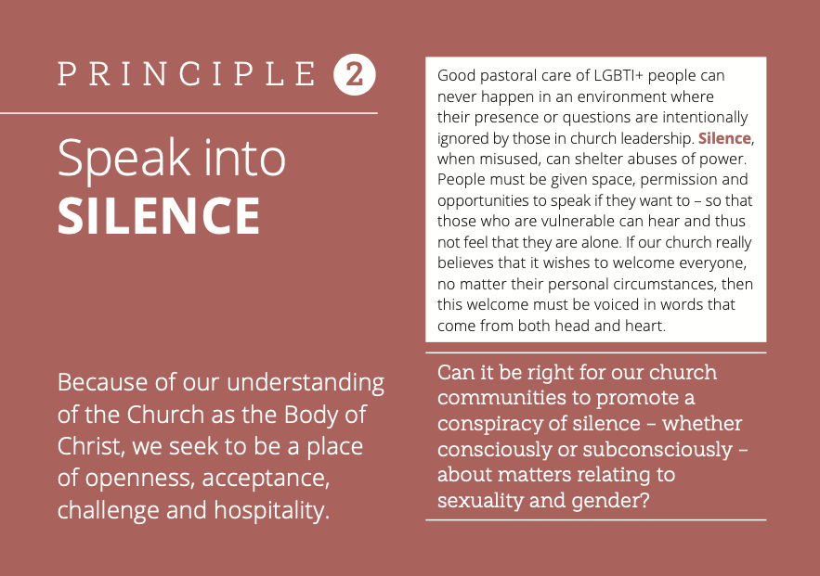
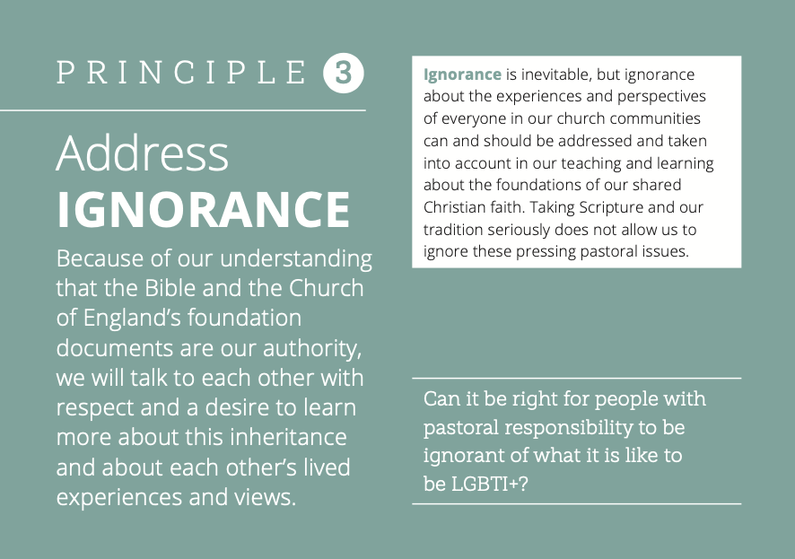
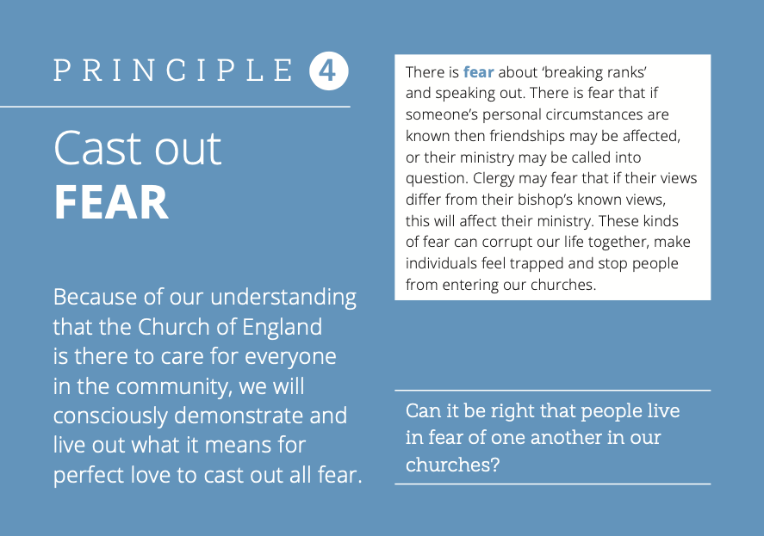

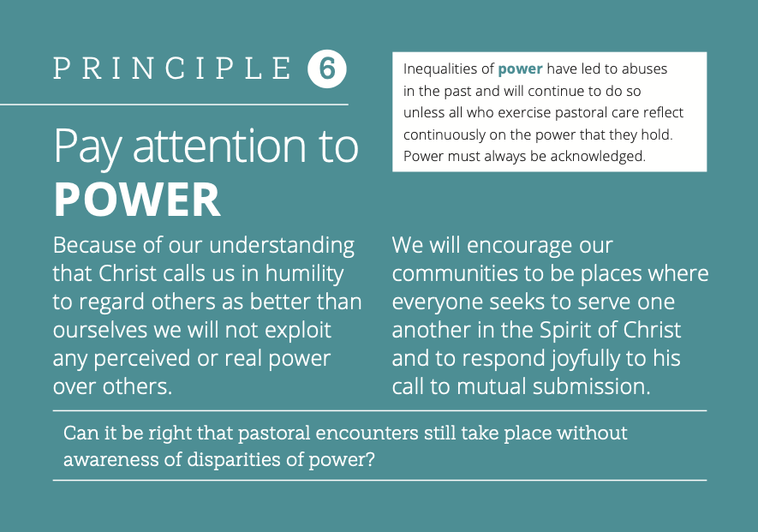
Creating spaces for
learning together well
braver
&
safer
Commitments
Notes for Leaders
Guidance:
Braver and safer
Training
Notes:
Mostly, people will be starting with the COURSE (which also points to ‘going deeper’ resources in the book, podcasts etc). Given how deeply personal and sensitive these questions are we need to engage with great care, grace and love. That’s why the Pastoral Principles embedded in each session to recognize the potential roadblocks we put in the way of learning together well. This is about helping all of us to create braver, safer spaces for learning well together. We need to be brave enough to learn new things, encounter different perspectives and experiences, but feel so safe enough that we can explore honestly and openly without hurting or being hurt.

Slide 12
Christian teaching and learning
about identity, sexuality,
relationships & marriage
More …
bravely
safely
Learn
together
Listen
to each other
Listen to God
Notes:
So… LLF is inviting people to learning together about complex matters and different perspectives – to deepen our understanding of who God is and who we are. But doing so is not easy! It can be painful and we can easily offend one another and fool ourselves. So we need the pastoral principles as a way of examining ourselves as individuals and as a church – so that we can truly learn, listen to each other and listen to God. It’s about learning in ways that are braver and safer…

Slide 13
What is God saying to the church today?
Notes:
This is our goal! To hear what God is saying to the church today.

Slide 14
AIMS
why?
what?
how?
when?
Notes:
When will all this happen? There is a clear timeframe.

Slide 15
NEXT STEPS
Notes:
What next now that the materials have been published? An LLF Next Steps Group has been formed.

Slide 16


Encouraging participation
learning
local churches, groups
youth groups
chaplaincies
inter-church groups
deanery study days
LLF advocate
diocesan study days
Notes:
New group led by Bishop of London, Sarah Mullally. Its tasks are 1. to encourage participation in learning together in and across churches everywhere 2. to listen attentively to one another – and especially for bishops to keep their ear to the ground, listen and reflect on what is emerging from churches’ engagement 3. listen also to what we are learning about what it means to be church with our diversity and difference 4. towards the end of the time, to move towards planning for whatever decisions may be needful for the church.
Timeframe: 2021 for engagement; 2022 for discernment and decision-making (bishops and General Synod)
LLF Next Steps Group is not representative! So LLF advocates will be appointed in every diocese to encourage participation and listening; a Reference Group of grassroots people who are active in their local church communities – very diverse: age, ethnicity, church (rural, urban, different traditions), sexuality. This group will help with creative and appropriate ways to help churches engage and to be a sounding board for the Next Steps Group.

Slide 17
Encouraging participation
learning
discerning
Listening attentively
Survey
questionnaire
Focus
groups
‘Say it creatively’
LLF advocate
Notes:
New group led by Bishop of London, Sarah Mullally. Its tasks are 1. to encourage participation in learning together in and across churches everywhere 2. to listen attentively to one another – and especially for bishops to keep their ear to the ground, listen and reflect on what is emerging from churches’ engagement 3. listen also to what we are learning about what it means to be church with our diversity and difference 4. towards the end of the time, to move towards planning for whatever decisions may be needful for the church.
Timeframe: 2021 for engagement; 2022 for discernment and decision-making (bishops and General Synod)
LLF Next Steps Group is not representative! So LLF advocates will be appointed in every diocese to encourage participation and listening; a Reference Group of grassroots people who are active in their local church communities – very diverse: age, ethnicity, church (rural, urban, different traditions), sexuality. This group will help with creative and appropriate ways to help churches engage and to be a sounding board for the Next Steps Group.

Slide 18
learning
2021
Encouraging participation
discerning
Listening attentively
Exploring possibilities
many voices, one church
2022
Moving into the future
planning
LLF advocate
Notes:
New group led by Bishop of London, Sarah Mullally. Its tasks are 1. to encourage participation in learning together in and across churches everywhere 2. to listen attentively to one another – and especially for bishops to keep their ear to the ground, listen and reflect on what is emerging from churches’ engagement 3. listen also to what we are learning about what it means to be church with our diversity and difference 4. towards the end of the time, to move towards planning for whatever decisions may be needful for the church.
Timeframe: 2021 for engagement; 2022 for discernment and decision-making (bishops and General Synod)
LLF Next Steps Group is not representative! So LLF advocates will be appointed in every diocese to encourage participation and listening; a Reference Group of grassroots people who are active in their local church communities – very diverse: age, ethnicity, church (rural, urban, different traditions), sexuality. This group will help with creative and appropriate ways to help churches engage and to be a sounding board for the Next Steps Group.

Slide 19
What is God saying to the church today?
Notes:
This is our goal! To hear what God is saying to the church today.

Slide 20
THANK YOU!

