Slide 1

Introduction to Understanding Trauma
Joanna Naomi Douglas

Slide 2

Disclaimer and What to Expect
Introduction – About Me.
Clarifying Terms.
Why is Being Trauma Informed Important?
Defining Trauma.
Understanding Suffering- ACEs
The Trauma Brain

Slide 3
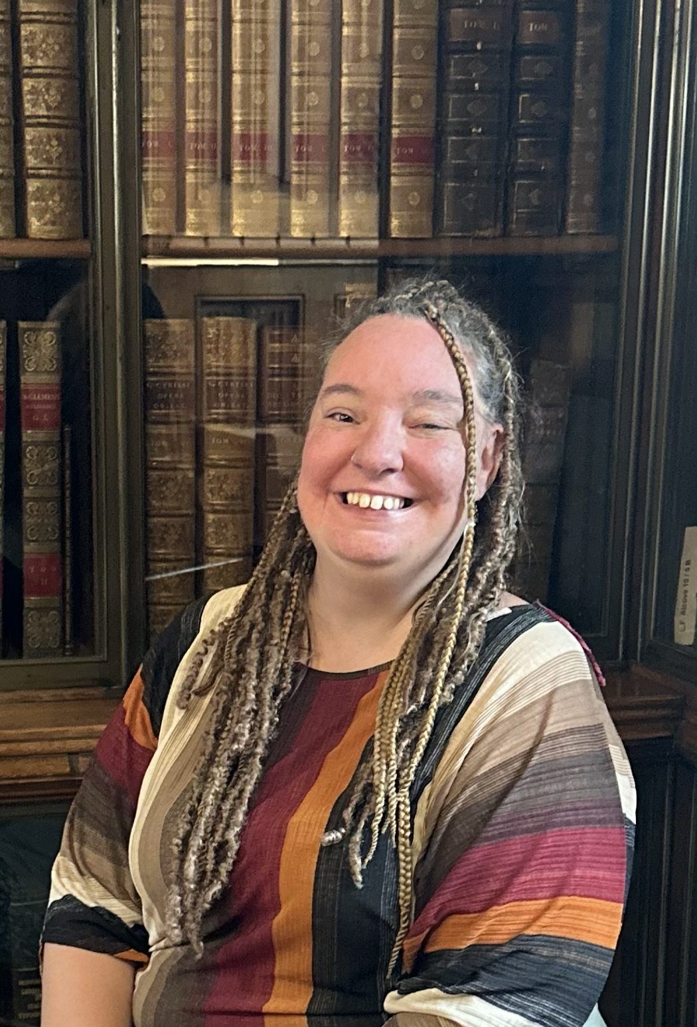

Introduction- About Me
Joanna Naomi Douglas
BA (Hons.), PGCE, QTS, MA.
Joanna.Douglas@traumainformedtheology.co.uk
www.traumainformedtheology.co.uk

Slide 4

Introduction- About Me

Slide 5

Clarifying Terms
Clinical Mental Health vs Trauma-Related Mental Health

Slide 6

Clarifying Terms
Survivor vs Victim

Slide 7
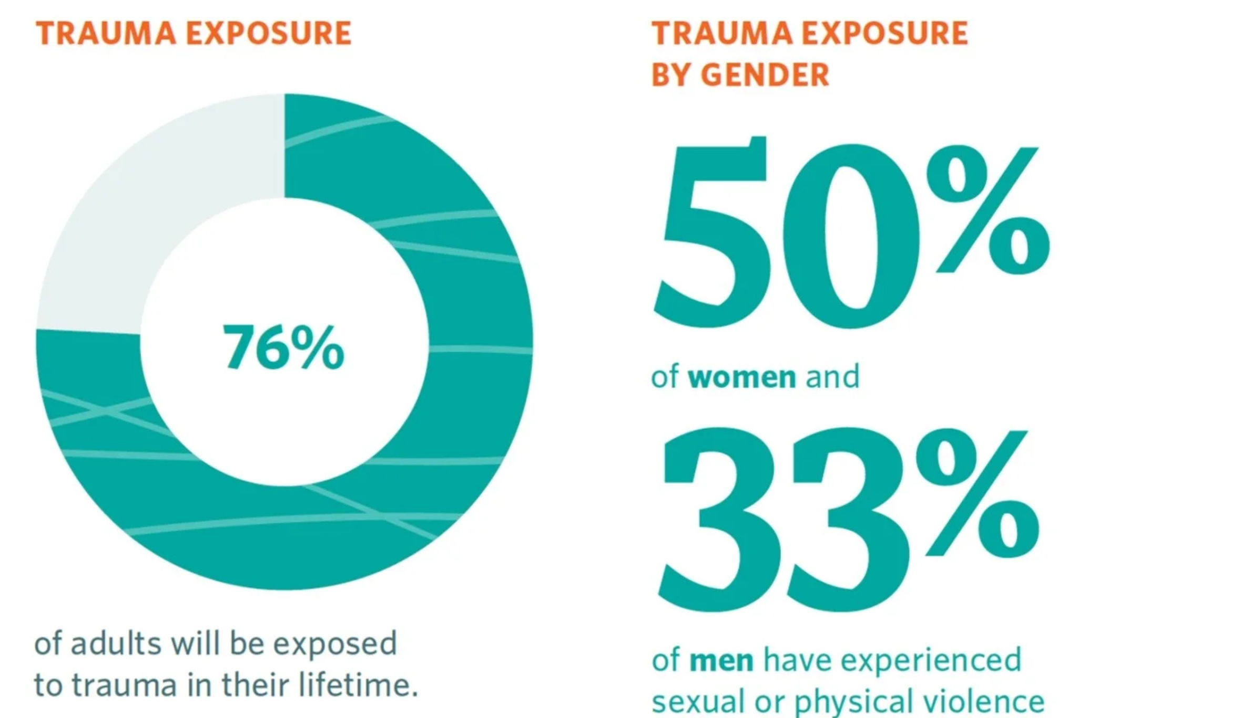
Why is being Trauma Informed important?
PTSD UK - 2025

Slide 8
Why is being Trauma Informed important?
PTSD UK - 2025

Slide 9
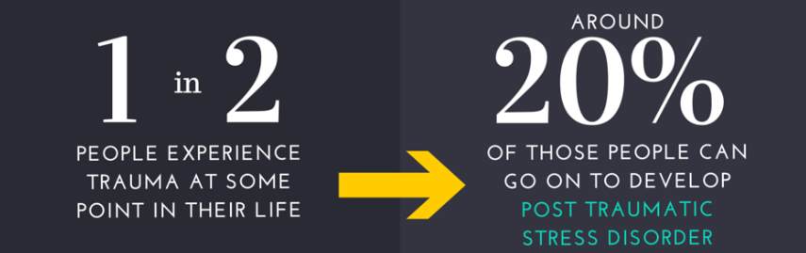
Why is being Trauma Informed important?
PTSD UK - 2025

Slide 10
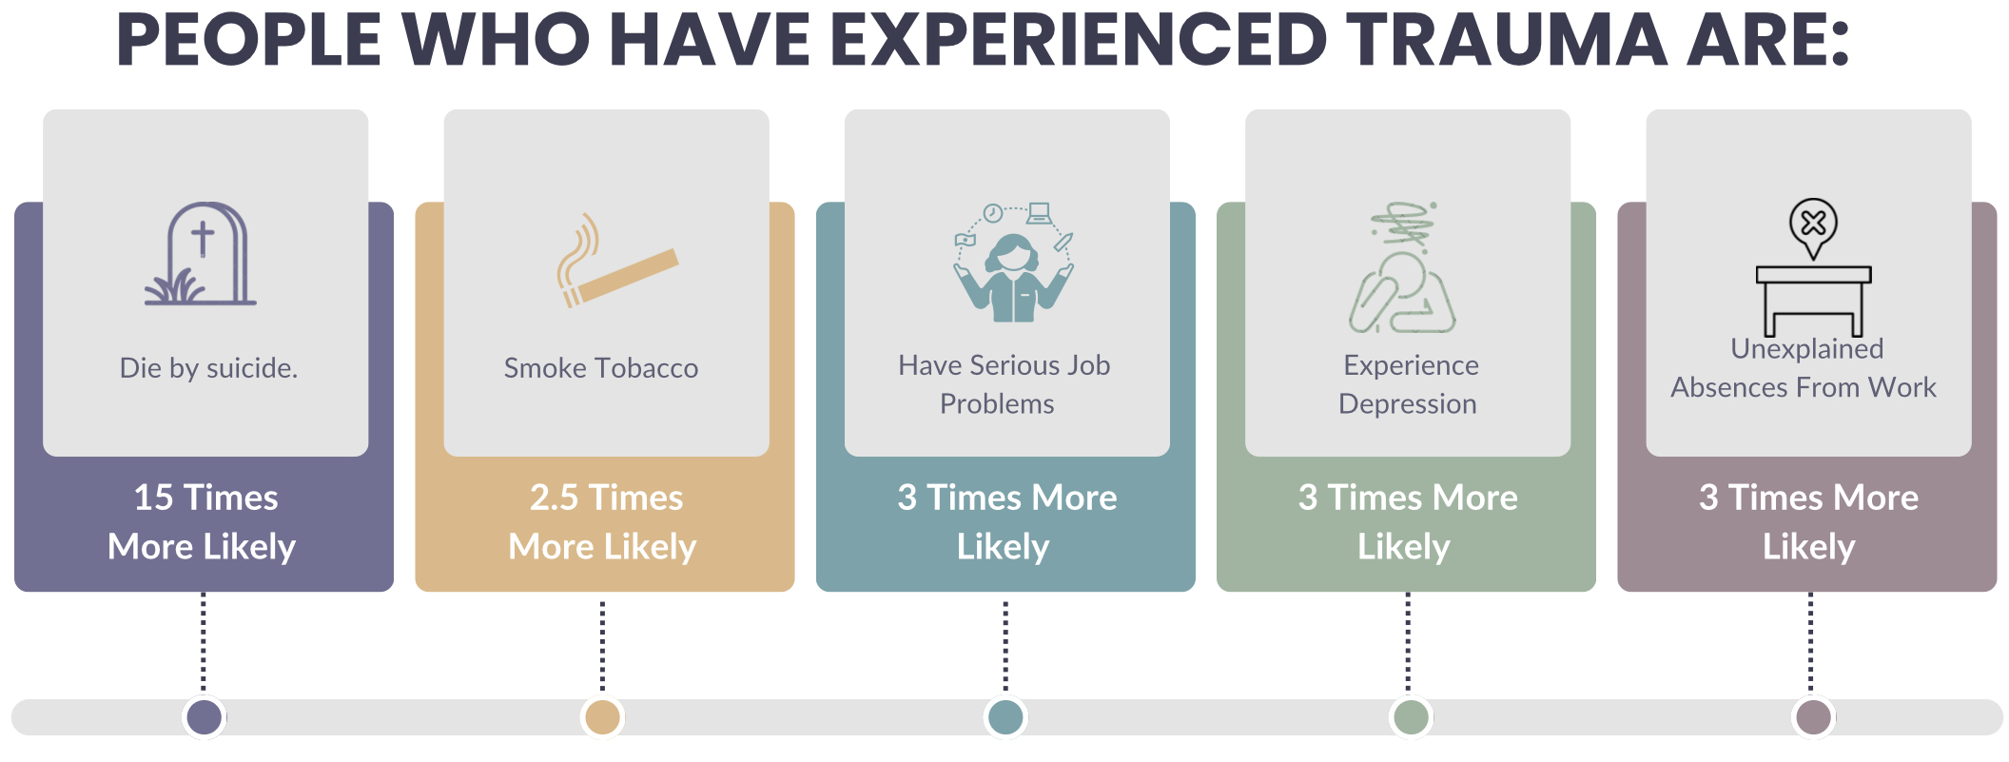
Why is being Trauma Informed important?

Slide 11
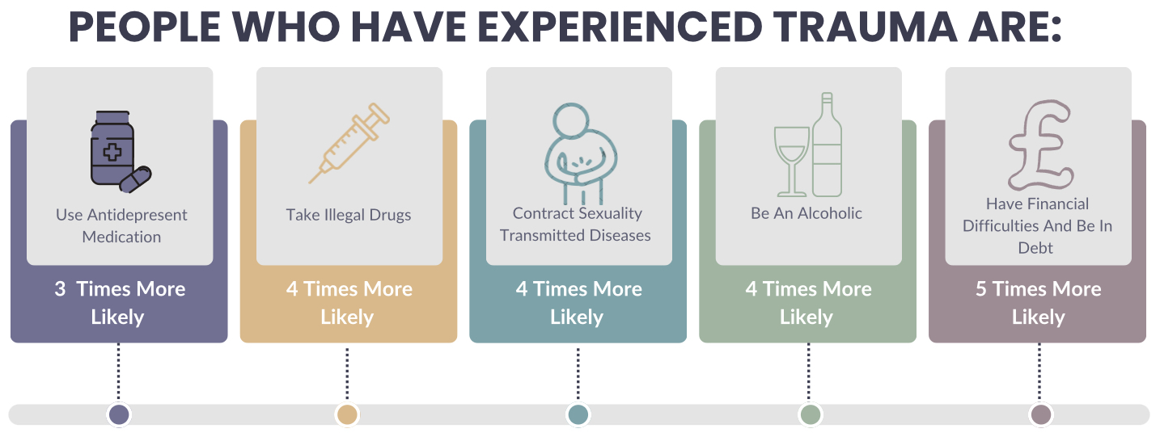
Why is being Trauma Informed important?

Slide 12

Defining Trauma
What is Trauma?

Slide 13
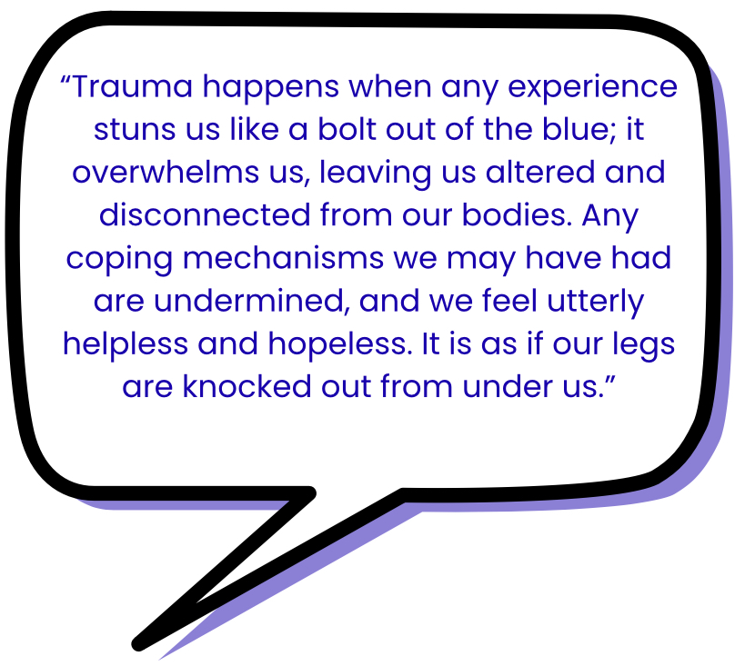
Defining Trauma
- Levine (2006)

Slide 14
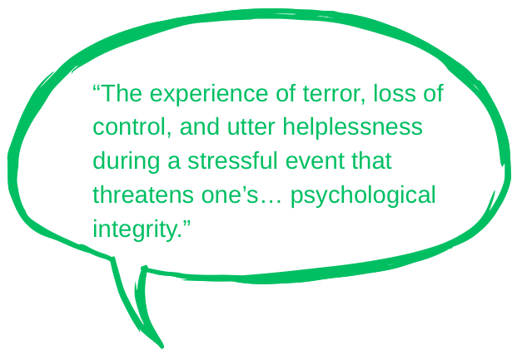
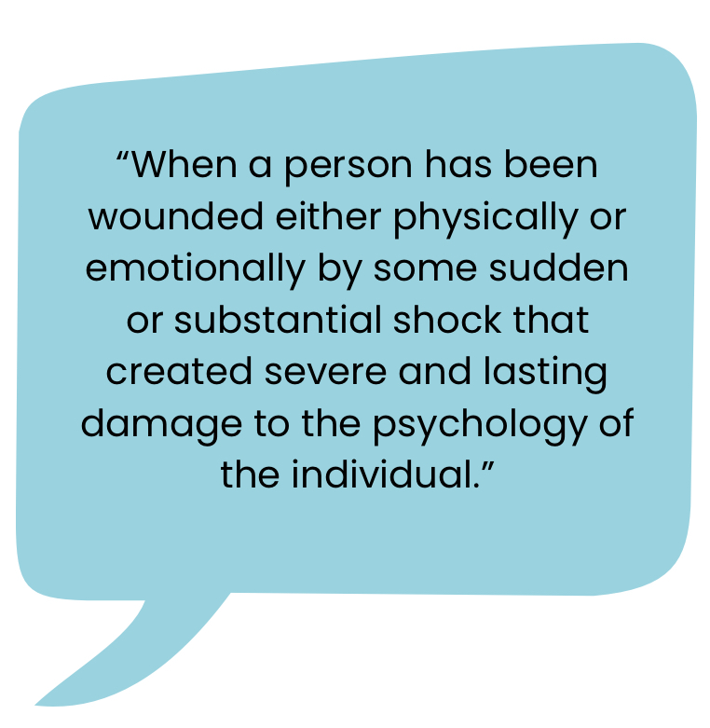
Defining Trauma
-Beaste (2007)
-Mayer (2003)

Slide 15
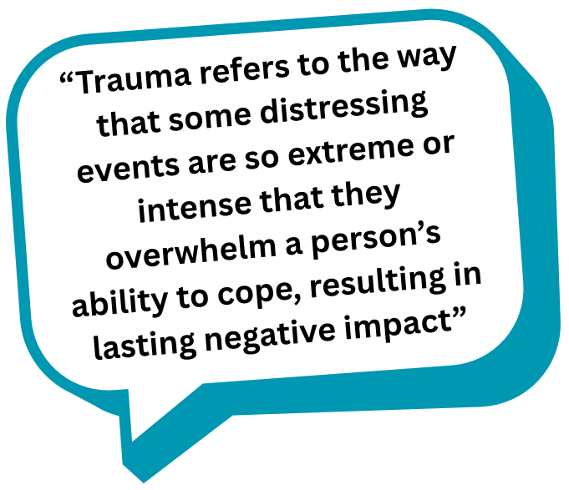
Defining Trauma
-Trauma Council UK

Slide 16

Defining Suffering

Slide 17
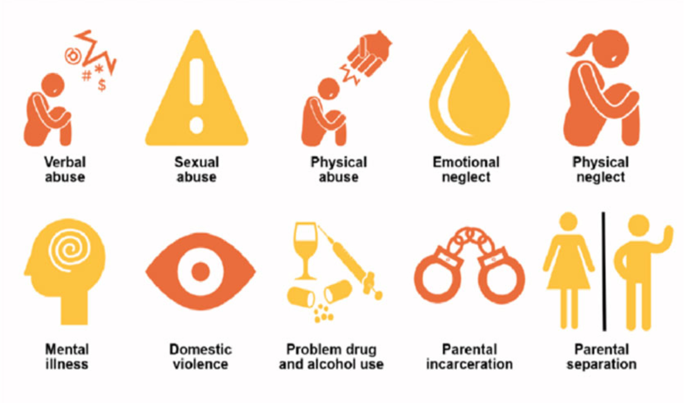

Understanding Suffering- ACEs

Slide 18

The Trauma Brain – The Brain’s Response to Suffering

Slide 19
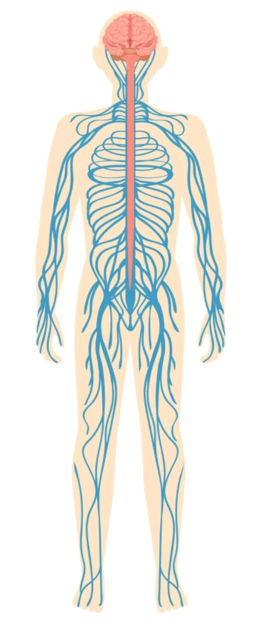
The Autonomic Nervous System (ANS)

Slide 20
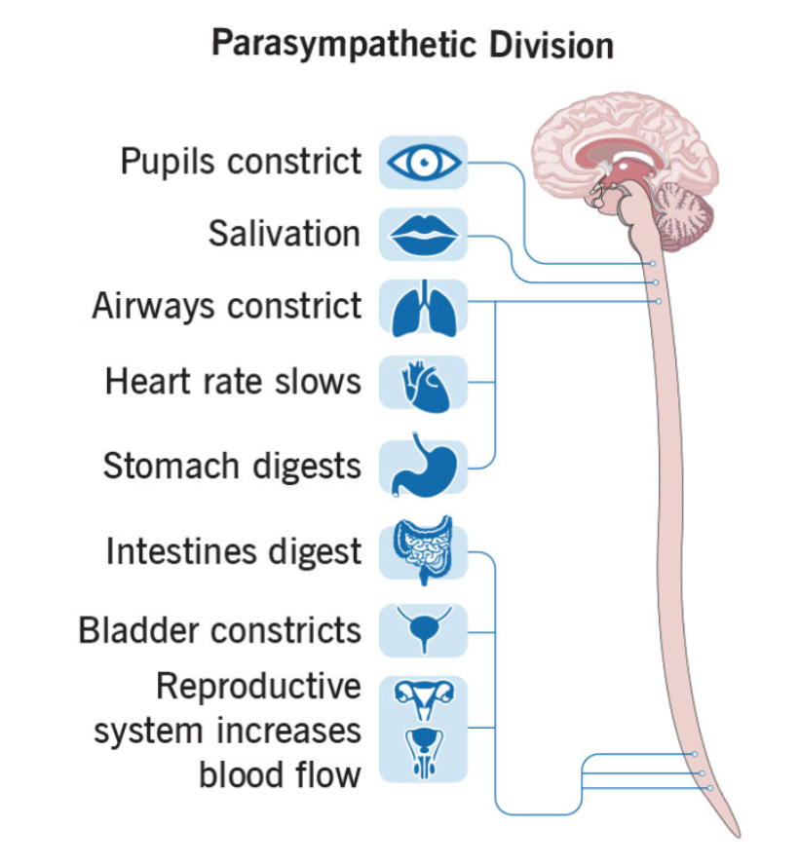
Parasympathetic Nervous System

Slide 21
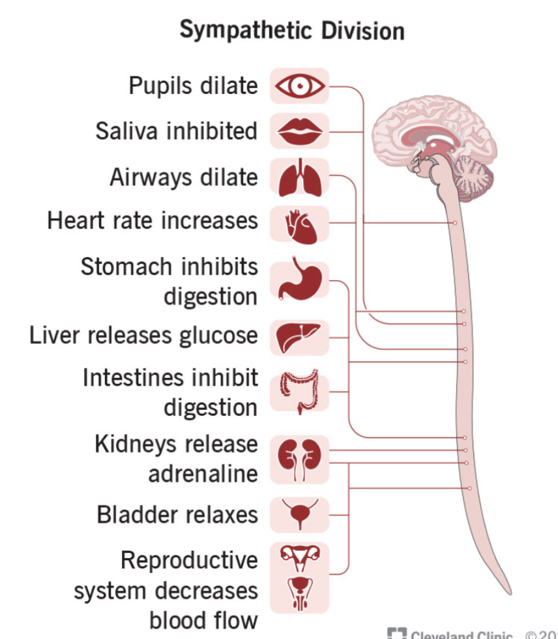
Sympathetic Nervous System

Slide 22
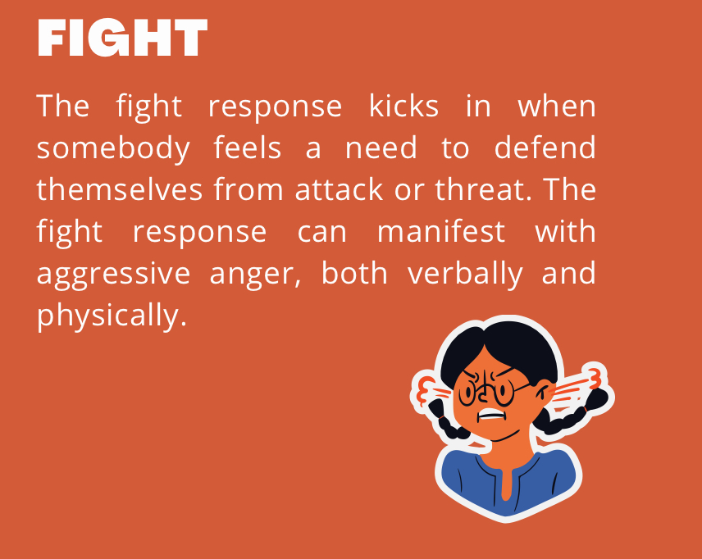
The Trauma Responses

Slide 23
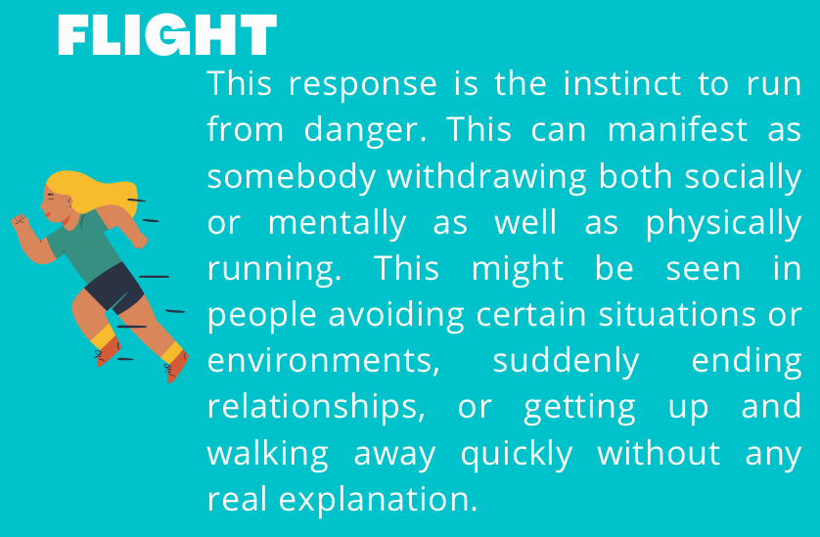
The Trauma Responses

Slide 24
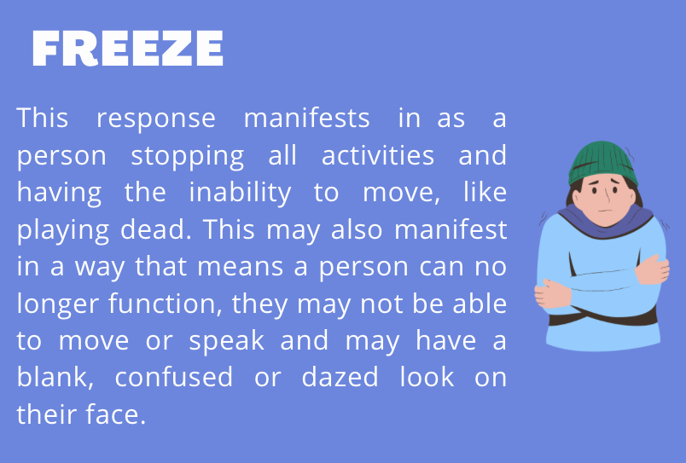
The Trauma Responses

Slide 25
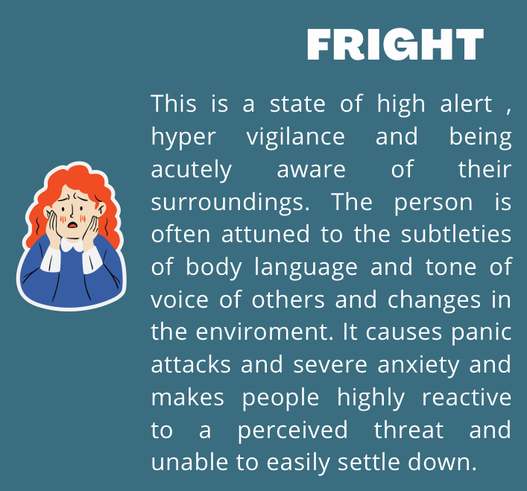
The Trauma Responses

Slide 26
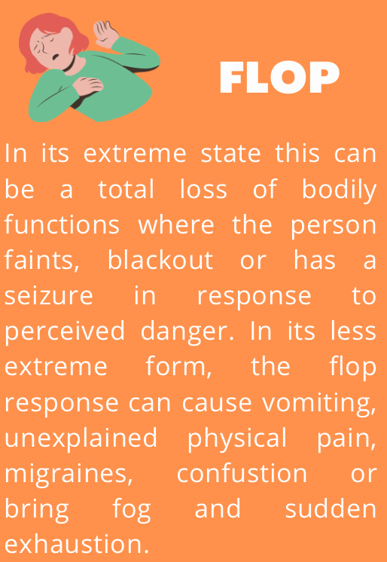
The Trauma Responses

Slide 27
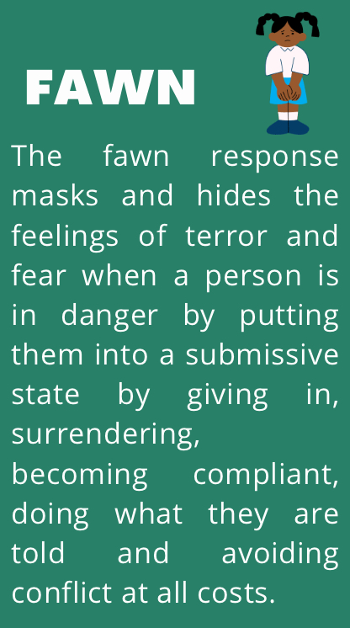
The Trauma Responses

Slide 28

Models and Frameworks

Slide 29
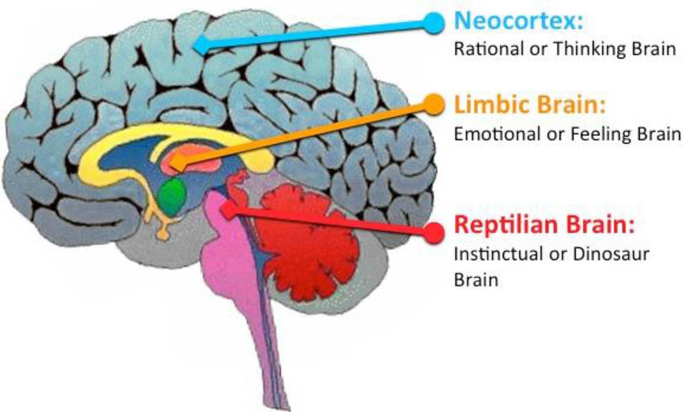
The Triune Brain

Slide 30
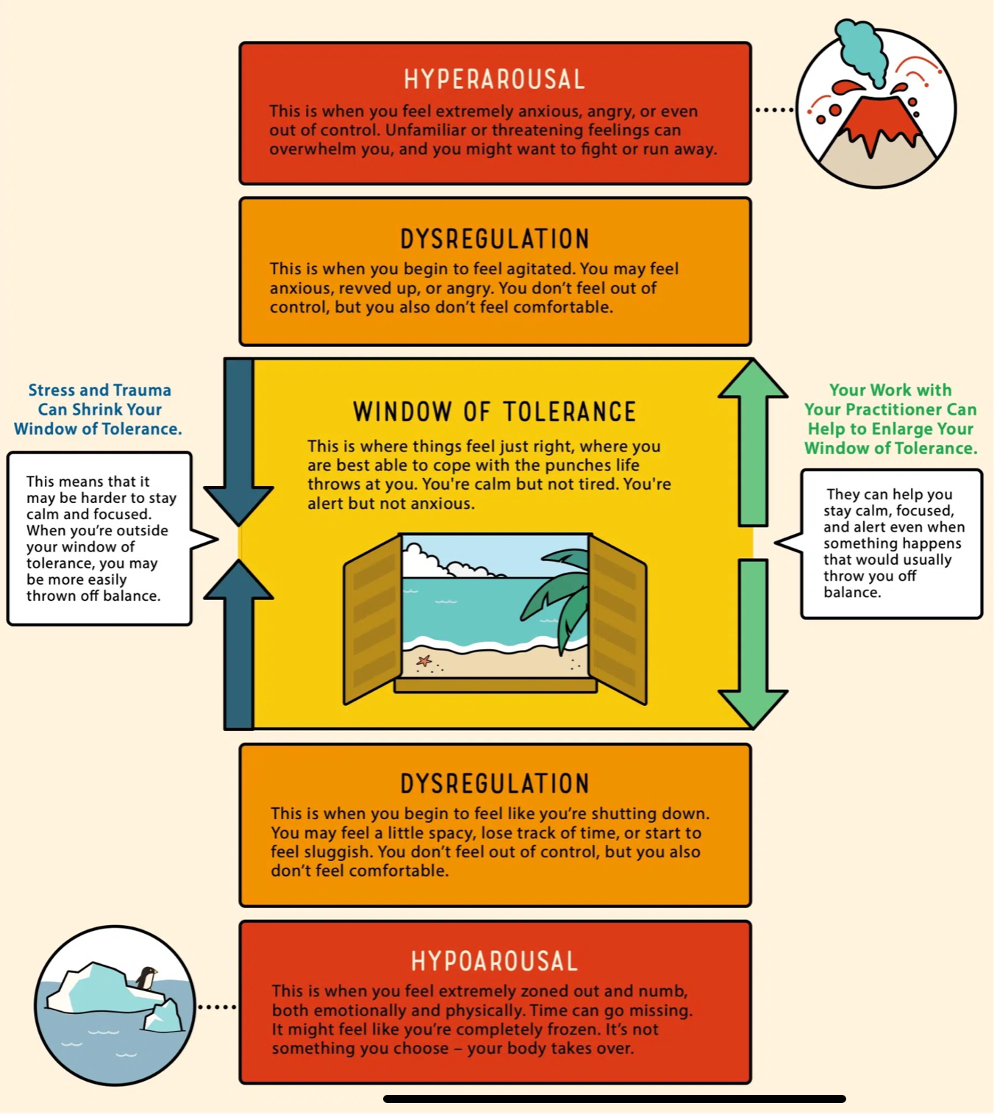
The Window of Tolerance

Slide 31
The Window of Tolerance

Slide 32
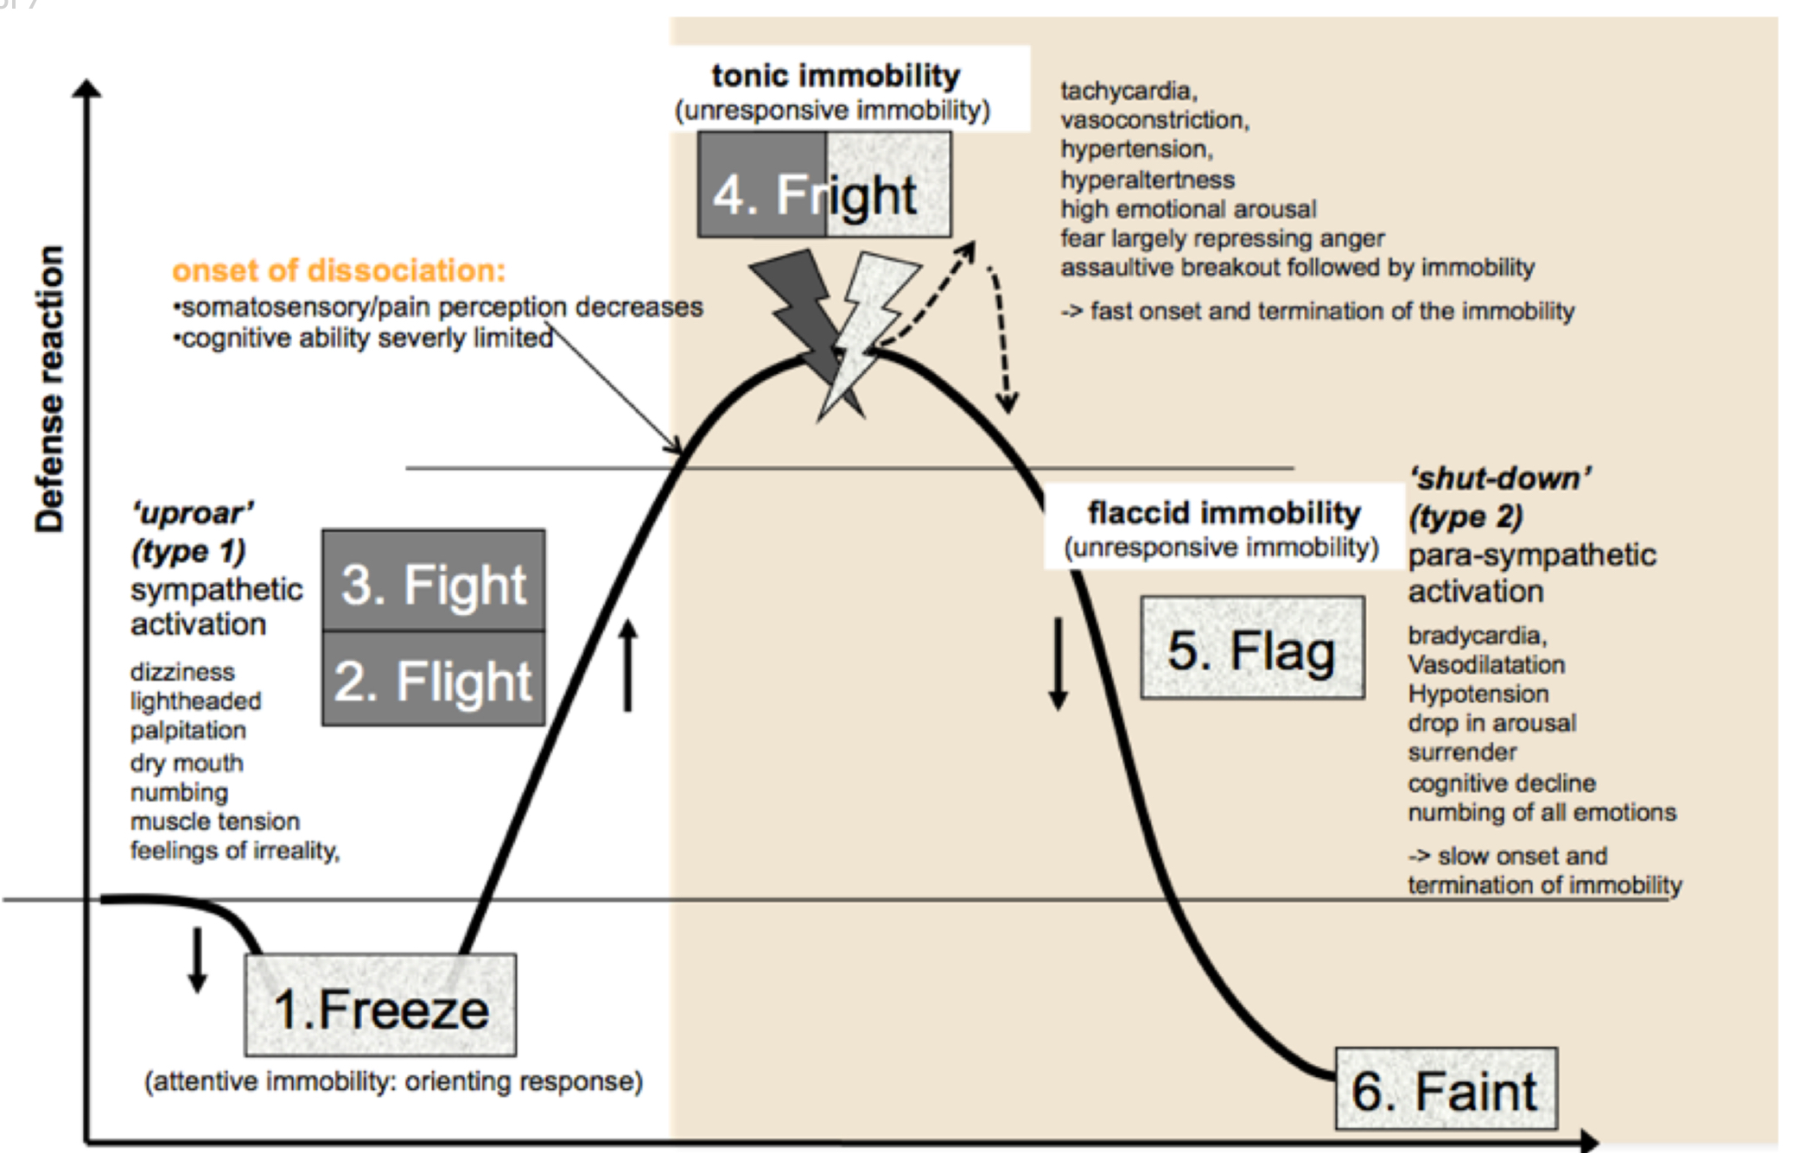
The Defence Cascade Model

Slide 33

The Active Predictive Processing Model

Slide 34

Dissociation

Slide 35


Slide 36
Thank You!
Joanna Naomi Douglas
Joanna.Douglas@traumainformedtheolog.co.uk
www.traumainformedtgeology.co.uk

