Slide 1

The Theology of Trauma
Joanna Naomi Douglas

Slide 2

Disclaimer and What to Expect
What is Trauma Theology?
The Imago Dei and the Shattered Self
Sin, Shame and Theological Estrangement
The Traumatised God
The Reconstruction of Identity
Developing a trauma informed church

Slide 3
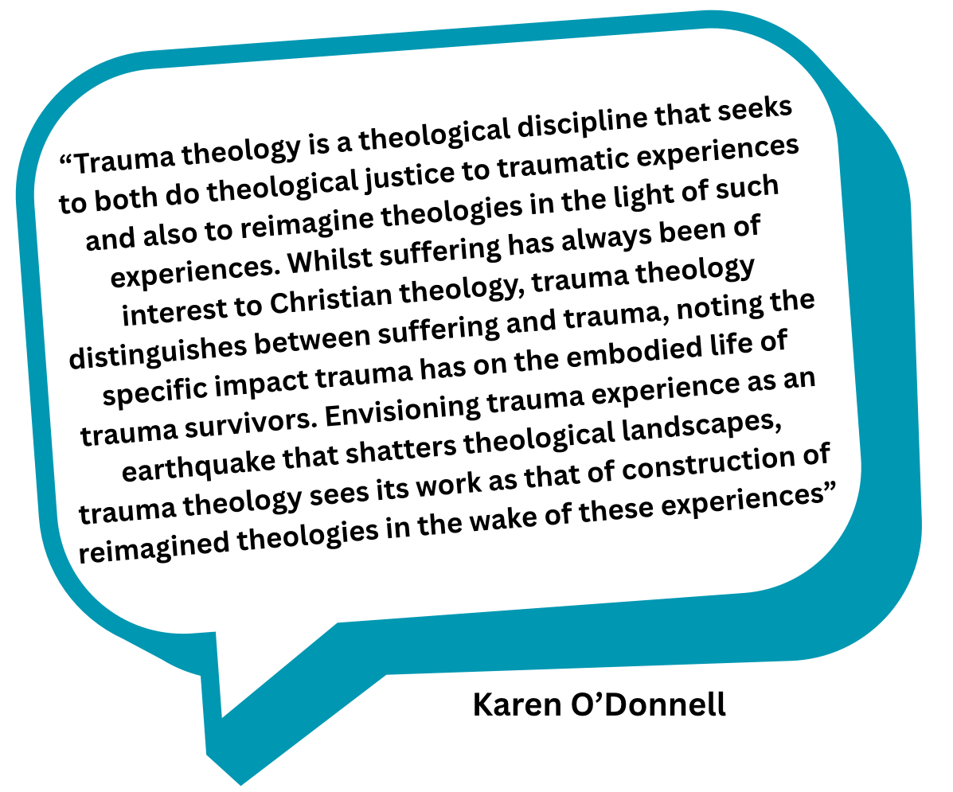
What is Trauma Theology

Slide 4
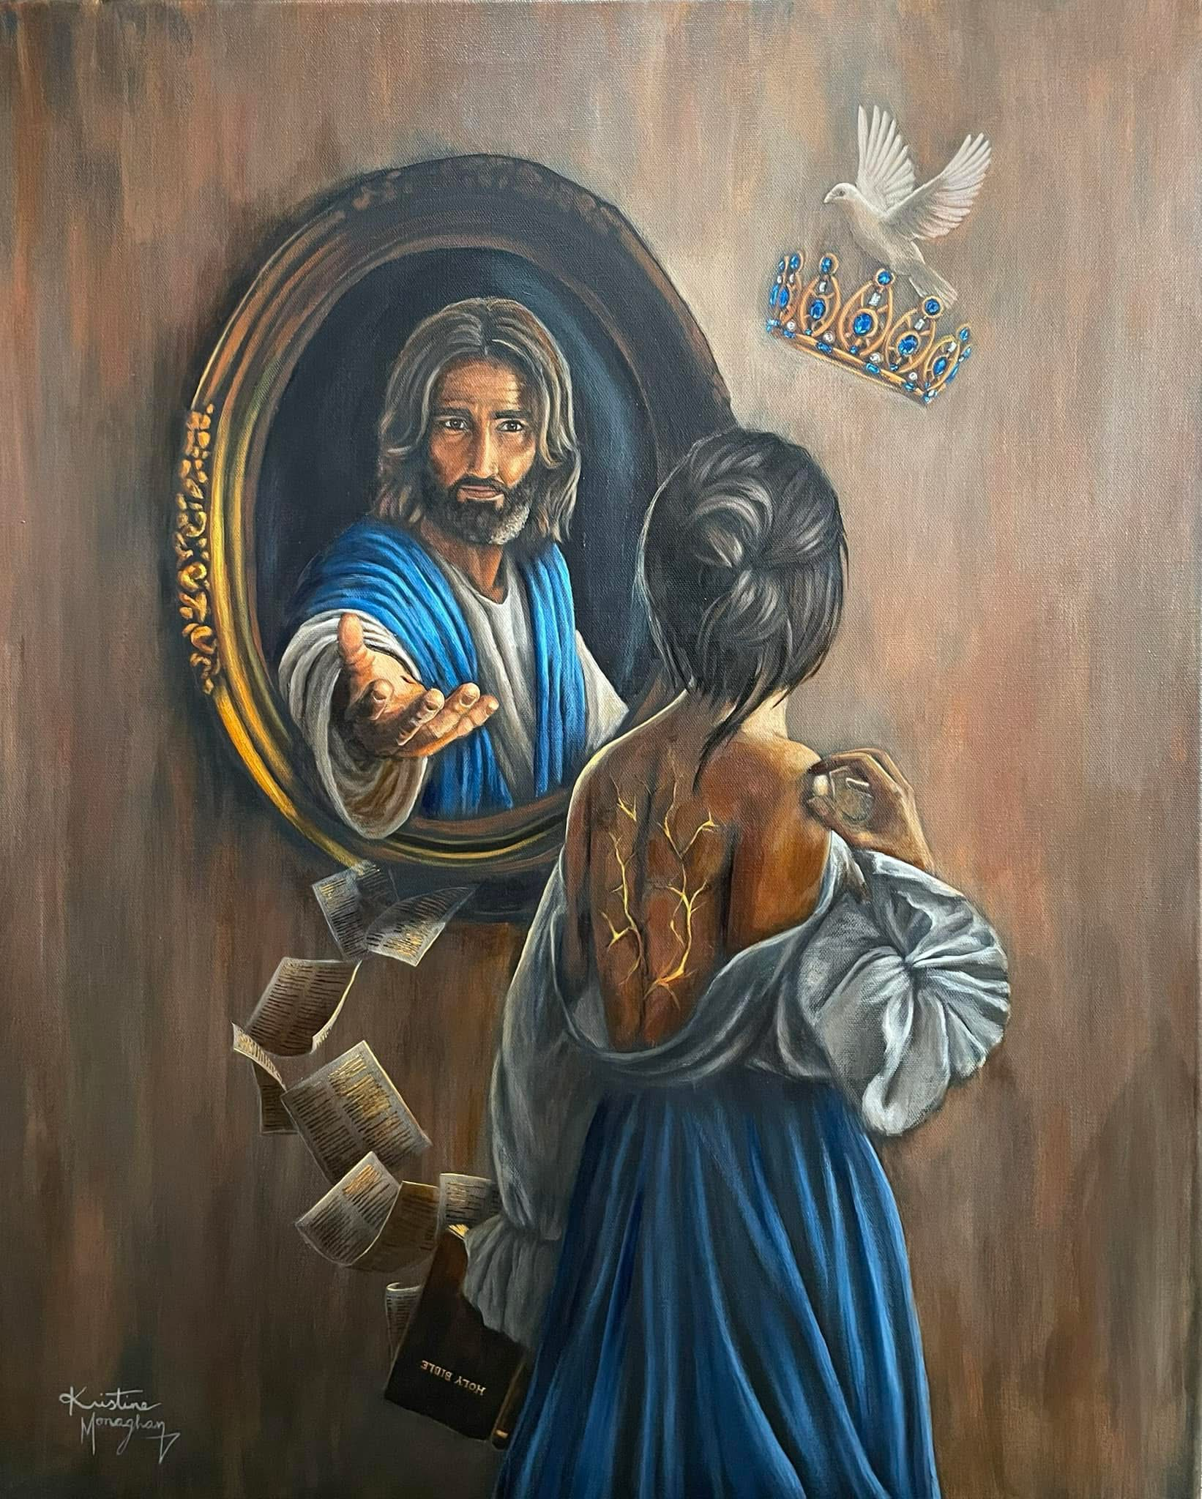
The Imago Dei and the Shattered Self

Slide 5

Sin, Shame and Theological Estrangement

Slide 6


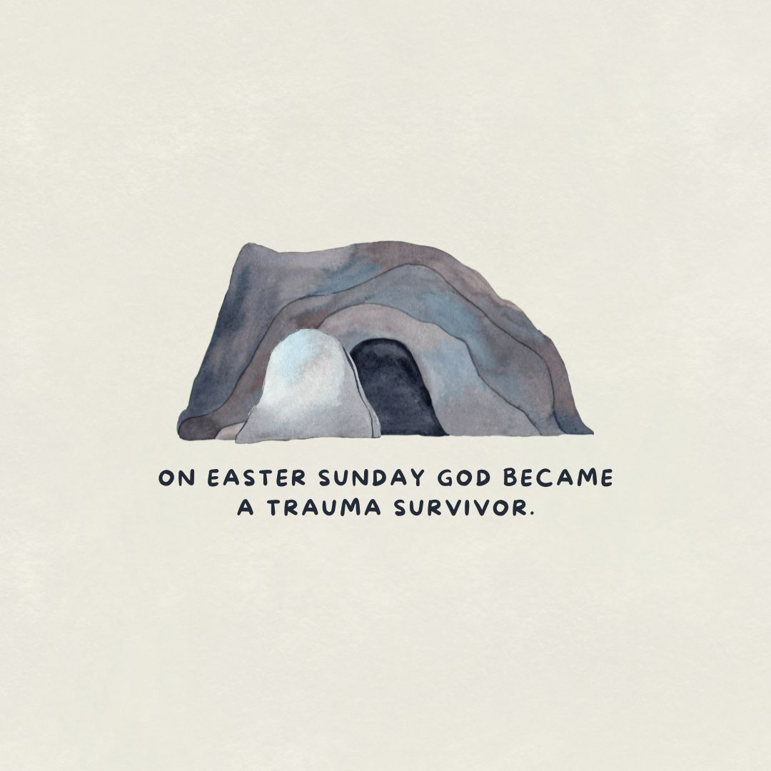
The Traumatised God

Slide 7

The Reconstruction of Identity

Slide 8
Developing a Trauma-Informed Church
Joanna Naomi Douglas

Slide 9
Disclaimer and What to Expect
Why is being trauma-informed important?
What is trauma-informed Care?
The five principles of trauma-informed care.
The Four R’s of Trauma-Informed Care.
What would it mean if our churches were trauma-informed?
Discussion
Building Trauma-Informed Churches- Practical Ideas

Slide 10
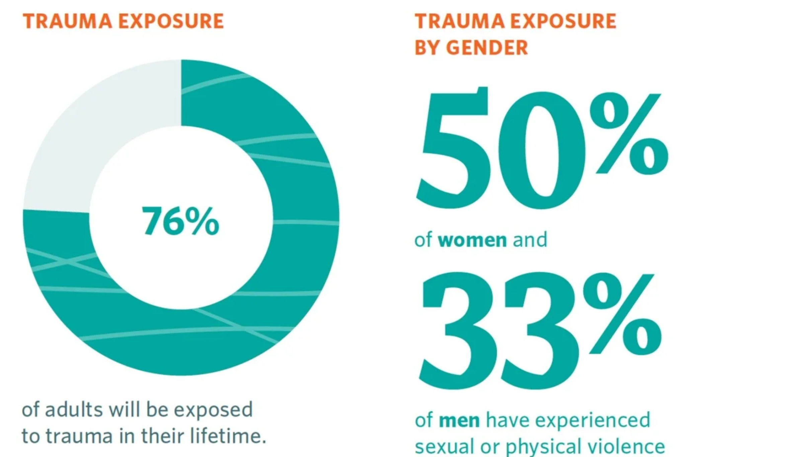
Why is being Trauma Informed important?
PTSD UK - 2025

Slide 11
Why is being Trauma Informed important?
PTSD UK - 2025

Slide 12
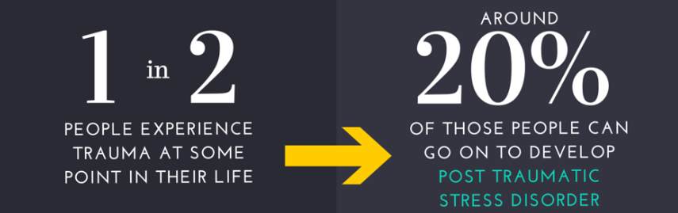
Why is being Trauma Informed important?
PTSD UK - 2025

Slide 13
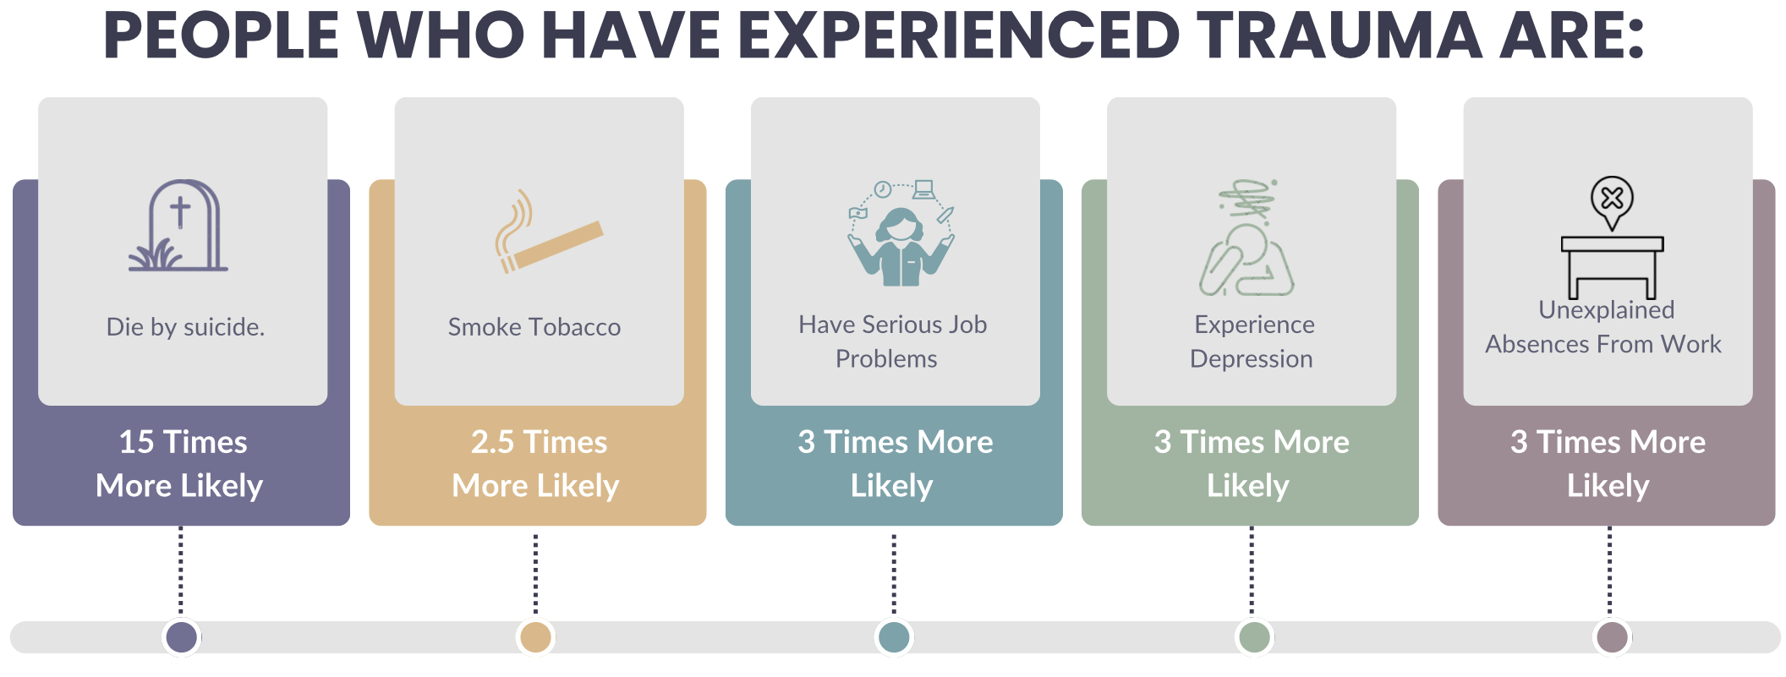
Why is being Trauma Informed important?

Slide 14
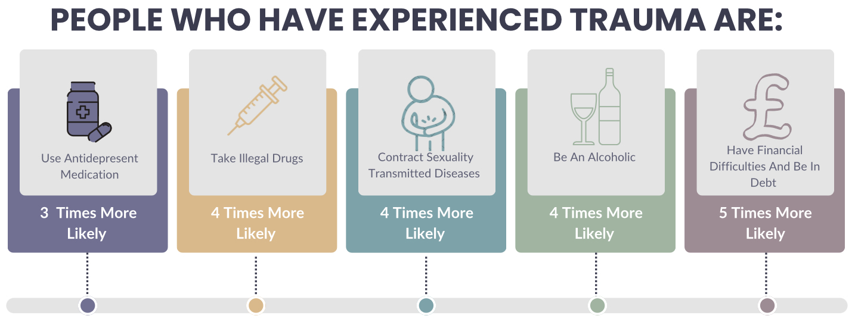
Why is being Trauma Informed important?

Slide 15
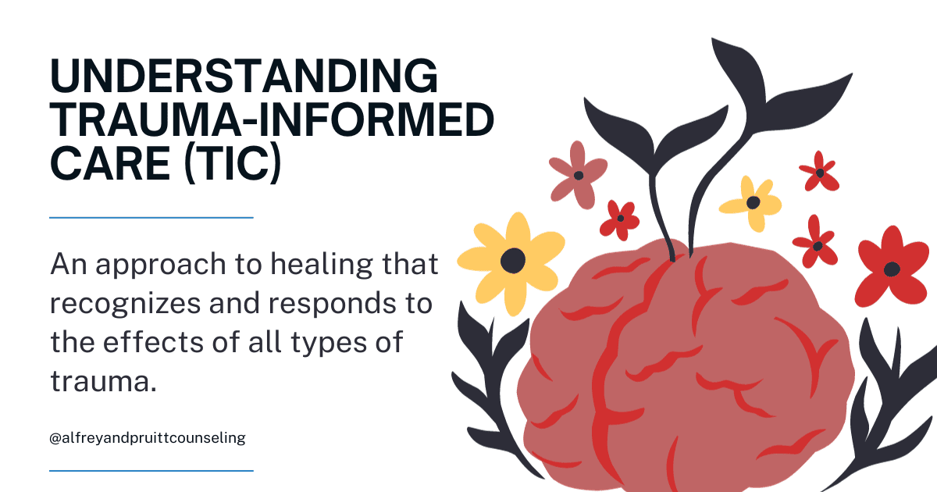

What is trauma-informed Care?

Slide 16

The Five Principles of Trauma-Informed Care

Slide 17

The Five Principles of Trauma-Informed Care

Slide 18

The Five Principles of Trauma-Informed Care

Slide 19

The Five Principles of Trauma-Informed Care

Slide 20

The Five Principles of Trauma-Informed Care

Slide 21
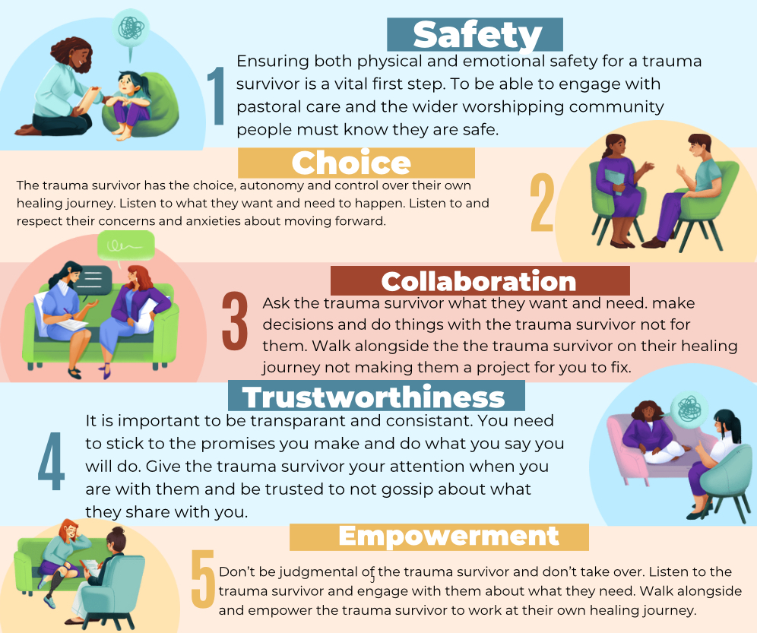
The Five Principles of Trauma-Informed Care

Slide 22

The Four R’s of Trauma-Informed Care

Slide 23
The Four R’s of Trauma-Informed Care

Slide 24
The Four R’s of Trauma-Informed Care

Slide 25
The Four R’s of Trauma-Informed Care

Slide 26

What Would it Mean if our Churches Were Trauma-Informed?

Slide 27
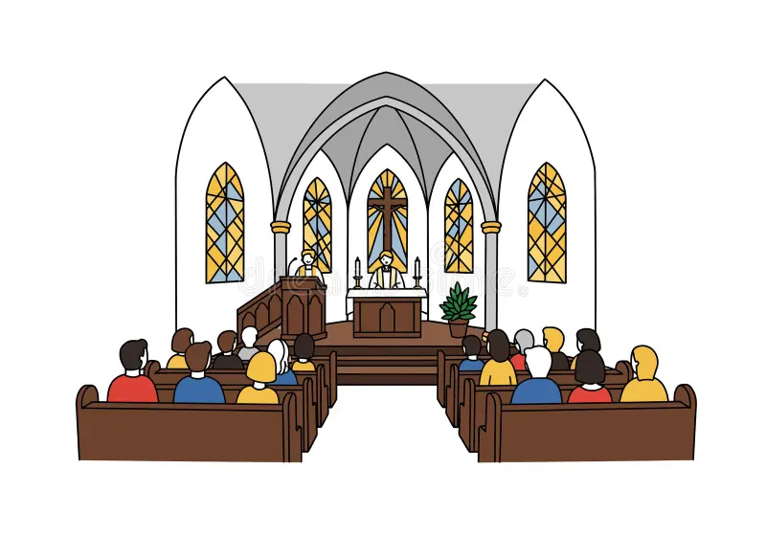
Building Trauma-Informed Churches
- Practical Ideas

Slide 28

Thank You!
Joanna Naomi Douglas
Joanna.Douglas@traumainformedtheolog.co.uk
www.traumainformedtgeology.co.uk

