Slide 1
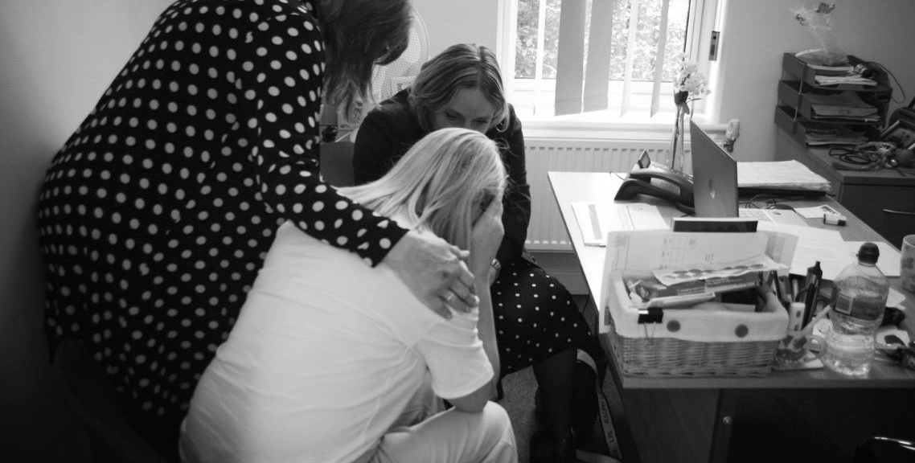


Partner with Us
Transform Lives

Slide 2


Our journey began
35 years ago with
our inspiring founder,
Kathy Coe M.B.E., herself a survivor of domestic abuse.
We believe in a world
free from fear and abuse
From a humble 24-hour helpline in a bedroom, we have evolved into a robust organisation with a comprehensive range of services, including two women's refuges.
We serve Lichfield and Tamworth and many other areas too.

Slide 3

Our services
Safe Accommodation : Refuges - 14 + 8 Rooms
Emotional and Practical Support
Helpline: Confidential support and advice, 24/7.
Counselling Services: Professional therapy for victims and survivors.
Support Groups: Peer-led groups
Children and Young People’s Support
Survivors’ Forum
Court Support: Guidance through legal processes - Legal Clinics
Community Engagement: Education and awareness programs to prevent abuse.
ONLINE REFERRAL FORM

Slide 4
What is Domestic Abuse?
Domestic abuse is when someone in a close relationship,
like a partner or family member, uses control, power,
or fear to harm or dominate the other person.
Types of Abuse:
Physical: Hitting, punching, or hurting someone.
Emotional: Name-calling, gaslighting, or making someone feel worthless.
Sexual: Forcing someone to do things they don’t want to.
Financial: Controlling someone’s money or preventing them from working.
Digital: Using technology to stalk, threaten, or harass someone.
Spiritual : Spiritual abuse occurs when someone uses spiritual or religious beliefs
to manipulate, control, or harm another person, often leading to emotional and psychological trauma.

Slide 5

How It Affects People:
Mental Health: Anxiety, depression, and low self-esteem.
Physical Health: Injuries or long-term medical issues.
Future Relationships: Struggling to trust others.
On Children:
Witnessing abuse can cause trauma, impacting their emotional development, education, and future relationships.
On Communities:
Domestic abuse leads to societal costs, including healthcare, lost productivity, and the criminal justice system.

Slide 6

1 : 4
1 in 4 women in England and Wales will experience domestic abuse in their lifetime.
1 : 6
1 in 6 men in England and Wales will experience domestic abuse in their lifetime.
Refuge.org.uk

Slide 7
1 : 3
1 in 3 Young people in England and Wales have experienced teen dating abuse
These figures come from a survey of 10,000 children aged 13–17 across England
and Wales by Youth Endowment Fund (YEF) in 2024.
31% reported experiencing some form of
physical or sexual violence in that relationship
19% reported being physically assaulted (hit, kicked or shoved) by a partner.

Slide 8
Less than 40%
say they’ve received lessons on how to be in healthy and respectful romantic relationships.
Younger teens (aged 13-15) in relationships are significantly more likely to report violent or controlling experiences in their relationships (58%)
than those aged 16-17 (42% of those in relationships).
Schools teach lessons on healthy relationships, but many topics are not fully covered and may not be reaching those who most need it.

Slide 9
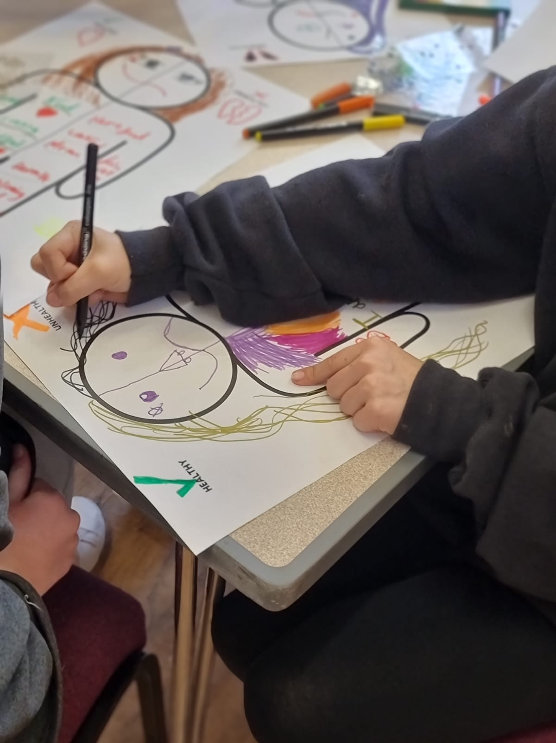
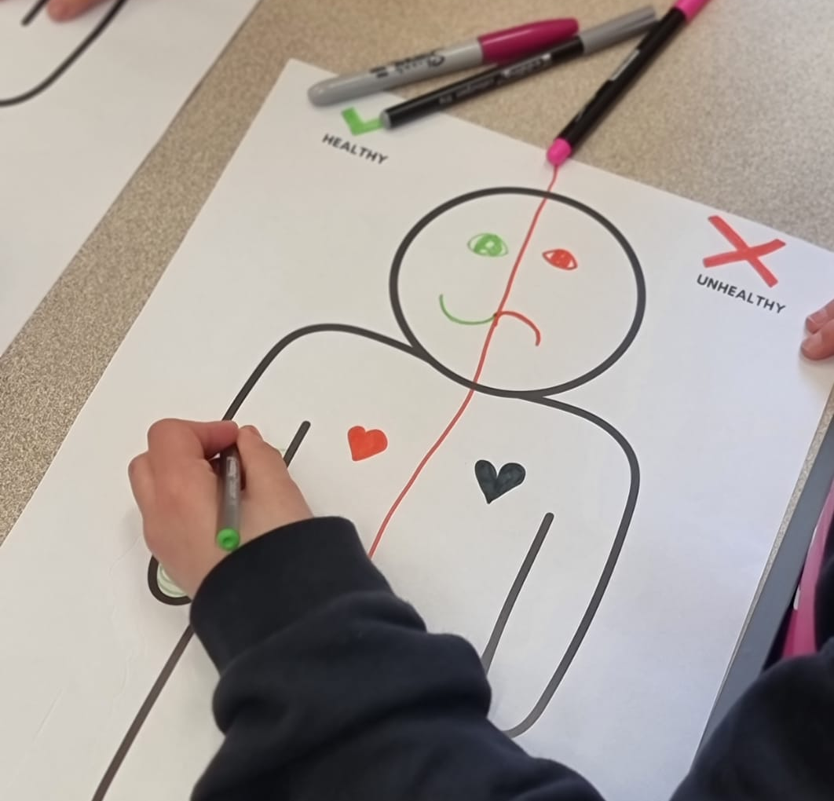
GLOW UP STRONG

Slide 10
We’re seeing far too many young people enter
harmful relationships without the tools to spot red flags.
Glow Up Strong is about early intervention.
It’s about planting seeds of awareness before harm takes root.
Why It Matters : Too often, young people don’t realise they’re in abusive relationships until it’s too late. The lack of early education means they miss subtle but dangerous warning signs from coercive
control to emotional manipulation.
Glow Up Strong want to give young people the language and power to say, ‘this isn’t right’ and the confidence to seek help

Slide 11




How You Can
Get Involved
At Pathway Project,
we believe in the power of community to break the cycle of domestic abuse.
By partnering with us, you’ll be part of a movement that is changing lives every day. Here’s why you should choose to support our mission:
Proven Impact
Holistic Support
Community-Centered
Opening doors
Charity of Choice
Join as Patron or Partner
Sponsorship of Events
Host a Sponsored Event
Employee Engagement Programs
Deliver Training
Provide a Service
Matched Giving Campaign
Skill-Based Volunteering

Slide 12
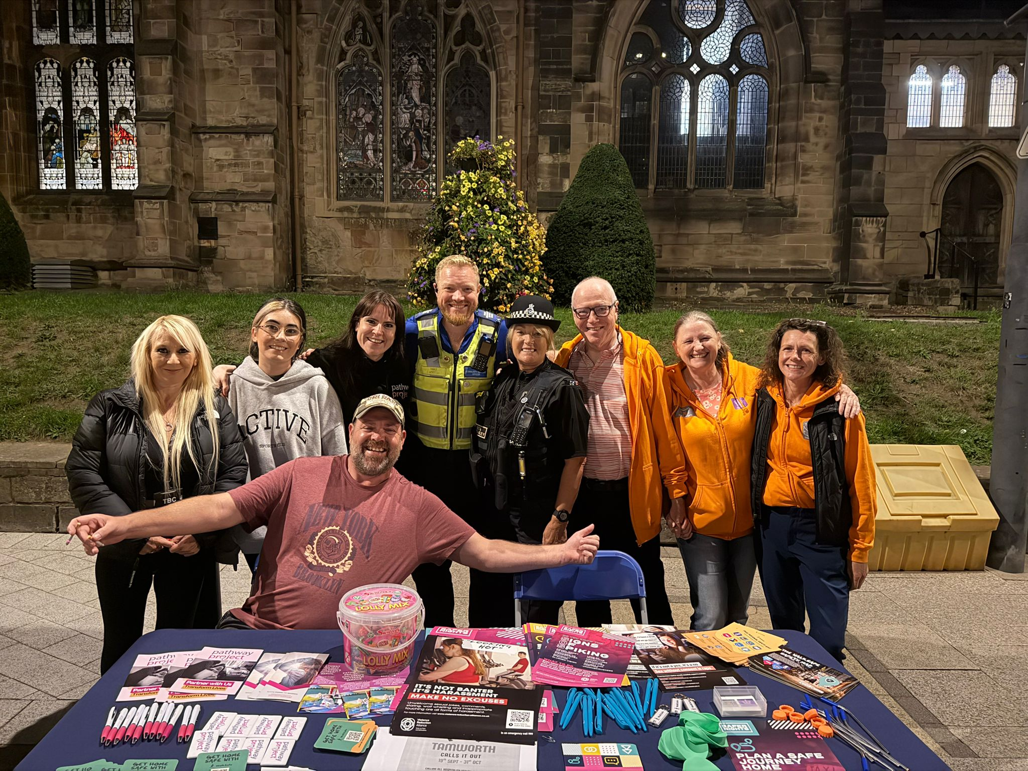
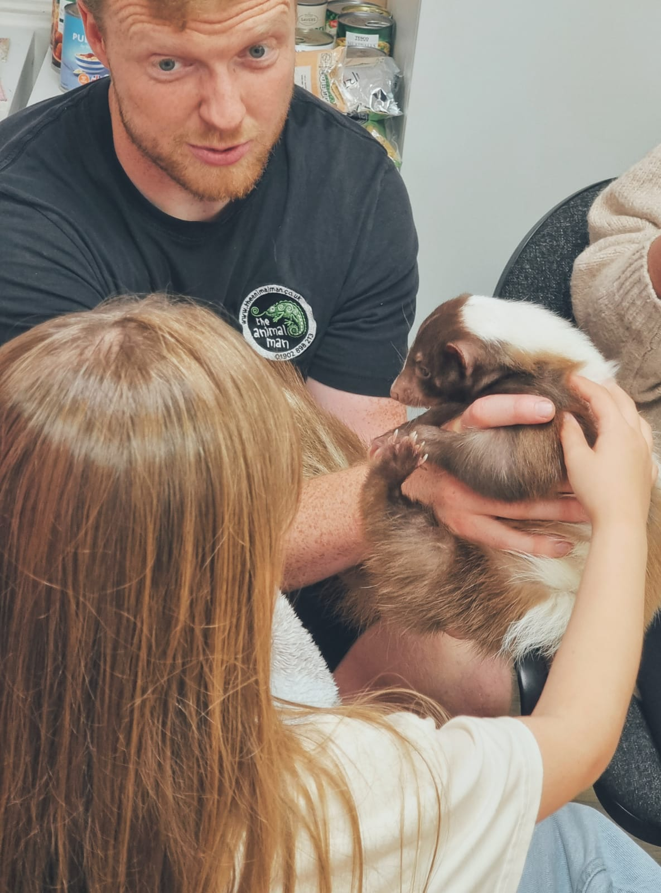
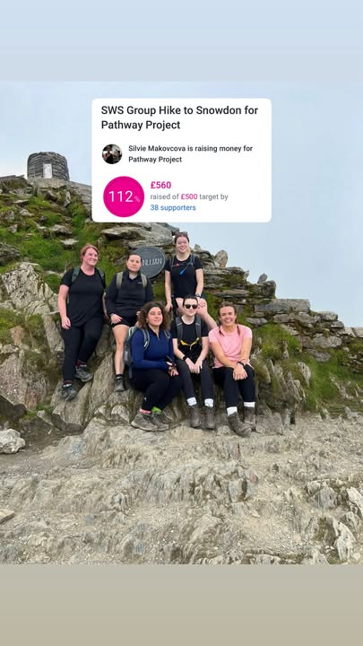
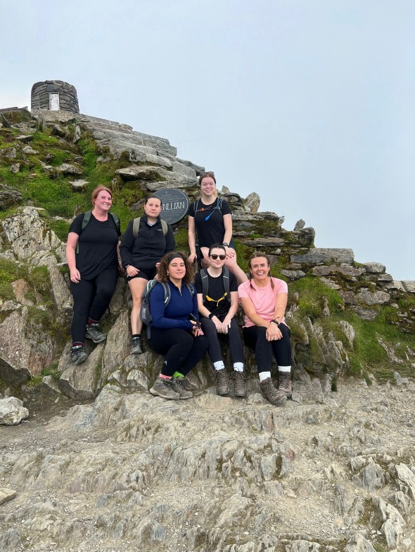
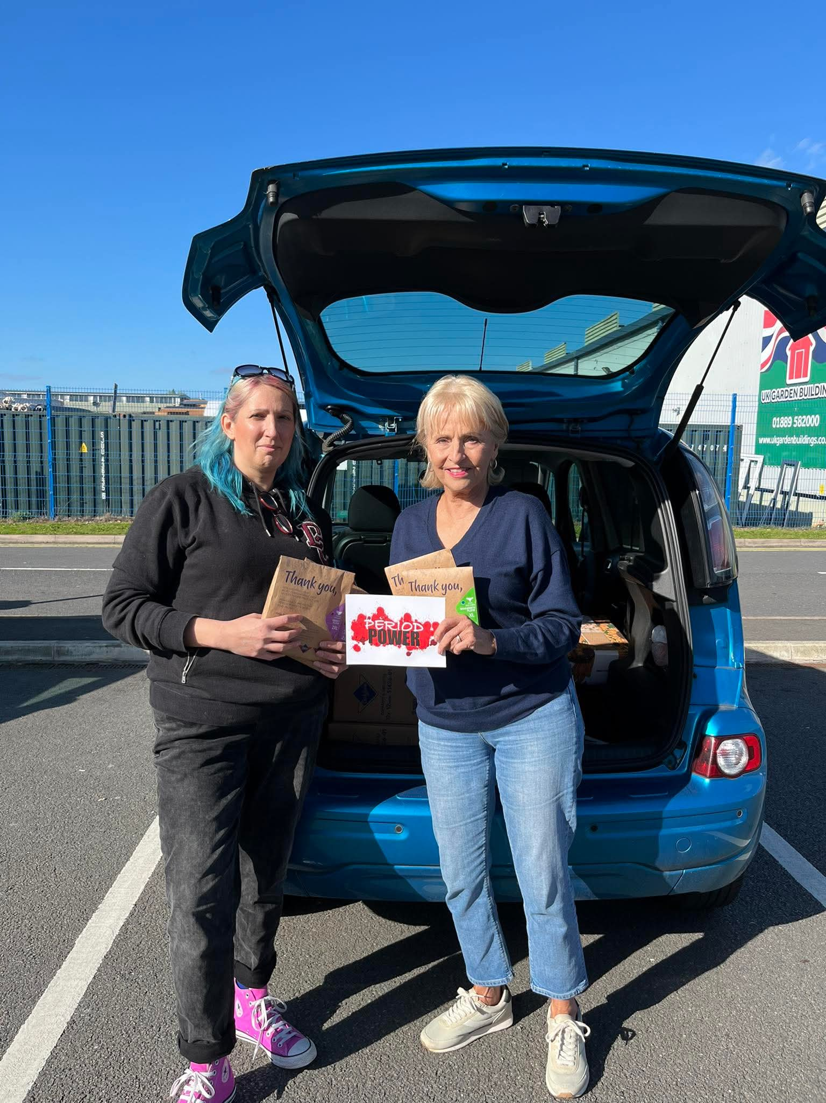
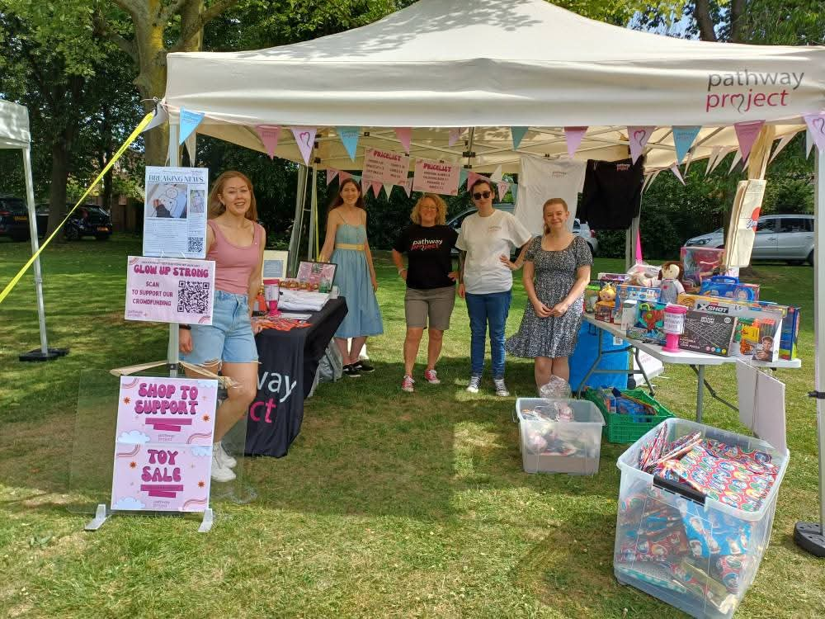

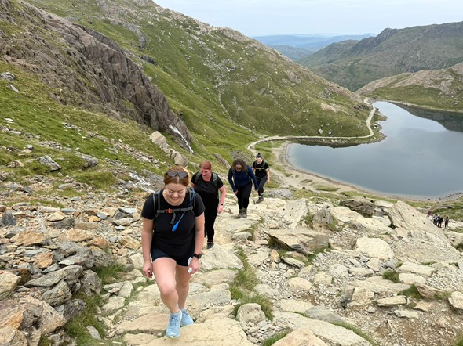

Slide 13
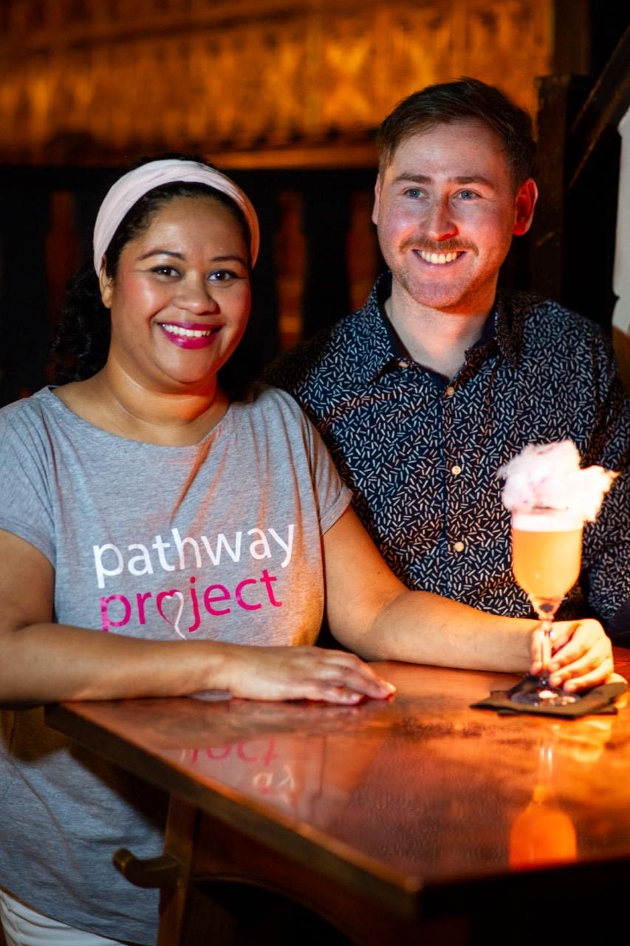
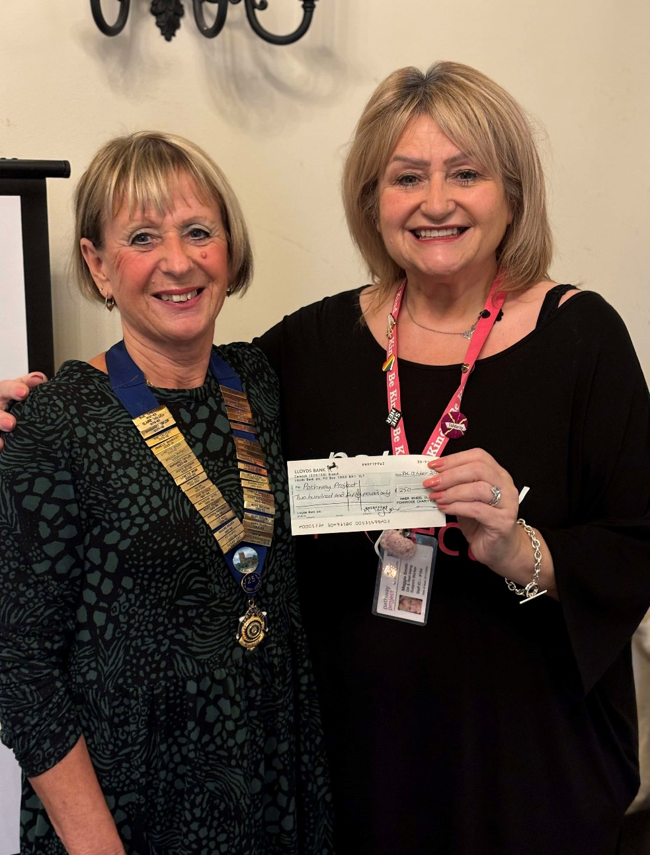
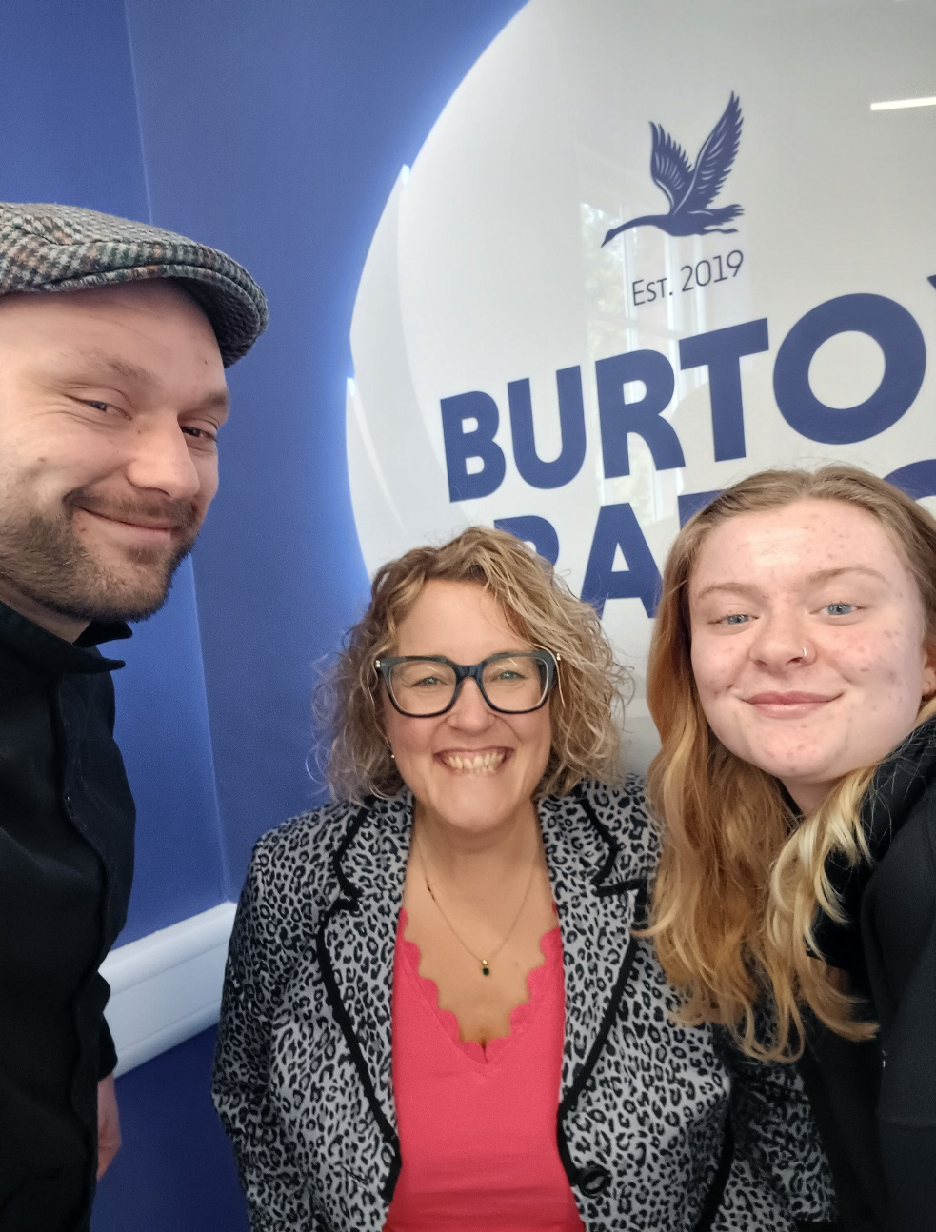
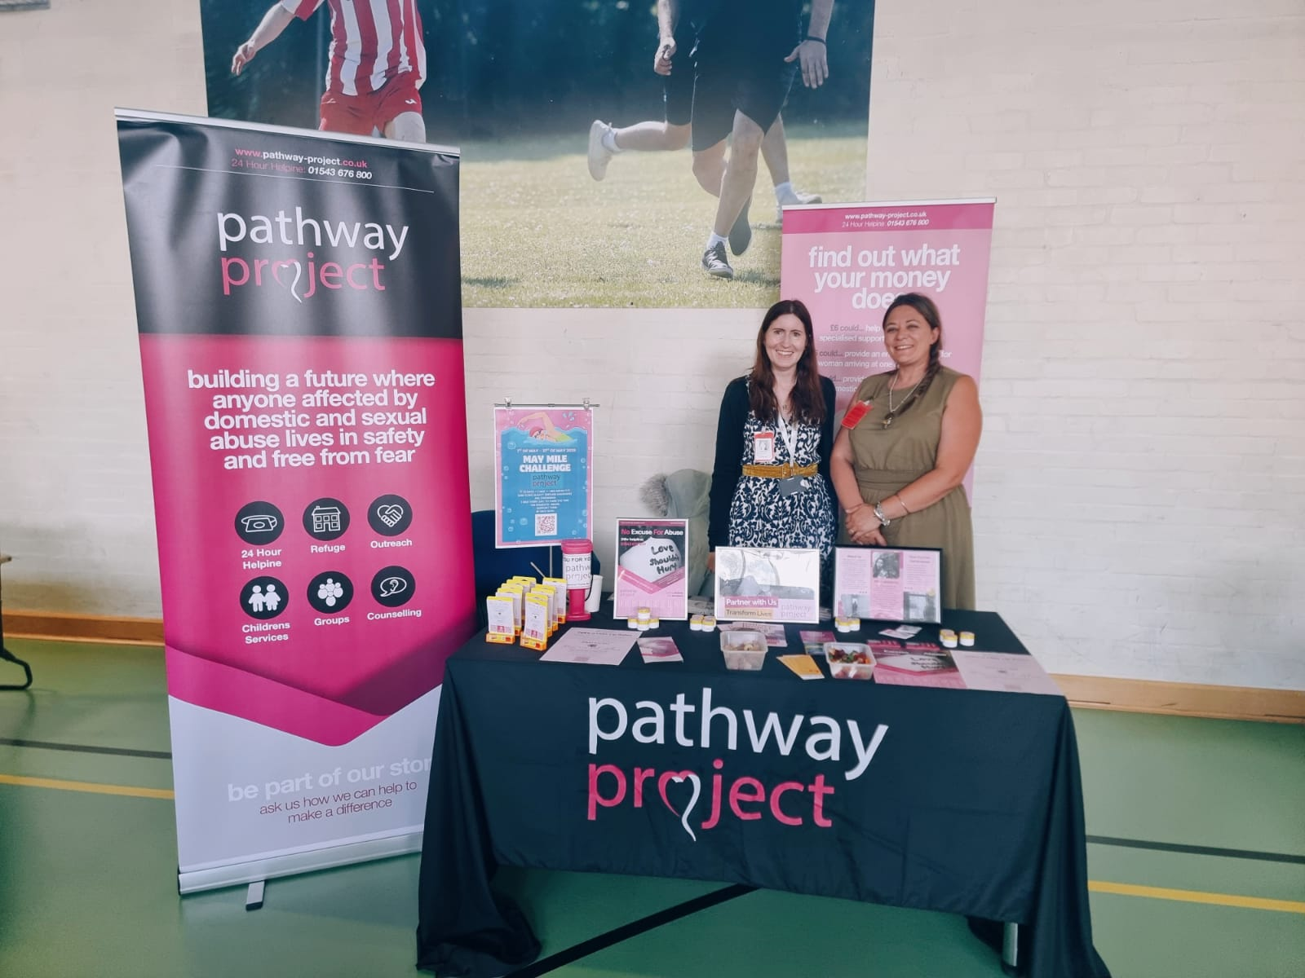
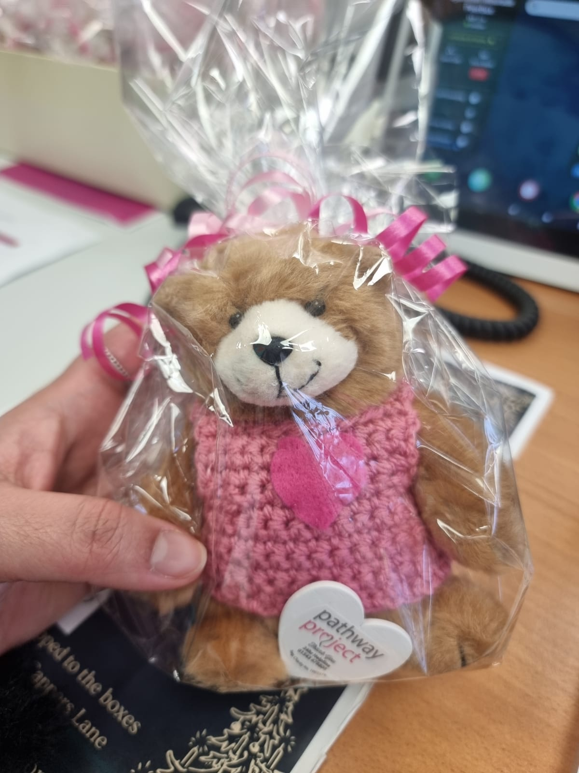

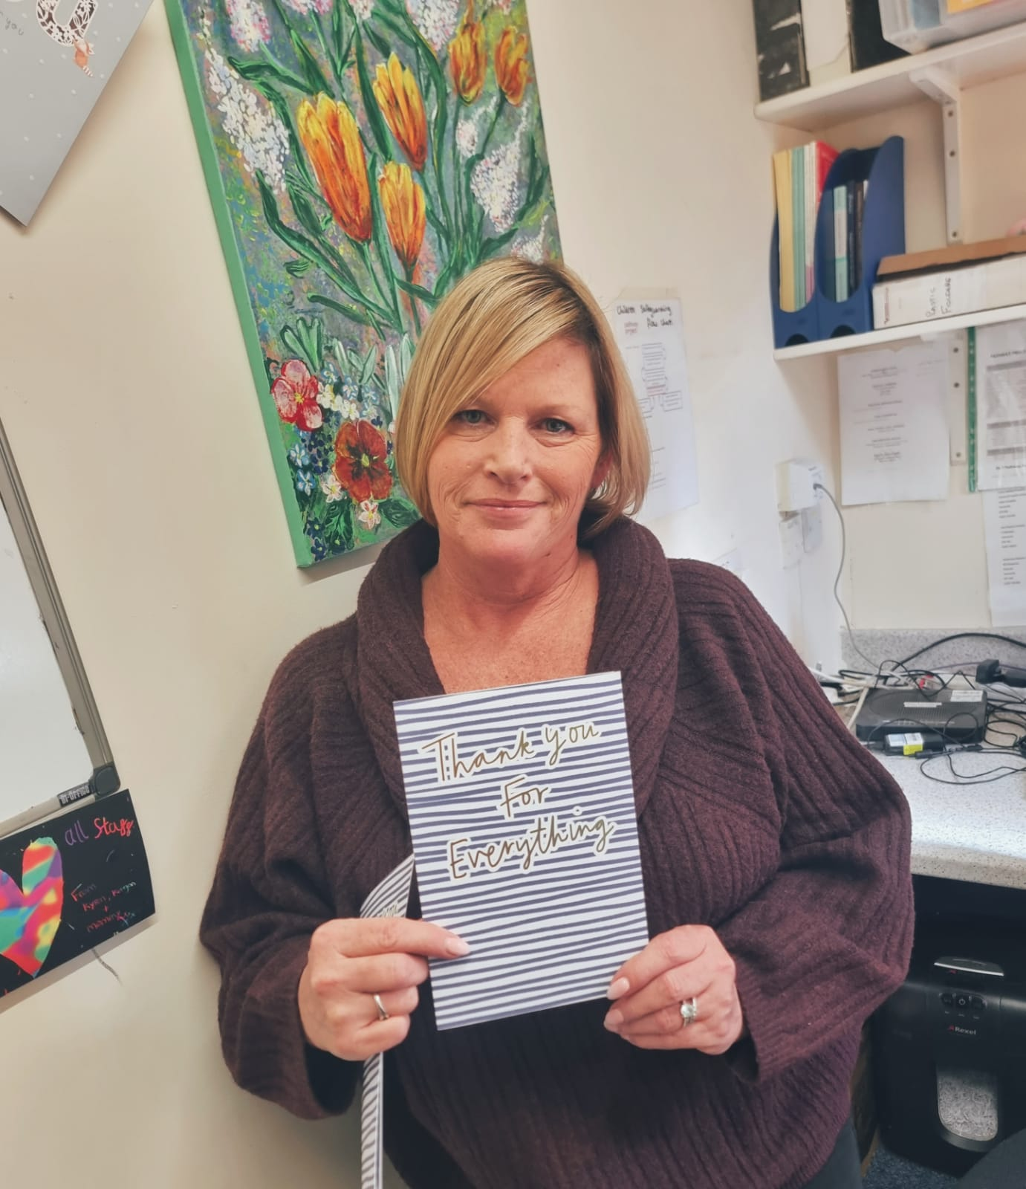

Slide 14
Helpline - Number
01543676800
Office Phone
We'd love to hear from you!
07511499532
Email Address
djemillahmp@pathway-project.co.uk
Website
Reach out to our team to get for any
inquiries or clarifications.
www.pathway-project.co.uk

