Slide 1

Welcome & Introductions
Agenda
Introductions
Referral Process
Safeguarding Dashboards – Graeme Pringle
Pathway Project – Debbie Kerwin
Future Input Suggestions
Q& A
Name slideshow here
Notes:
1

Slide 2


Responding Well to a Safeguarding Concern
Safeguarding Concern Identified
You witness, suspect or someone makes a disclosure

Slide 3


Action
Is there immediate Risk ?
If Yes
Contact Emergency Services – 999
Record all relevant information
PSO reports to the Diocese Safeguarding Team
Email Safeguarding@lichfield.Anglican.org

Slide 4
If No !
Report Incident to Incumbent (unless they are implicated)
Record all relevant information and retain in secure location
Email Diocese Safeguarding Team (including all relevant information) Safeguarding@lichfield.anglican.org
Email monitored daily – response within 24 hours.
Safeguarding Team will offer ongoing advice/support

Slide 5
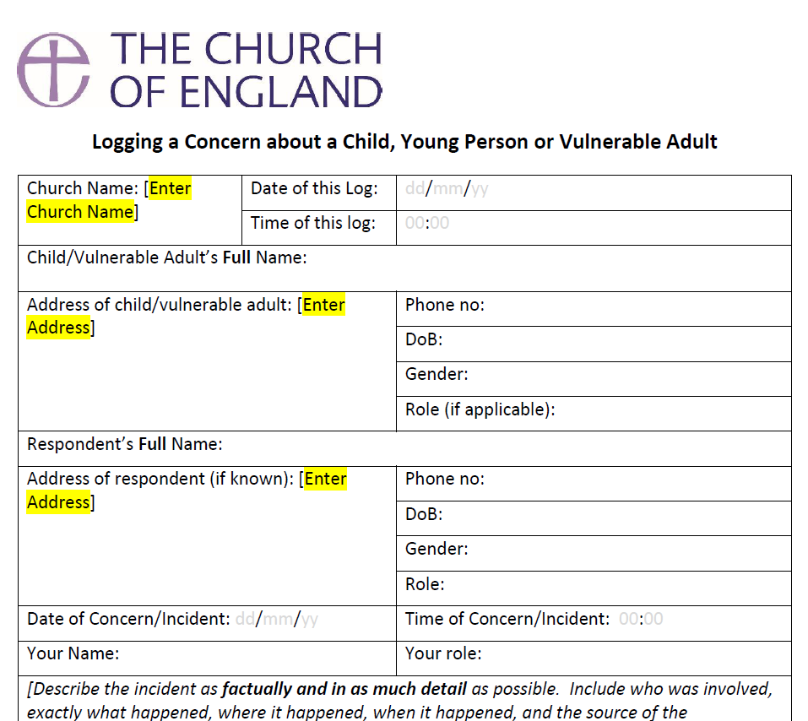
4 W’s of Disclosure
What
Where
When
How
https://www.churchofengland.org/sites/default/files/2026-01/log-of-concern-template.docx
PSO Safeguarding Webinar Feb 2026
Notes:
5

Slide 6
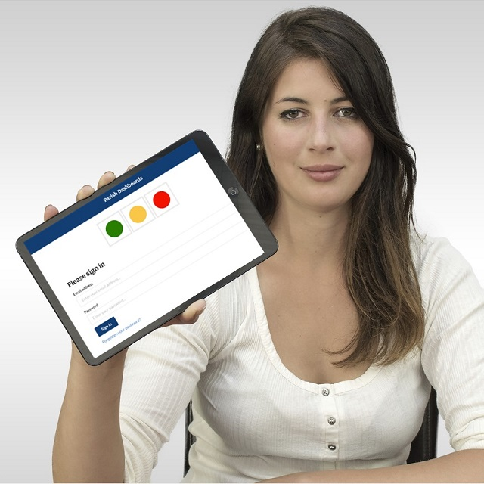
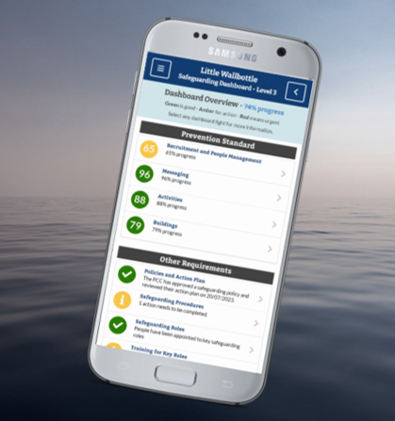
Safeguarding Dashboard

Slide 7

Pathway Project

Slide 8


Suggestions
Future Dates:
Summer 2026 – In Person
November 10th 2026
Feedback Form

Slide 9

Questions ?

Slide 10

Thank you

Slide 13
Template 3
Navy background with orange footer
Logo at bottom corner of slide

